Slide 1

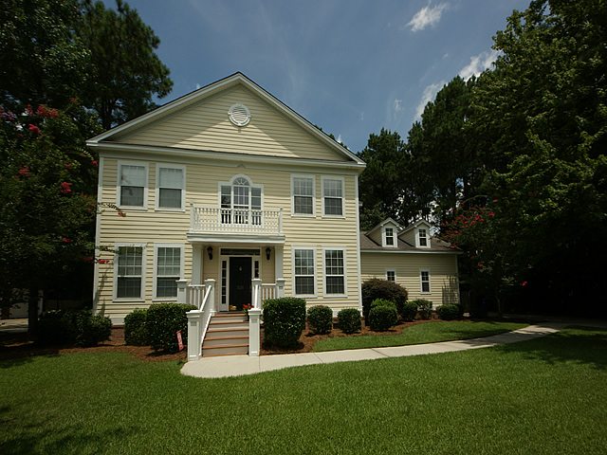
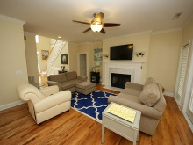
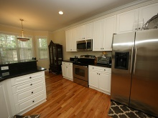
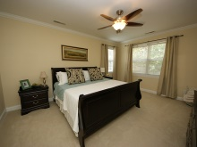
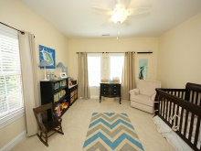
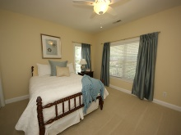
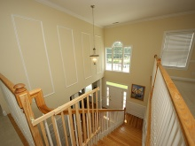
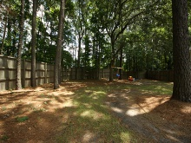
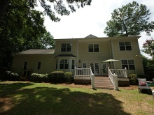

Just listed in Desirable Hobcaw Creek Plantation
536 Chimney Bluff
Mt Pleasant - MLS# 1419122 - $560,000
This is a stunning home that was completely renovated in 2011. Beautiful hardwood floors in the entrance, dining room, family room, and kitchen. The master suite is on the first floor with large dual-closets, and a master bath with a Jacuzzi tub, separate shower and double sinks. Upstairs, there are four bedrooms, two of which share a Jack and Jill bath. Finished room over the garage has a separate stair access through the kitchen area, and can be used as play room or office. The open kitchen features granite countertops, double door refrigerator, built-in microwave, and smooth top stove. Hobcaw Creek Plantation offers fantastic amenities, which include a community pool, club house, play ground and access for two community docks, one crabbing dock, and one boat dock.
Andrew Tackitt
843-437-8726 cell
andrew@radekopf.com
1205 Two Island Court, Suite 201 | Mount Pleasant, SC 29466
Phone: (843) 579.2217 | Fax: (843) 971-0281

