Slide 1
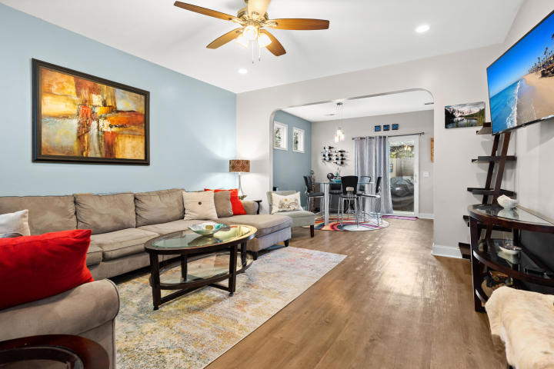
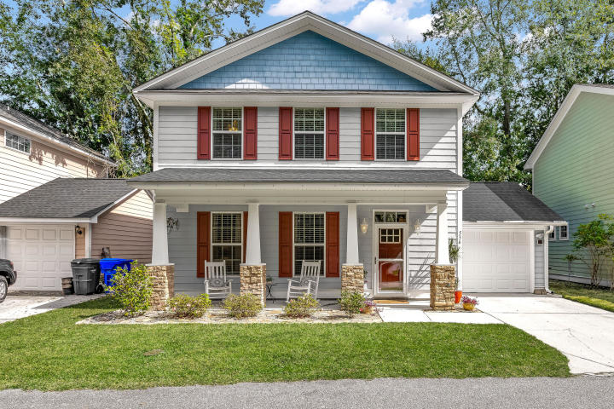
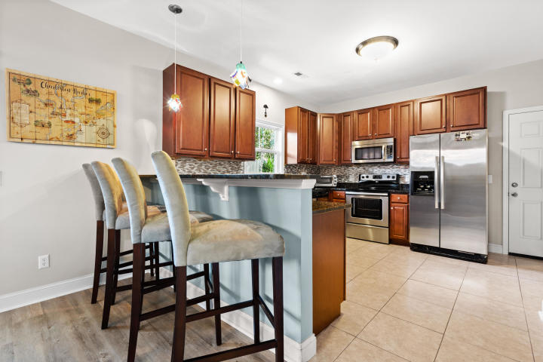
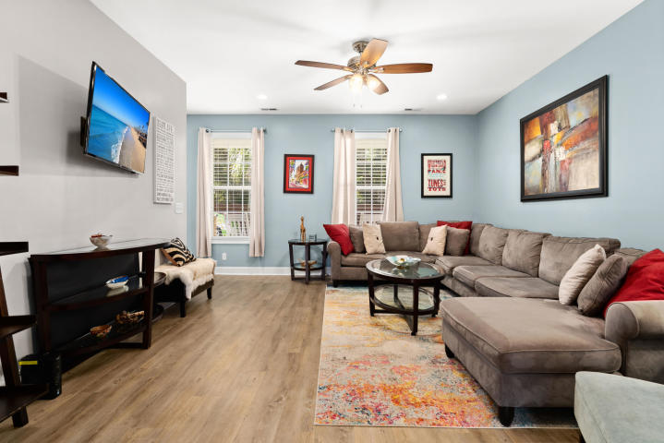
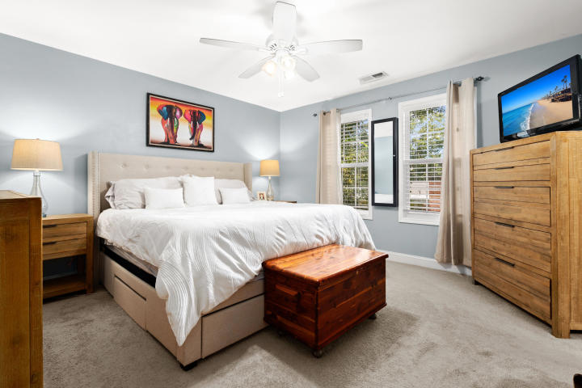
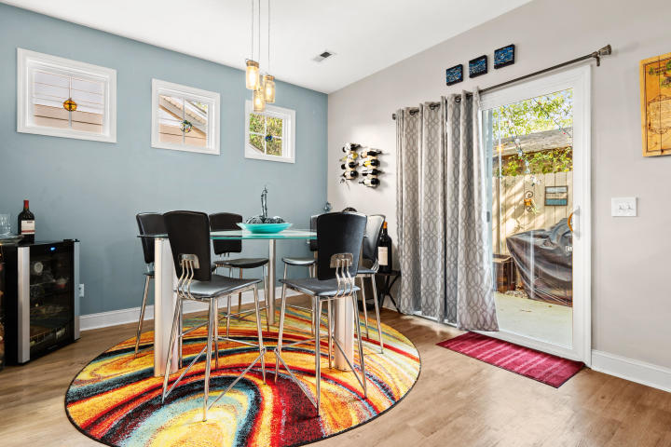
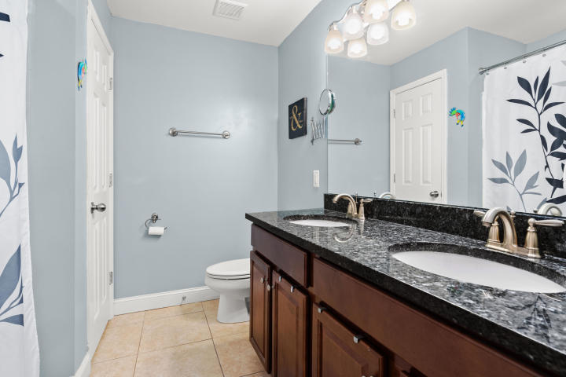
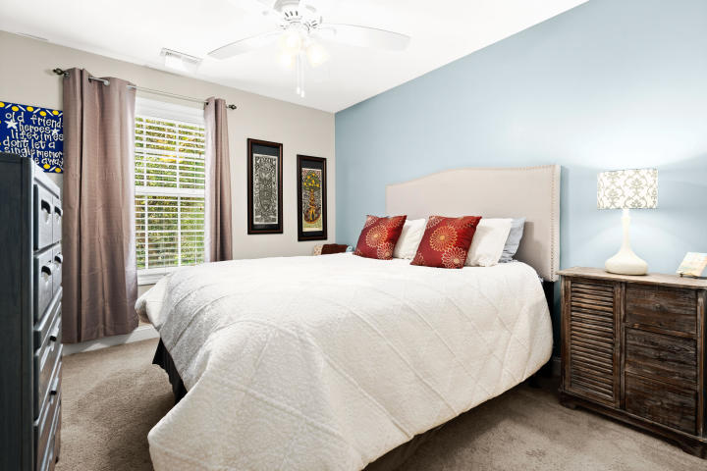
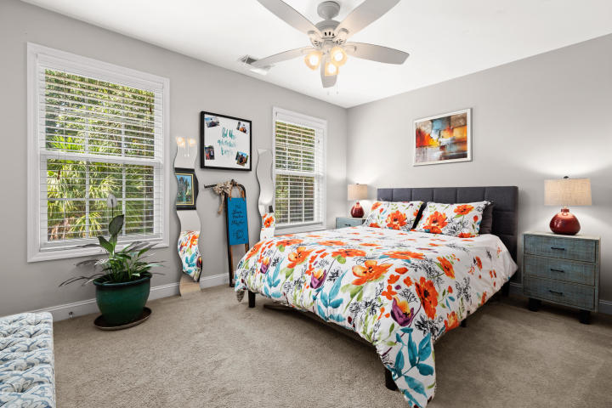
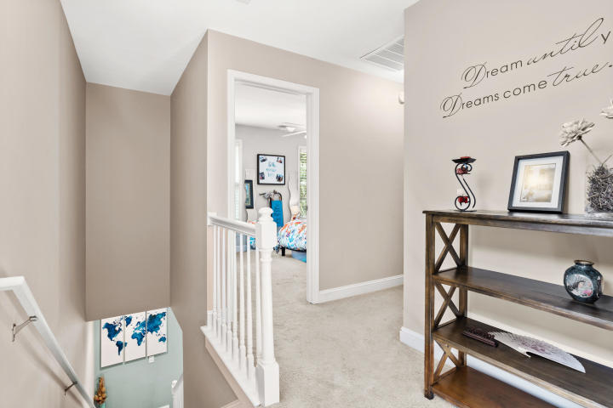
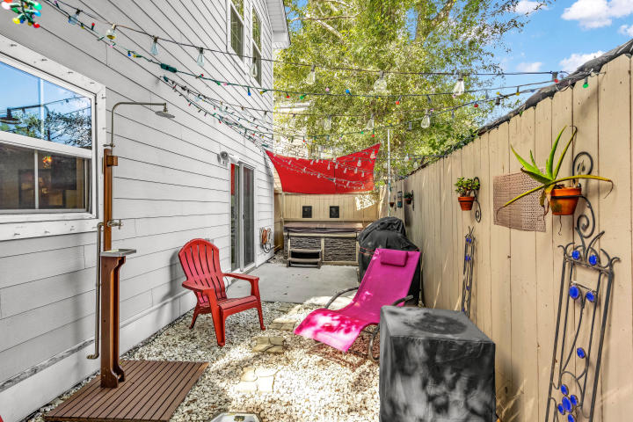


"WALK EASY" INTO YOUR GREAT NEW HOME!
536 Walk Easy Lane
Pebble Estates · Charleston · MLS# 20028692 · $325,000
Charming newer home in an enclave of just 8 houses located close in West Ashley!! Location is hard to beat with this two story home boasting cement plank siding and a garage! Top of the line Karndean luxury vinyl plank flooring throughout the downstairs and a kitchen you will love to cook in. Tons of counter space, 42" cabinets, granite countertops and a separate pantry. Relax on your full front porch and chat with your neighbors or hang out out back while grilling out with friends. All the bedrooms are upstairs and the large master bedroom is a welcome retreat after a long, hard day. It's easy to see why this move in ready home located in the center of everything is a great choice. Did I mention there is access to the West Ashley Greenway right at the end of the street?!? It's a perfect place to get out and go for walk/run and ride your bike to yoga, Whole Foods or many of the fantastic restaurants nearby. Easy to see, don't miss out!
Keller Williams Realty Charleston West Ashley
1180 Sam Rittenberg Ste 105
Charleston, SC 29407
Amy Zonarich Powers
Realtor
(843) 534-3523
amy@amyzonarich.com
www.liveandlovecharleston.com

