Slide 1
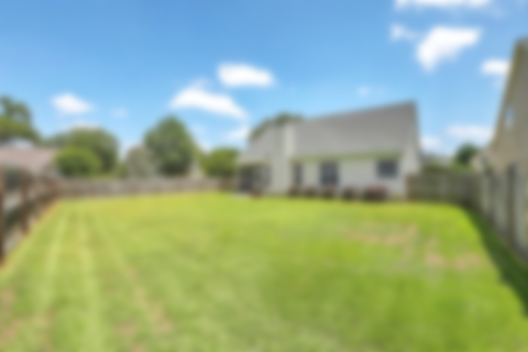
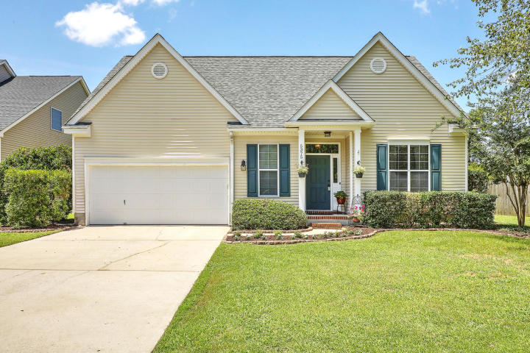
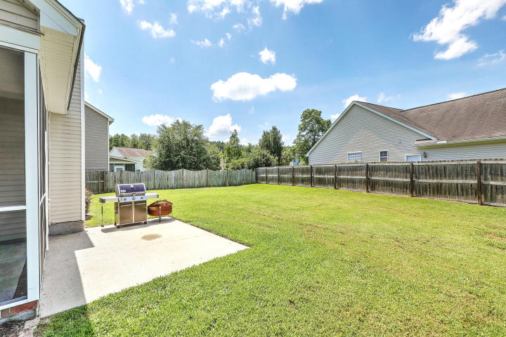
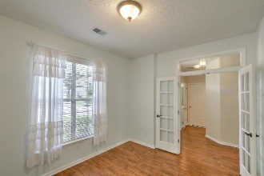
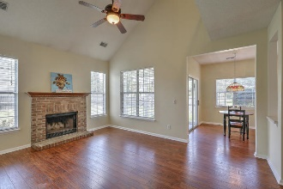
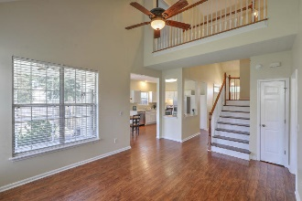
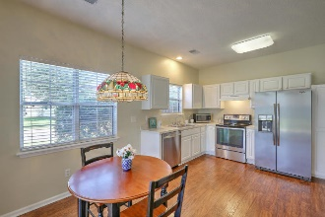
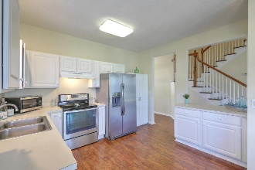
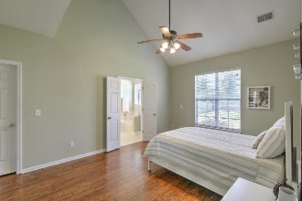
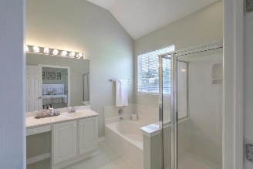
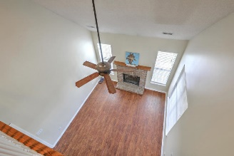
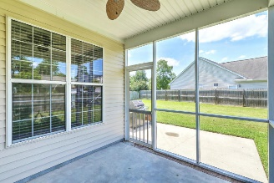
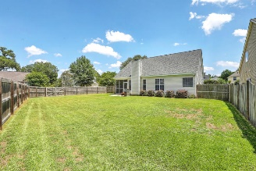


JUST LISTED!! Whitehall - Lovely Move-in Ready Home
Open House Sat 12-3
5375 Greggs Landing Drive
Whitehall | North Charleston, SC 29420 | MLS# 19018846 | $237,999
Look no further! This move-in ready home in the sought-after Whitehall subdivision will end your search! Located on a large, fenced corner lot, this well-maintained home has a BRAND NEW ROOF, is freshly painted & has beautiful high quality laminate flooring throughout! Features include**First floor Master En Suite w/vaulted ceilings, large walk-in closet, separate tub & shower**Enjoy chilly winter nights snuggled in front of the wood burning fireplace in the light & bright family room, also w/vaulted ceilings**Many meals will be enjoyed in this spacious eat-in kitchen with s/s appliances**Formal dining room w/French doors that could also be an office or playroom**Upstairs you will find two spacious guest bedrooms and full bath**Relax in your screened in porch, enjoying sweet tea on hot summer nights or entertaining guests...Enjoy wonderful amenities including a pool, playground, fishing ponds and tennis courts. And, of course, you can't forget the award winning DD2 Schools! Located near Boeing, Bosch, Mercedes, Joint Base Charleston andCharleston International Airport, you will also find plentiful shopping and restaurants. Don't miss this gem!
Desiree Maurer
Office - (843) 416-2000
Mobile - (843) 327-9010
desiree.maurer1@gmail.com
www.yourcharlestonhousesearch.com
Keller Williams Realty
496 Bramson Ct Ste 200
Mt. Pleasant, SC 29464

