Slide 1
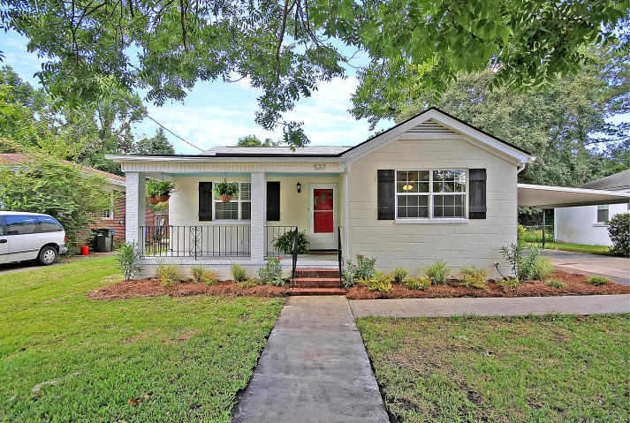
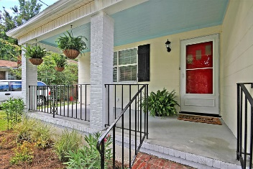
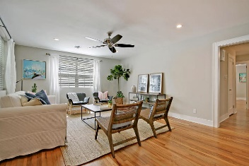
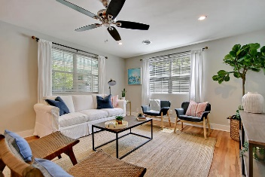
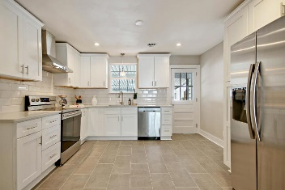
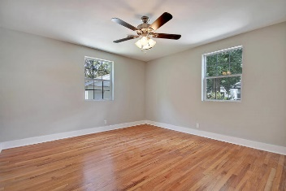
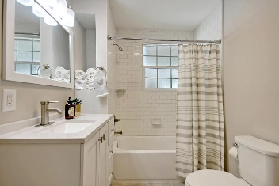
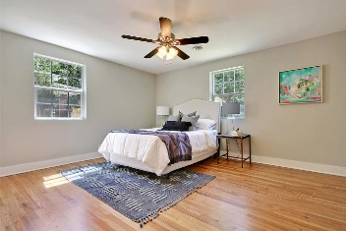
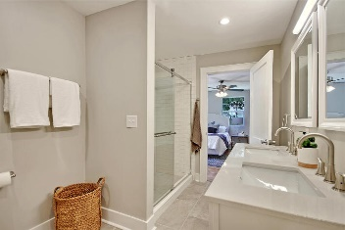


537 St Andrews Boulevard Moreland ~ Charleston, SC 29407 ~ MLS# 18024607 ~ $375,000
Open House Lunch ~ Friday, Oct 3 from 11 - 1
Handyman Special… Bring your hard hats!
Reduced Price + Agent Bonus
Don't miss out!! This newly renovated home is conveniently located in the desirable Moreland/Avondale area. Just minutes from MUSC and Downtown Charleston! Entering the home you are welcomed by the open concept living room and kitchen that offers plenty of natural light. The modern kitchen features shaker style custom cabinetry, quartz countertops and new stainless steel appliances. To keep some of the Charlestonian charm, this home includes the original hardwood floors. Both bathrooms offer gorgeous tiled showers with brushed nickel fixtures. A tankless hot water heater and energy star windows are a few of the upgraded features to make this home energy efficient. This home offers an encapsulated crawl space with dehumidifier, sump pump and French drains around the perimeter.
Carla Musgrave (843) 371-2689
cmusgrave6987@gmail.com
HomeGate Real Estate
4000 S Faber Place Dr Ste 300
Charleston, SC 29405

