Slide 1

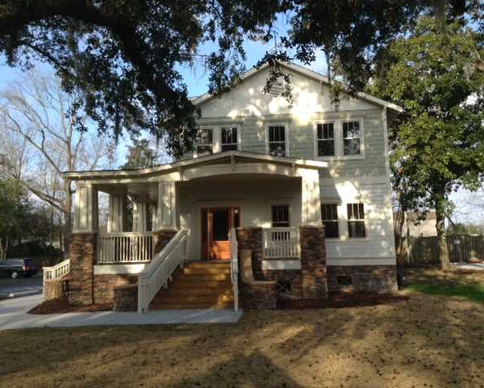
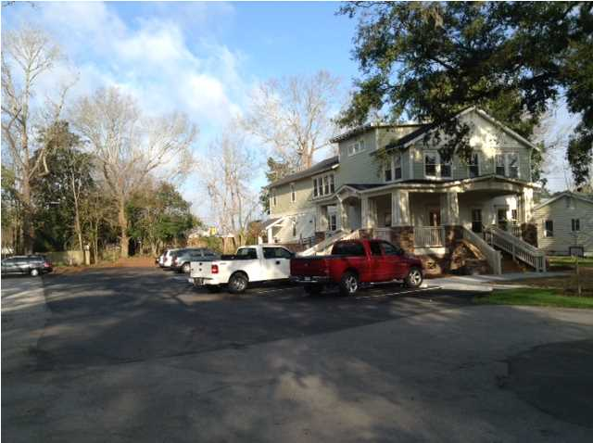
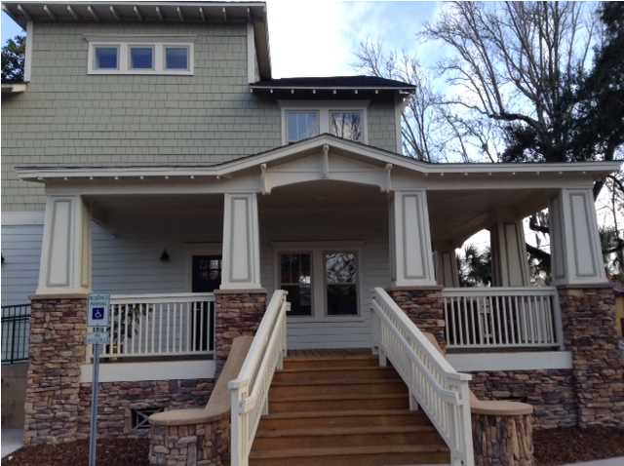
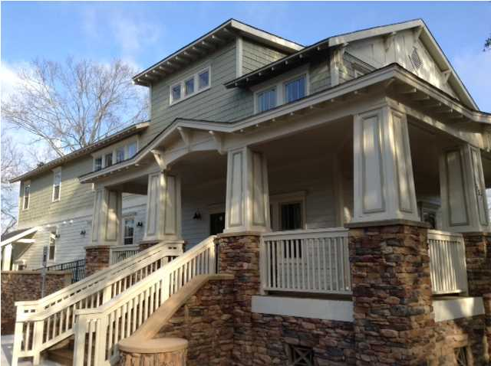
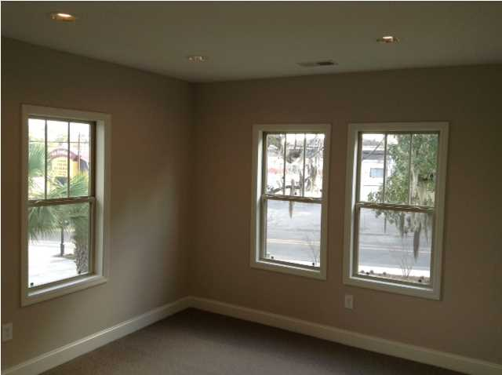
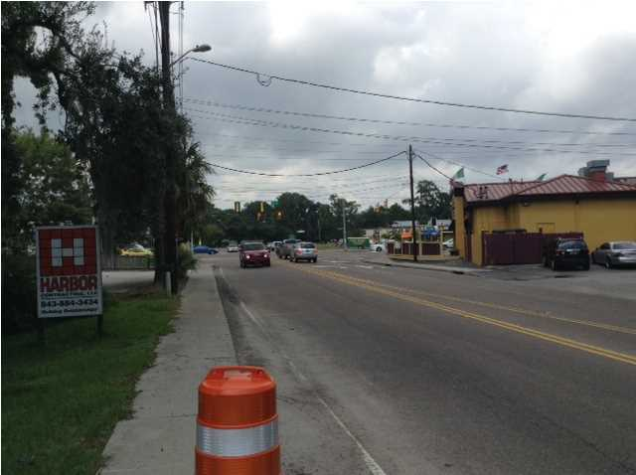


BRAND NEW & READY FOR OCCUPANCY
Second floor suite of 1,078 square feet that has a private entrance and great shared parking. Four offices and a rest room. All have windows.
On top of Goolsby Dental Practice, this office suite is currently under construction and the Tenant may still have the ability to select certain finishes.
This location is very convenient to access, yet feels private once you arrive.
Address: 537 WAPPOO RD
Area: CHS-W.Ashley inside I-526 to Ashley Rive
Building Square Feet: 1078
Category: details
City: CHARLESTON
County: Charleston
Listing ID: 1325705
Listing Price: $18
Max Contiguous SqFt: 1078
Minimum Div. SqFt: 1078
Office Class: A

