Slide 1
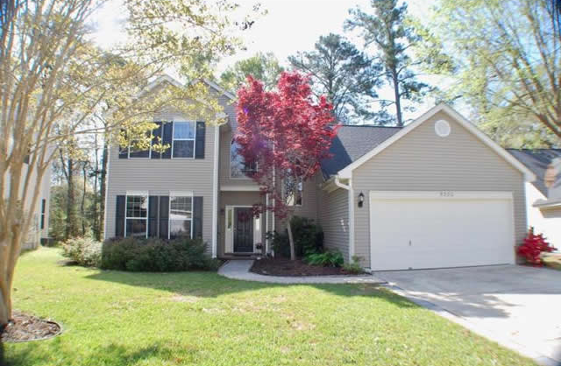
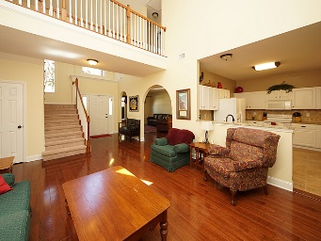
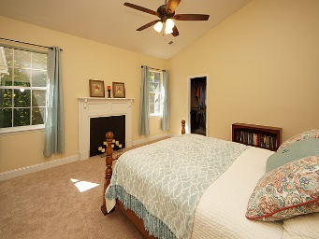
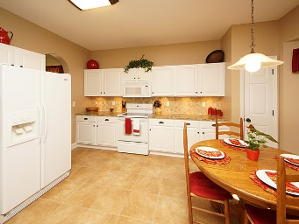
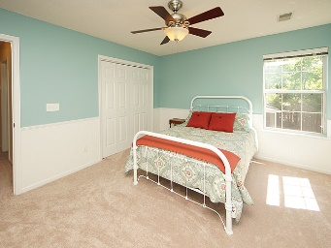
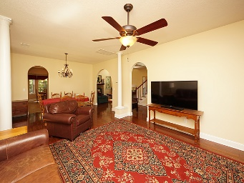
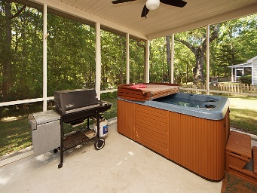
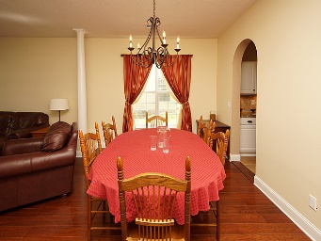
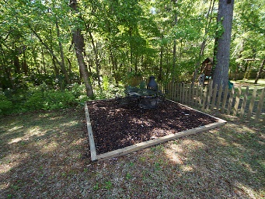


5380 Greggs Landing Dr
Whitehall
North Charleston, SC 29420
MLS# 18008522
$275,000
4 Beds | 2½ Baths
2,292 Square Feet
Come view this wonderful home this Saturday from 3-5
Great home for entertaining that looks like NEW! Everything improved, painted & upgraded! New Stainless steel appliances installed Saturday 4/28.
All counters are granite. Two yr old roof & 2010 AC. Stunning OPEN FLOOR PLAN, two story Foyer & Family Rm w Fireplace. Architectural arches open to the Dining Rm & Living Rm. HARDWOOD FLOORS throughout. Granite Eat In Kitchen is open to the living and family rooms. FIRST FLOOR MASTER. Soaking tub & shower, dual basin granite sinks. New carpet in bedrooms & stairs.
Private back yard w lovely panoramic view. The screened porch has a relaxing HOT TUB big enough for six. Huge FROG or forth bedroom/media room take your pick! Neighborhood has pool, tennis, playpark & field. Dorchester 2 schools.
Di Johnson
843-270-6448
dijohnsonsc@gmail.com
www.agentownedrealty.com
AgentOwned Premiere Group
824 Johnnie Dodds Blvd
Mt Pleasant 29464

