Slide 1
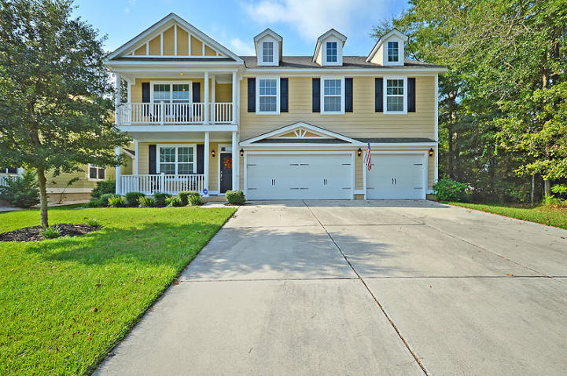
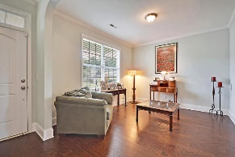
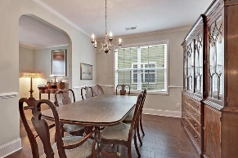
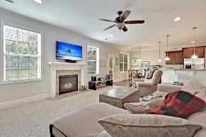
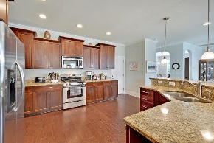
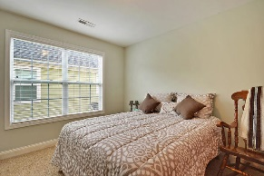
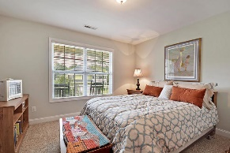
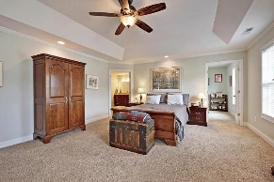
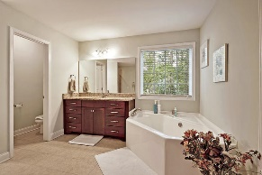
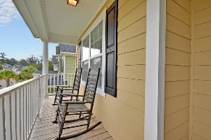
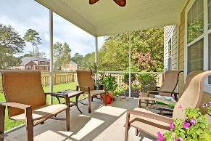
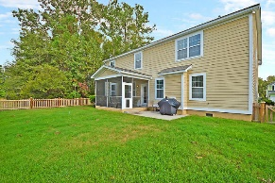
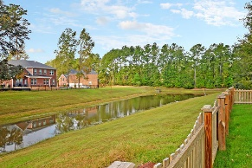


Under $400k - 3 Car Garage - DD2 Schools!!
5398 Clairmont Lane
Cedar Grove
North Charleston, SC 29420
MLS# 19015547
$399,000
5 Bedrooms | 3 Baths | 3,686 sf
HUGE REDUCTION!
Get ready to be impressed!! Awesome home with an awesome floor plan on a gorgeous lot overlooking a serene pond. Curb appeal galore as you walk up to this home. The home features a front porch as well as a second upstairs porch! True Southern charm! Upon entering, to the left is a formal living room with lovely wood flooring. Pass through the arched doorway to the dining room. The dining room is spacious and perfect for entertaining. The family room, which has brand new carpeting has lots of natural light as well as a gas fireplace. Never feel left out as the kitchen is open to the family room! Large kitchen island with a breakfast bar overlooks the family room, eat in kitchen and has views of the backyard. The kitchen is a chef's delight, with ample cabinet space large pantry, granite countertops and stainless steel appliances. Off the kitchen is a bedroom with access to a full bath. Perfect guest room or can be used as a mother-in-law suite! Make your way upstairs and you'll find so much space!! There are three large bedrooms all with great closet space. There is a full bathroom as well as the laundry room which has cabinet space and countertop. Also upstairs is a huge bonus room with attic storage. This room can be a secondary family room, a toy room, media room...you name it! Finishing off the upstairs is the huge master suite. This is the master you've been dreaming of! Access to the front upstairs porch, a room off the master that can be a nursery or office and a huge master bath. The master bath has dual vanities, a separate shower and tub, water closet and walk in closet. Ready to relax outside? The backyard has a great screened in porch, patio, fenced in yard and lovely pond views. And let's not forget the 3 CAR GARAGE!! So great for storage!! This home is conveniently located close to the airport, Bosch, and Palmetto Commerce Park! Dorchester District 2 schools service this community. Come see this house today!
Larry & Kathy Mazalatis
Larry Cell 843-693-0529
Kathy Cell 843-693-0159
Office 843-871-9133
AGENTOWNED PREMIERE GROUP | 1800 TROLLEY RD | SUMMERVILLE, SC 29485

