Slide 1
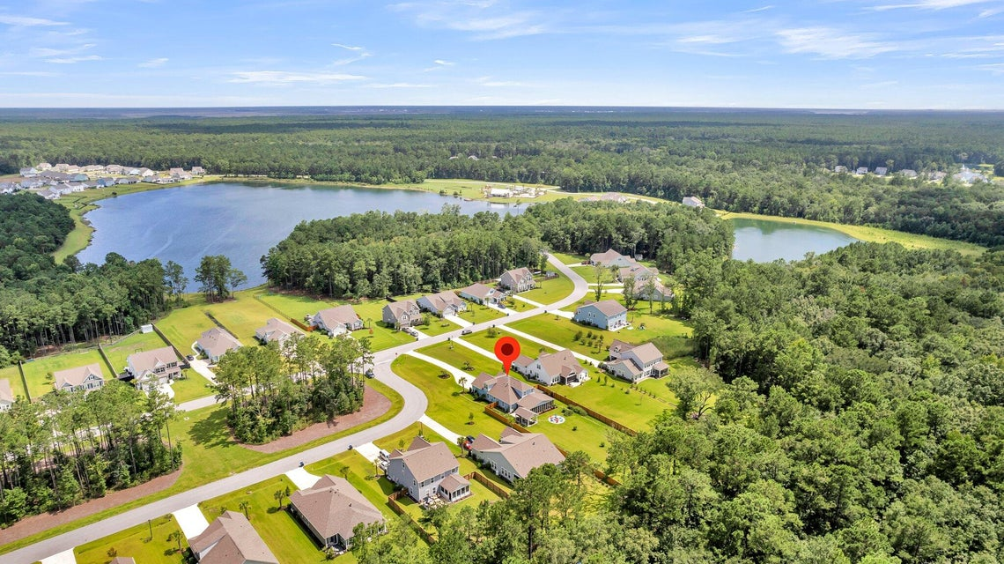

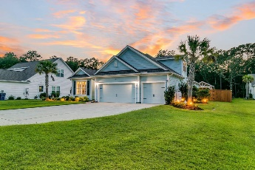
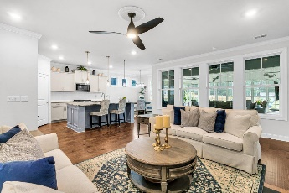
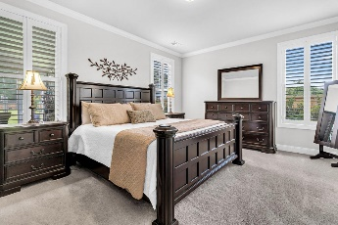
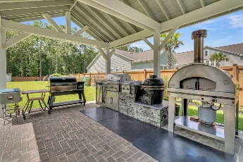
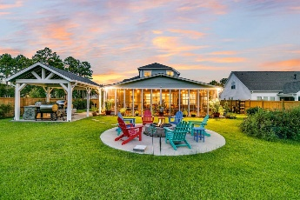
Dream Home with Unbelievable Amenities
539 Pontoon Road
Bridges at Seven Lakes ~ Huger, SC 29450 ~ MLS# 24018884 ~ $925,000
Large property at .77 acre! Welcome to your dream home in The Bridges at Seven Lakes, a stunning oasis where luxury meets comfort. As you approach, the expansive, groomed front yard and exquisite landscaping set the stage for what lies within. The three-car garage and striking exterior make a grand first impression. Step inside to discover a world of elegance, with beautiful flooring, crown molding, and plantation shutters enhancing every corner. Natural light floods the open floor plan, creating an inviting atmosphere. To your left, the formal dining room awaits, perfect for hosting intimate dinners. Further down the hall, the space opens up to the family room and kitchen area, where a wall of windows and a cozy fireplace flanked by built-ins create a warm, welcoming space. The kitchen is a chef's delight, featuring stone countertops, modern cabinetry, a subway tile backsplash, stainless steel appliances, and an island with seating. The casual dining area provides access to the four seasons room, blending functionality with beauty.
The primary bedroom, with views of the serene backyard, boasts a walk-in closet and an en suite bath with a dual sink vanity, step-in shower, and a soaking tub. The main level also includes two additional bedrooms, two full bathrooms, and a laundry room for ultimate convenience. Upstairs, a spacious loft offers endless possibilities - a second family room, media room, or whatever suits your needs. An upstairs bedroom with an ensuite bathroom ensures comfort for guests or family members. Designed for entertaining, the massive four seasons room offers ample space for dining and lounging, with views of the picturesque backyard. The fully fenced backyard is a true oasis, featuring a covered brick paver patio with a built-in outdoor grilling station and a firepit for those cozy nights. Raised gardens and a handy storage shed add to the charm. Living in The Bridges at Seven Lakes means enjoying exceptional community amenities, including a swimming pool, firepit area, play park, and lake access dock. This home presents a rare opportunity to own a slice of paradise in a highly sought-after location. Don't miss out!
*Select furniture included with an acceptable offer.
Verna Bunao-Weeks verna@mattoneillteam.com 843-364-2447

