Slide 1
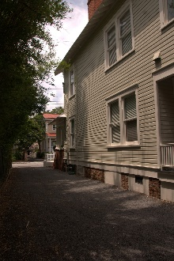
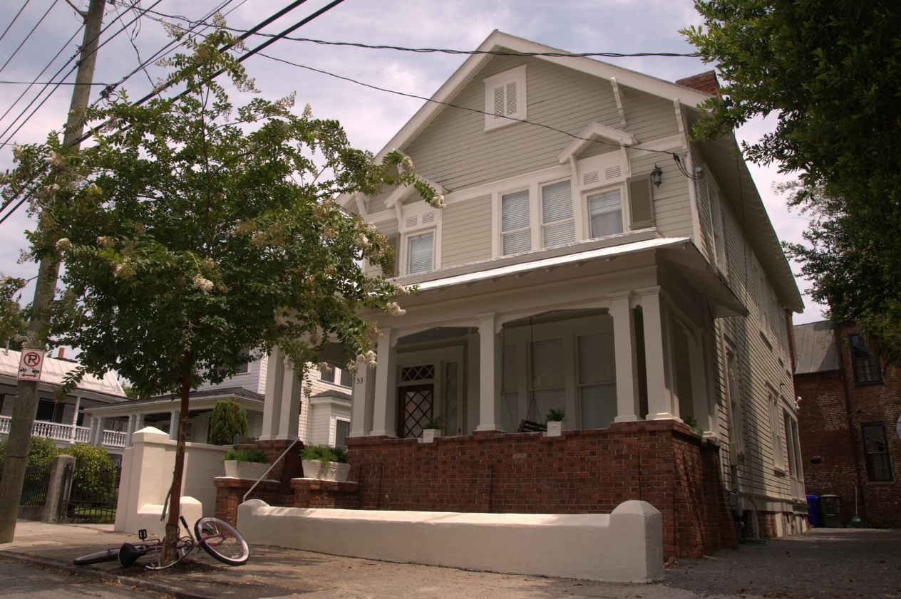
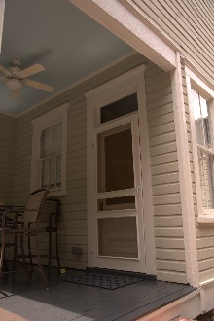
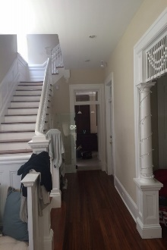
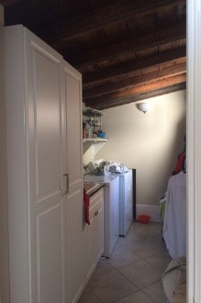
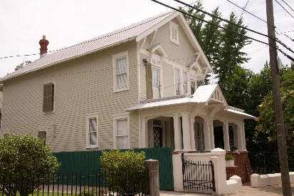
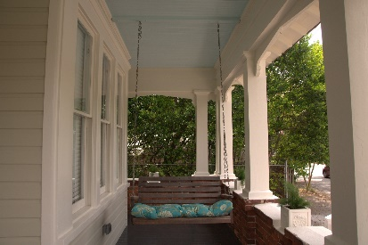
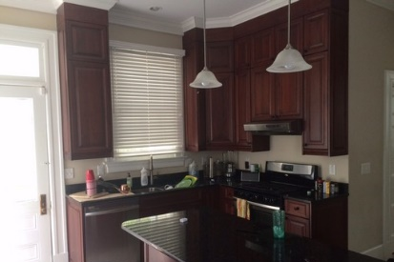
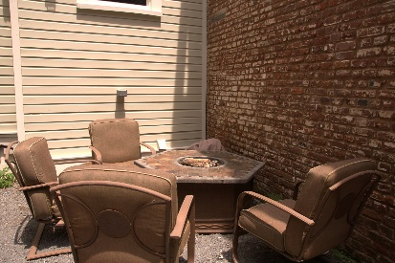
Luxury Single Family House Excellent Investment Property 53 Vanderhorst St, Charleston, SC 29403
53 Vanderhorst St, Charleston, SC 29403
For Sale: $795,000
- Located in very close proximity to College of Charleston, MUSC, and Ashley Hall.
· 2,264 SF (Flexible Layout) Single Family House with 4 bedrooms and 2 baths (*optional third bath)
· High ceilings on first and second floor with beautiful staircase
· Custom Cherry Cabinetry with soft close doors and drawers
· Whirlpool Gold Stainless Steel Appliances (French door fridge, 5 burner gas stove, dishwasher)
· Granite countertops in kitchen, bathrooms, and laundry room
· Spacious covered front and rear porches
· Custom 1st floor tiled shower with glass door
· Large laundry/utility room with exposed beam ceiling
· 5 Off-street parking spaces
· Private back patio area
· Rinnai Gas Tankless Water heater
· House was recently renovated with new electric, plumbing, and 1st floor HVAC system
· TMS: 460-16-03-119 | Rental Income: Conact For Details
Brokers Protected
Offered by Steven Wilk (843) 697-4774

