Slide 1
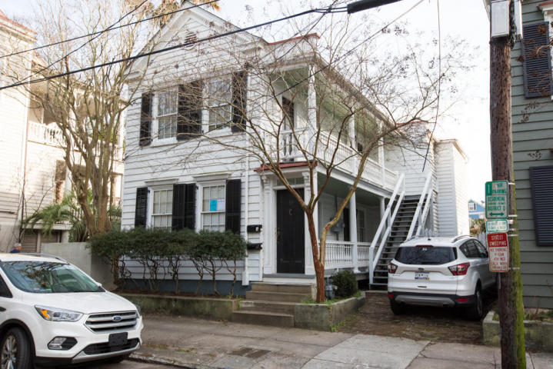
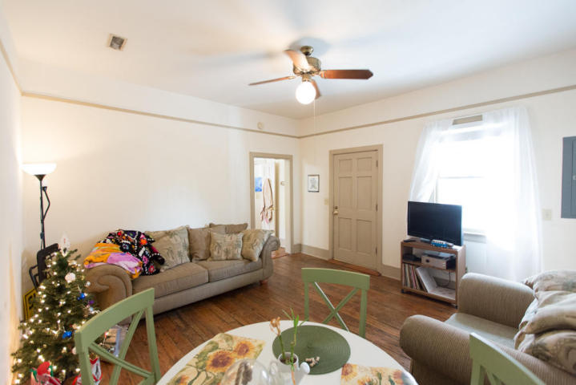
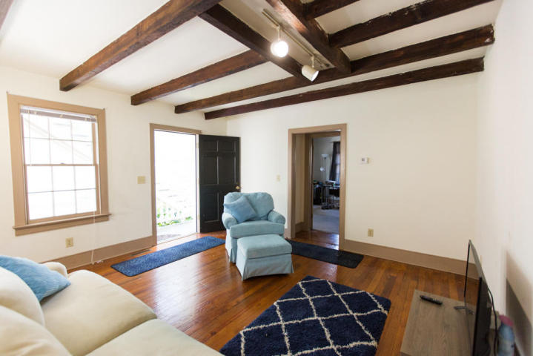
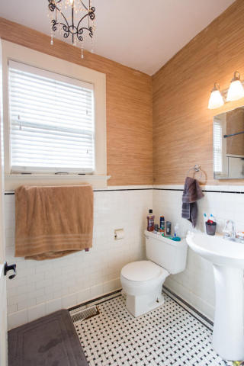
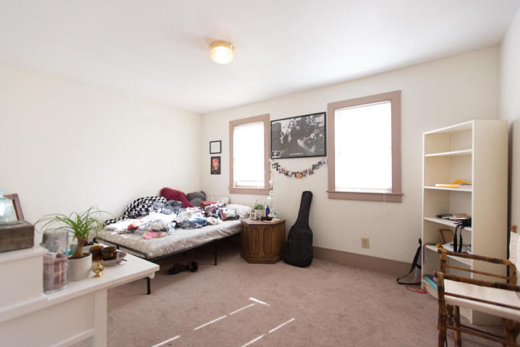
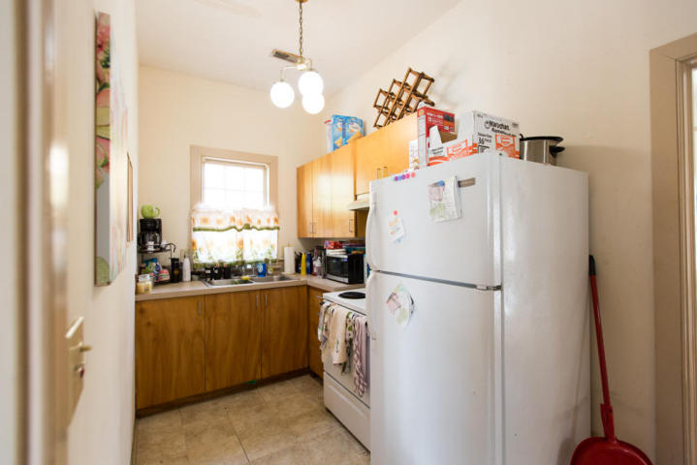
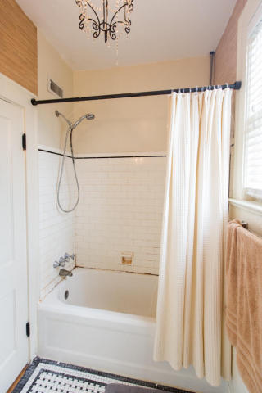
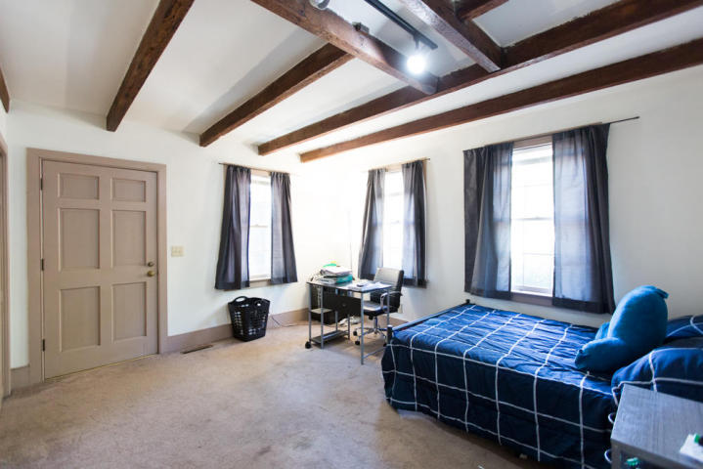
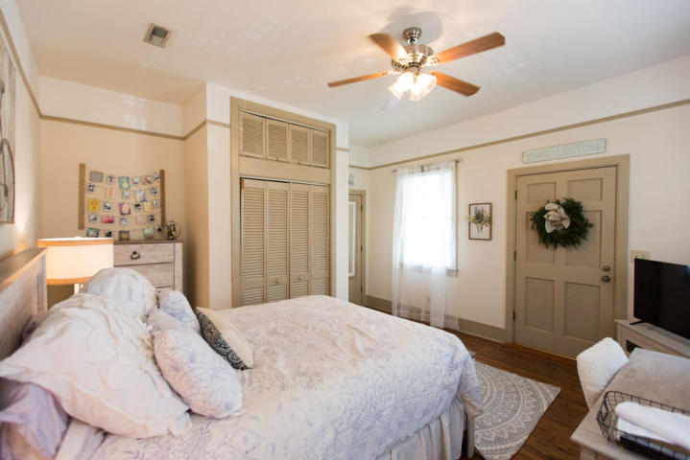
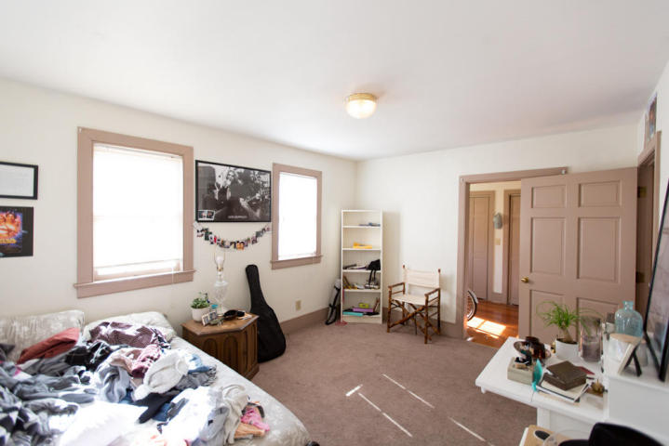
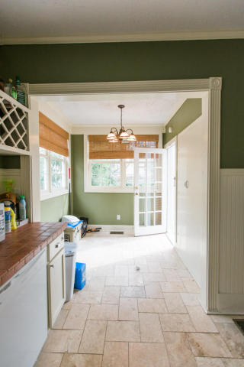

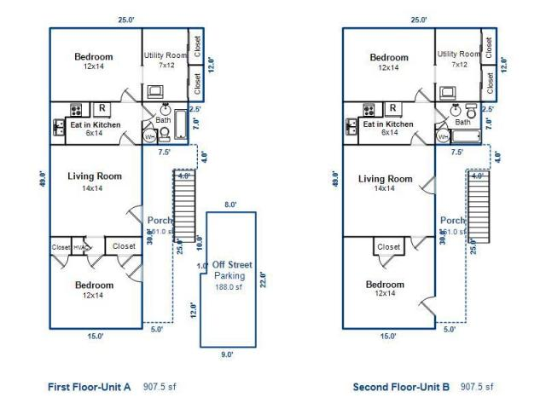
53 Warren Street A & B
Radcliffeborough ~ Charleston, SC 29403
MLS# 18001125 ~ $699,000
Historic duplex; extensively renovated in the '90's. New insulation, wiring, plumbing, roof, etc.. Rent the downstairs and keep the upstairs for yourself! Or renovate whole as a lovely single home.
Units are 2 bedroom / 1 bathroom each. There is currently one off-street parking space plus a small courtyard. Both leases are for $1,800/mo. ea. and both leases expire 5/31/2018.
Marion Jackson
Mobile - (843) 442-4404
marionjacksonrealtor@gmail.com
Charleston Property Brokers | 151 St. Philip St. Apt A | Charleston, SC 29403

