Slide 1
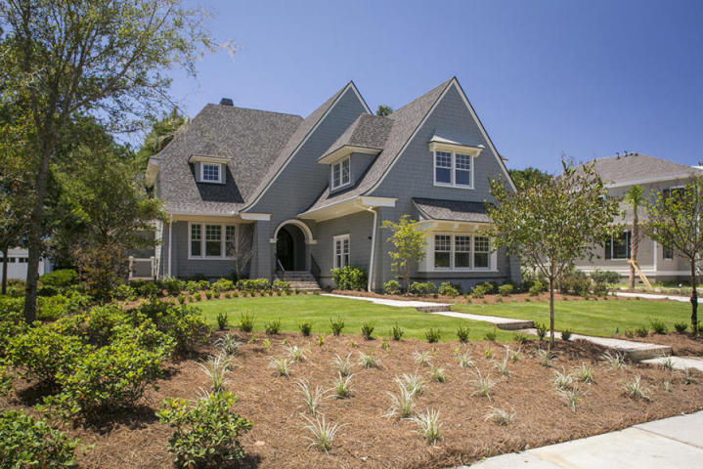
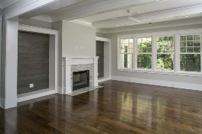
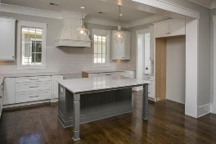
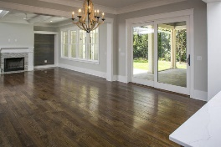
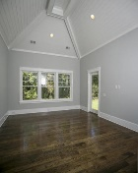
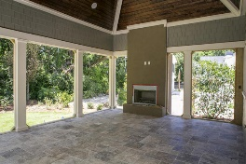
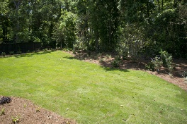
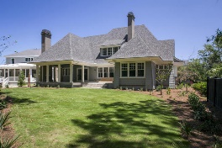


New Construction Just Completed
53 Woodford Street
Daniel Island Park | Charleston | MLS# 16022304 | $1,399,000
Beautifully designed home with detailed craftsmanship by Carson Homes is located within the exclusive Daniel Island Park Community. The home features a well thought out, and very open floor plan. Main living area has large family room with custom built-ins and a wood burning fireplace. Gourmet custom kitchen has Cambria Quartz counter tops, Thermador stainless steel appliances, large center island, walk-in pantry and plenty of cabinets. The open, family style dining room is perfect for entertaining and flows into a beautiful rear porch, with solid surface silver travertine walking surface, vaulted stained wood ceiling, and a wood burning fireplace. Also located on the main level is the master suite retreat which has access to the rear porch as well. The suite has a vaulted wood ceiling, a large walk-in closet with custom built in shelving, and an elegant bath featuring marble tile, custom framed mirrors, his and her vanities, and an oversized shower. In addition, the first floor has a study off the foyer with a wood coffered ceiling, a mudroom, a large laundry room and a powder room. The second floor features three additional spacious bedrooms. One of the bedrooms has a private full bath and the other two have a uniquely designed Jack and Jill each featuring their own private vanity area. Lastly, one essential feature to the home is an enormous bonus room with a private bath located over the rare three car garage. This flex space could be used in many ways such as a playroom, media room, or additional guest suite. Other unique features of this home include a spray foam roof, enclosed crawl space with dehumidification, stained select white oak flooring, epoxy garage floor, tankless hot water heater, central vacuum, wired for home stereo, Hardishake siding, solid surface porches (brick on front and silver travertine on rear), lush landscape with irrigation and a private wooded back yard that backs up to wetlands. This property includes Daniel Island Club social membership privileges with the opportunity to upgrade to a Sport membership, or an Invitational Golf membership.
Jennifer Liverett
Office - (843) 416-2000
Mobile - (843) 810-5346 jennifer.liverett@kw.com
Keller Williams Realty 496 Bramson Ct Ste 200 Mt. Pleasant, SC 29464

