Slide 1
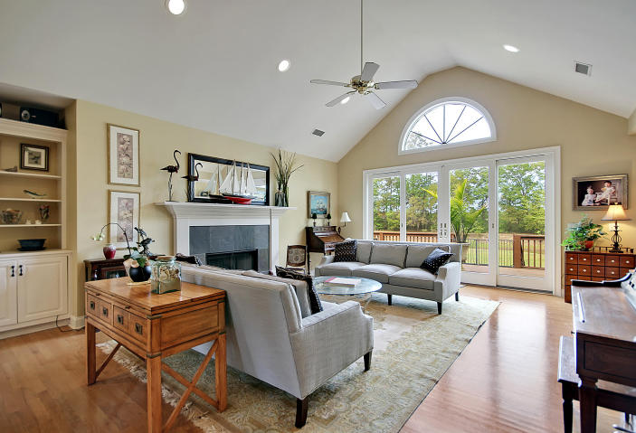
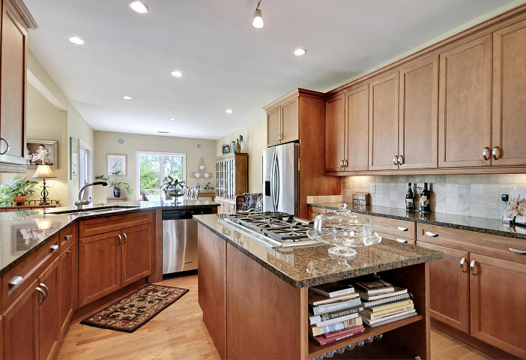
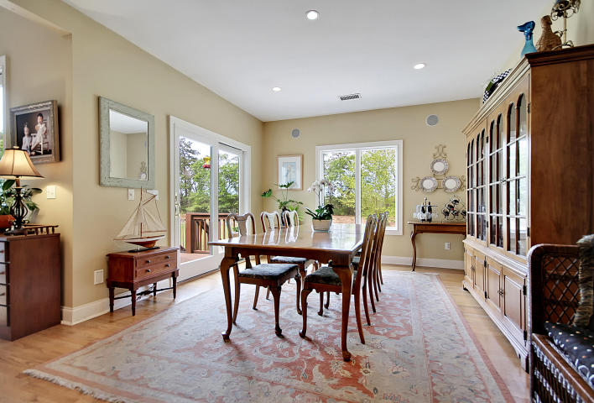

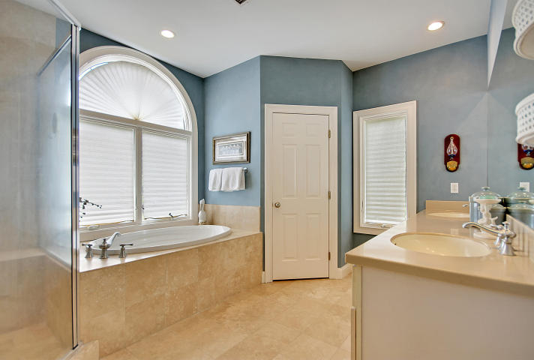
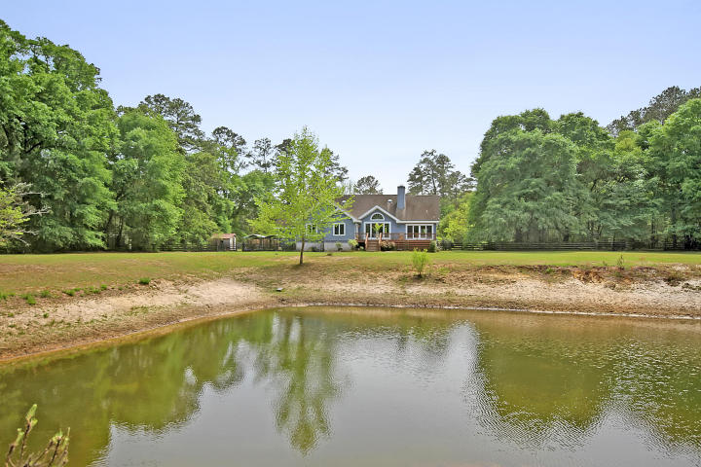
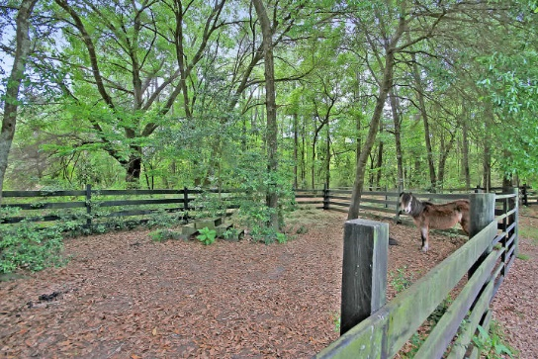
Private Location ~ Move-in Ready
Reduced $200k!
5400 County Line Road
Ravenel ~ MLS# 16010545 ~ $629,000
If you’re looking for a private location with a move-in ready home, Heron Oaks Farm is a 3BR, 2.5BA, 2 car garage home you need to see today! Situated on 3.38 acres with no deed restrictions, you can bring your horse, dogs or whatever animals you’d like so you and your pets will have amazing accommodations. This open and spacious floorpan has an office and huge FROG, both of which could easily be converted to additional bedrooms if needed. The pond on the property is not only beautiful to look at from the home and huge deck but is stocked with fish for some backyard fishing. The living room features a cathedral ceiling, fireplace with slate surround and sliding doors to the deck. This amazing home won't be around for long, so book your showing today!
Additional features include:
Book your showing today!
If you’re looking for a private location with a move-in ready home, Heron Oaks Farm is a 3BR, 2.5BA, 2 car garage home you need to see today! Situated on 3.38 acres with no deed restrictions, you can bring your horse, dogs or whatever animals you’d like so you and your pets will have amazing accommodations. This open and spacious floorpan has an office and huge FROG, both of which could easily be converted to additional bedrooms if needed. The pond on the property is not only beautiful to look at from the home and huge deck but is stocked with fish for some backyard fishing. The living room features a cathedral ceiling, fireplace with slate surround and sliding doors to the deck. This amazing home won't be around for long, so book your showing today!
Additional features include:
Granite kitchen boasts a breakfast bar, SS appliances, center island, gas range and tile backsplash
The dining area off of the kitchen has built-in surround sound and sliding doors to the deck
The master bedroom has a walk-in closet and master bath with dual vanity, walk-in shower with dual heads and bench and a garden tub
Palladian windows
Laundry room has a prep sink
Hardwood floors throughout / Travertine in bathrooms and laundry
Mature pecan trees and live oaks on the property
Pond is fully stocked with bass and brim
Less than 15 miles from downtown Charleston
Fenced-in property
Paddock for a horse is currently set up
Property is in the Historic Plantation District as well as surrounded by Poplar Grove's 'The Plantations' estate homes, currently under development
Fletcher Thompson
fletcher@mattoneillteam.com
843-530-6118

