Slide 1
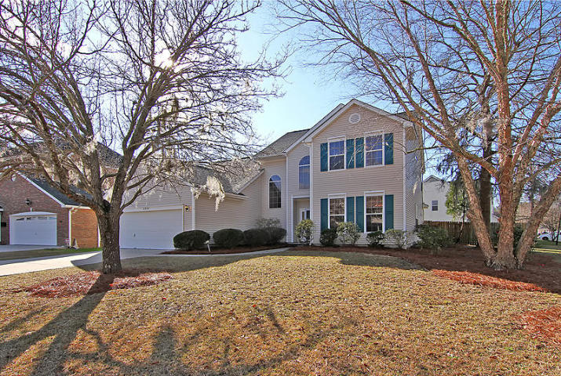
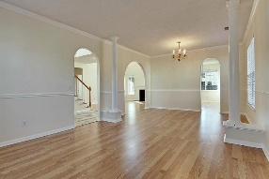
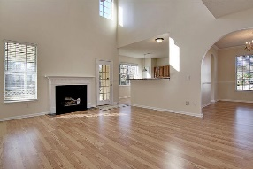
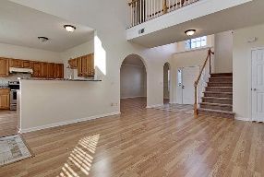
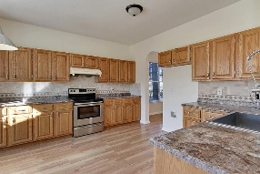
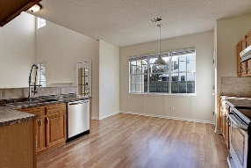
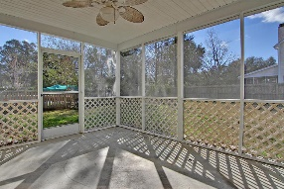
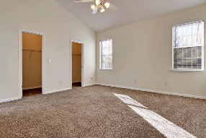
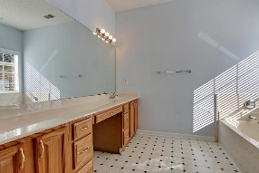
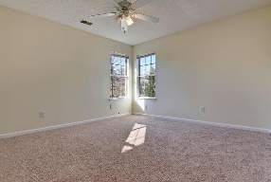
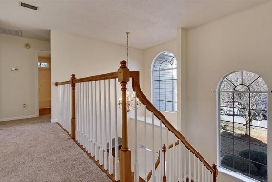
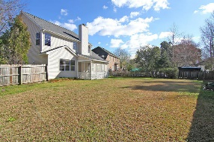
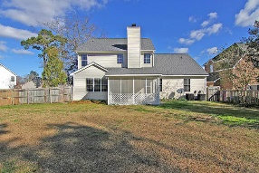


Whitehall Beauty! Move in Ready!
5400 Dwight Drive
Whitehall Plantation
North Charleston, SC 29420
MLS# 17003496
$264,900
4 Bedrooms | 2½ Baths | 3,129 sf
This 2,281 Sq. Ft. home features a NEW ROOF, all NEW CARPETING and is freshly painted to be move-in ready! The kitchen offers stainless steel appliances, huge farm sink, sitting bar, tile backsplash, pantry, eat-in kitchen area and is open to the family room. The spacious family room has vaulted ceilings and a wood fireplace. Downstairs buyers will also find a dining room / formal living room (or possibly office) combo.
The master bedroom is downstairs and features ''his and hers'' dual walk-in closets, new carpet and a master bathroom with tub and shower. A laundry room is also found downstairs as well as entry to the 2 car garage and entry to a screened porch overlooking the private, fenced-in backyard. Upstairs buyers will find 3 more bedrooms with new carpet and a bathroom with new tile flooring.
Whitehall is located within Dorchester District II schools, close to the airport, Boeing and Bosch as well as many local restaurants and shopping opportunities! The neighborhood has a community pool, tennis courts, playground and ball field. Come view this home today!
Larry & Kathy Mazalatis
Larry Cell 843-693-0529
Kathy Cell 843-693-0159
Office 843-871-9133
AGENTOWNED PREMIERE GROUP | 1800 TROLLEY RD | SUMMERVILLE, SC 29485

