Slide 1
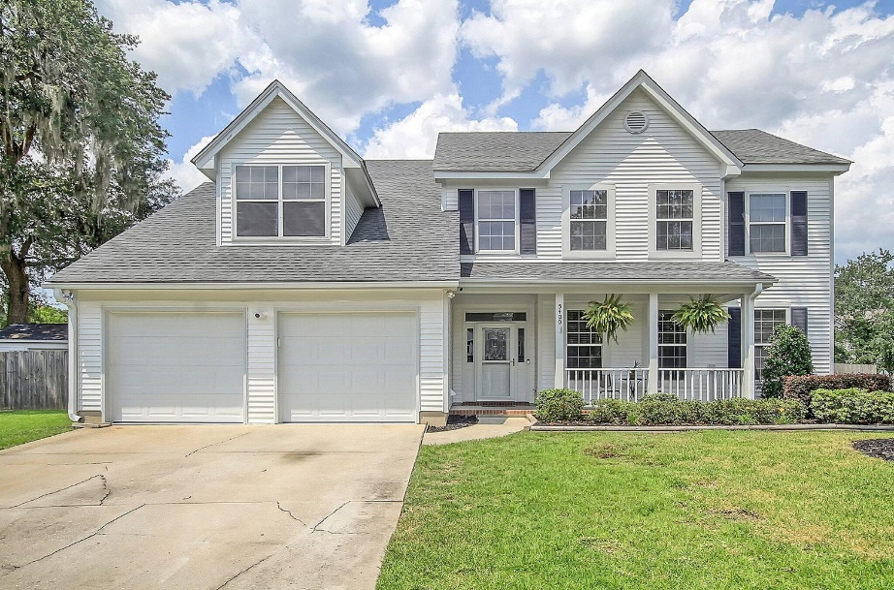
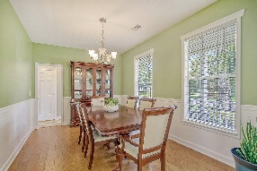
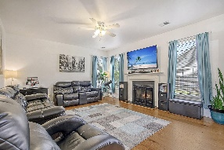
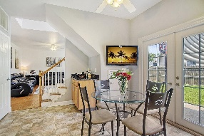
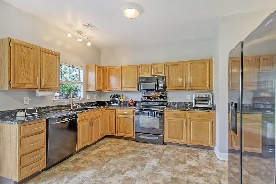
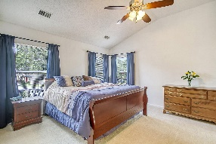
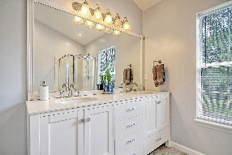
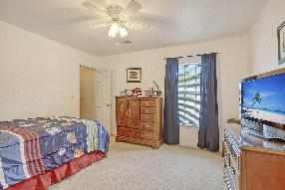
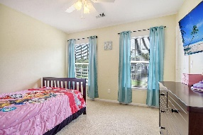
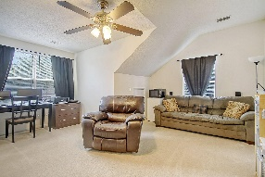
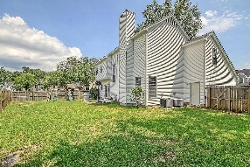
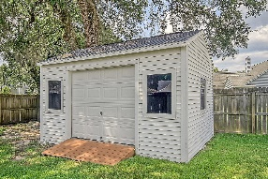
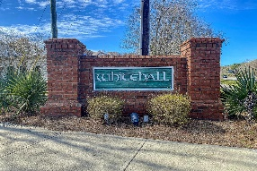


North Charleston Beauty Close To It All!
5400 Diston Court
Whitehall
North Charleston, SC 29420
MLS# 23016393
$399,900
4 Bedrooms | 2½ Baths | 2,205 sf
Welcome home to 5400 Diston Court located in the sidewalk lined community of Whitehall! This corner lot home, located in a cul-de-sac, is move in ready! Upon entering, the arched entry to your right leads to the dining room, a perfect size for entertaining! The large family room offers a wood burning fireplace, wood floors and is open to the kitchen. The kitchen has an eat in area, a pantry, plenty of cabinetry and access to the backyard. Off of the kitchen is the laundry room and half bath. Head upstairs and you'll find the huge primary bedroom with a large walk in closet . The primary bath has been newly updated and offers dual vanities and a separate shower and tub. There are two more good size bedrooms, both with walk in closets. In the hall, is an updated full bath. Also upstairs, is the fourth bedroom which could also be used as a bonus room. This bedroom is large enough to be a work out room, media room or game room. This bedroom also offers some attic storage. The backyard is completely fenced in and has two access gates. There is also a large shed that has a door big enough that you can store your golf cart in there! This home is close to it all...minutes from Bosch, the airport, Boeing, Mercedes and shopping! Dorchester district 2 schools service this neighborhood as well. Come see this home today!
Larry & Kathy Mazalatis
Larry Cell 843-693-0529
Kathy Cell 843-693-0159
Office 843-871-9133
AGENTOWNED PREMIERE GROUP | 1800 TROLLEY RD | SUMMERVILLE, SC 29485

