Slide 1
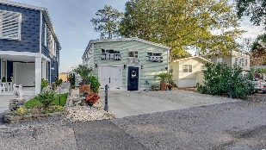
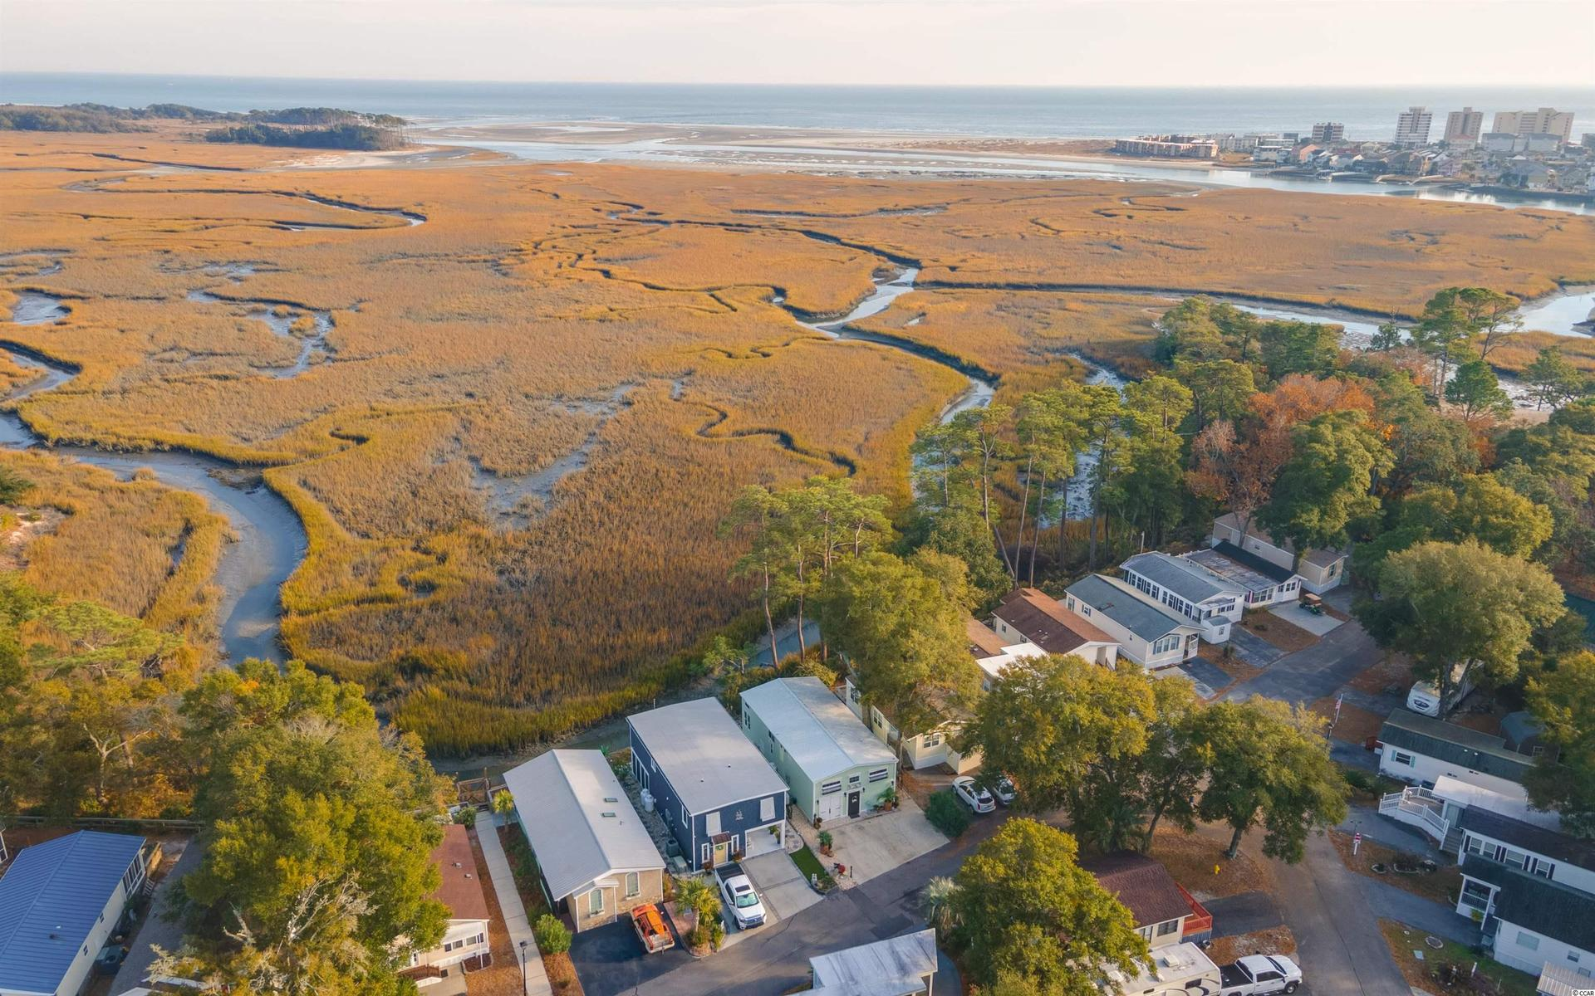
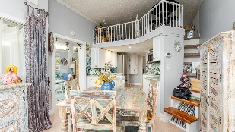
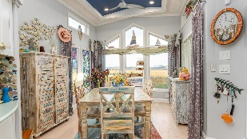
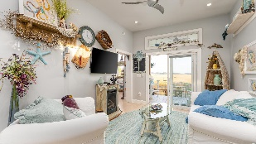
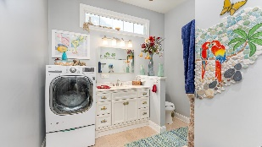
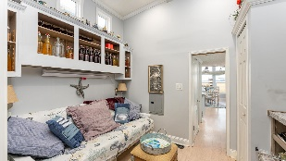
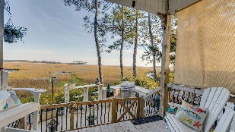
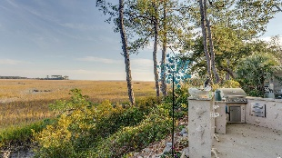
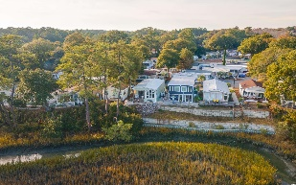
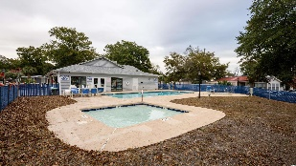



Fall In Love With The Atlantic Ocean Right In Your Own Backyard!
5400 Little River Neck Rd
North Myrtle Beach, SC 29582 ~ MLS# 2127061 ~ $349,900
This one-of-kind marsh front/oceanfront upscale manufactured Park Model home has significant viewing frontage to where the Atlantic Ocean rolls into the Cherry Grove Marsh and spectacular vignettes of Waties Island. Breathtaking does not begin to do this private enclave of astounding natural beauty justice. It is remarkably stunning and teaming with wildlife. Myrtle Beach RV Resort is a deeded campground nestled in a safe, gated community oceanfront on Little River Neck Rd., a tree-lined road to oceanfront Anne Tilghman Boyce Coastal Reserve, a nature conservancy, including Waties Island, with access for managed recreational use. Little River Neck itself is on an elevated peninsula of live oaks and southern pines between the Intracoastal Waterway and the Cherry Grove Inlet to the Atlantic Ocean. The area also preserves the singular look of its own historic origins. Low HOA fees include water & sewer, trash, basic cable, internet, lawn maintenance, pool maintenance & common area maintenance. There is an onsite park manager, security gate, laundry facilities and individual post offices. It is minutes from the beach, shopping & dining, schools, medical services, entertainment and access to major highways. Nearby public amenities include the ability to golf cart to the beach; close proximity to world-class Tidewater Plantation Golf Course, pro shop and restaurants and bar, driving range, putting greens, and event facilities overlooking the 18th hole; and access to Waties Island, one of the last accessible barrier islands in the world! This section of Horry County has a full range of things to do and to enjoy which really reflects a "way of life" in safe, popular, affordable North Myrtle Beach, a Top 5 Beach Town in the nation...and with low city and county taxes. Flood zone X, minimal. Hope Point Subdivision is approved for development across the street, and Little River Neck Rd. will be widened with a multi-purpose path for walking and bike-riding. There is discussion of a state park on neighboring Waties Island. Listing agents are always willing to accompany and or to provide virtual showings...Do not miss out on this unforgettable opportunity to fall in love with the Atlantic Ocean right in your own back yard. But inside is more than just stunning, too! The star of the show is the ocean, but the indoor and outdoor luxury, upscale kitchens are scene stealers! There are two bedrooms, a gorgeous master bath, second guest bath, dining area with views and even a fireplace, loft and secluded back porch with swing and ceiling fan. It is an artist's residence, so the decor is beautiful as well as collectable, with much of it being built-in, such as the amazing back splash in the stylish kitchen-dining areas. In quick summary, improvements include a whole-house Generac Generator with warranty; outside kitchen, granite countertops and stainless grill; concrete patio; concrete driveway; completely remodeled kitchen with new cabinets and countertops; new hardwood flooring throughout; new appliances; custom back splash and tile work; hurricane panel shutters; Trane high-efficiency heat pump/central air; propane fireplace and stove; and new 40-gallon hot water heater and MORE! All this luxury is in a fabulous gated resort in North Myrtle Beach, loaded with amenities, walk able, bike and pet friendly, two pools, a hot tub, kiddie pool, tennis courts, putt-putt golf, picnic areas, two ponds with fountains and a clubhouse with planned activities for the homeowners. And the land conveys! Welcome to your new private beach retreat and secluded nature enclave on the oceanfront! See it today; watch the tides roll in tomorrow...simply incomparable!
Video Tour: https://youtu.be/00YrLuViopA
3D Virtual Tour: https://my.matterport.com/show/?m=omRpuGK7dCH
Connie Ross-Karl
702-306-2643
conniesross@aol.com
Ronnie Nichols
Realtor / BIC
ronnienichols8@aol.com
NEW WAY PROPERTIES MYRTLE BEACH

