Slide 1
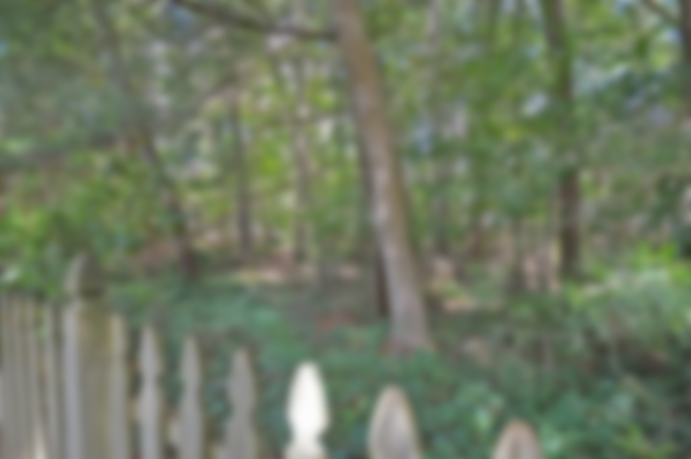
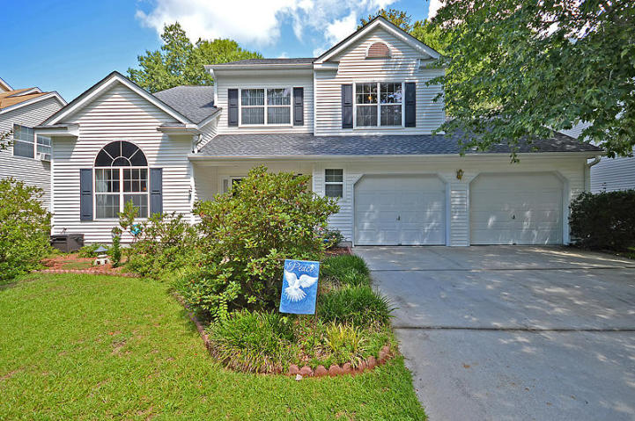
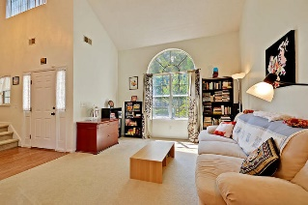
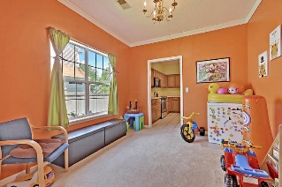
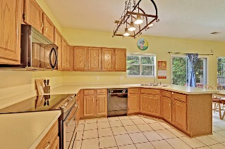
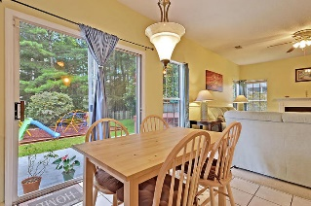
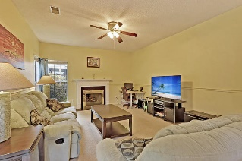
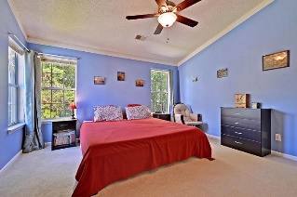
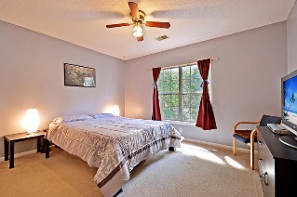
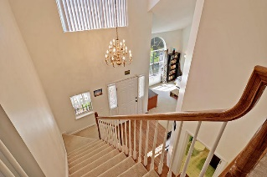
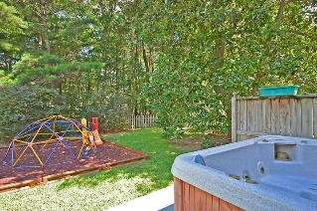


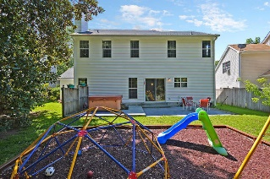
5403 Greggs Landing Dr Whitehall ~ Charleston, SC 29420 MLS# 17017358 ~ $245,000
Don’t Miss This One! It Won’t Last Long!
This house will not last long! Gorgeous private lot that backs up to protected wetlands in the highly sought after neighborhood of Whitehall and Dorchester 2 School District. Conveniently located with tons of nearby restaurants and shopping, 10 minutes to Air Force Base and Boeing, and 25 minutes to downtown Charleston. Double story foyer and formal living room with open staircase gives the entryway a grand feeling. Formal dining room with lovely moldings is currently used as a playroom, but can be easily converted back to a dining room. Large kitchen opens to breakfast area and family room with fireplace. All four bedrooms are upstairs. Large master bedroom has nice walk in closet and en suite bathroom with separate tub and shower. Large back yard includes a hot tub which will convey. Home comes with access
to neighborhood amenities including pool, tennis courts and playground. Roof is 3 years old and electric range was replaced this year.
Carey Nikonchuk
(843) 276-1701 M
cnikonchuk@gmail.com
www.palmettoproperty.net

