Slide 1
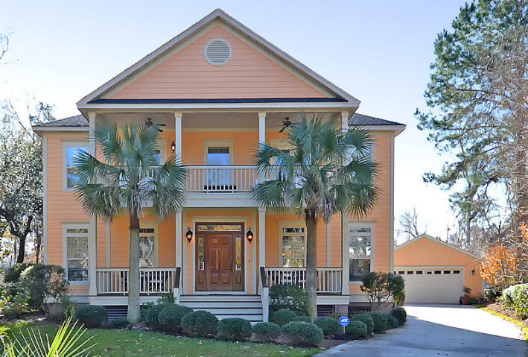
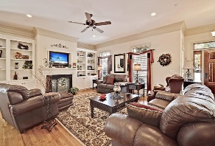
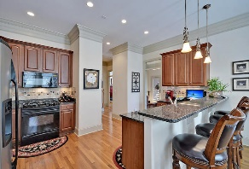
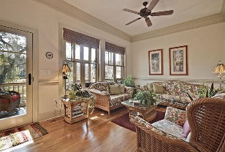
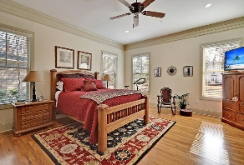
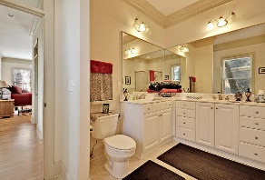
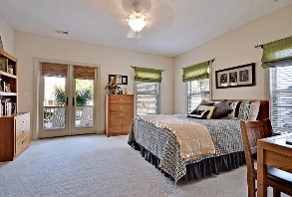
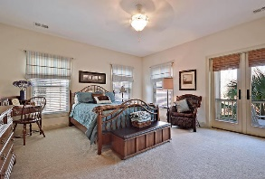
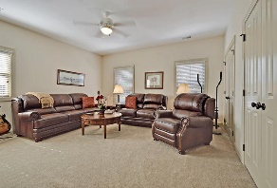
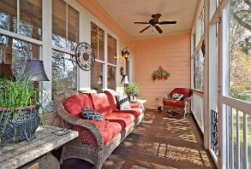
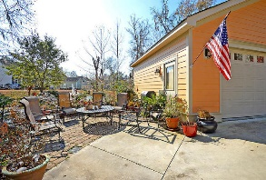
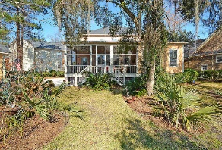
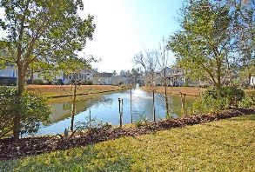


This is a WOW house!
5408 Walking Stick Ln
The Refuge
North Charleston, SC 29420
MLS# 16002486
$495,000
5 Bedrooms | 4½ Baths | 3,567 sf
Custom built beauty on one of the largest lots in the Refuge! Curb appeal galore as you pull up to this home's cul-de-sac location. No detail was left out when this house was built. It will impress you! Double porches on the front of the house give this home a real Southern feel. Walk in and immediately notice the quality of workmanship throughout! Thick, heavy doors, transom windows over doorways, wood floors throughout the entire first floor, trim work and molding, lush carpeting in the upstairs bedrooms, extra large closets for storage. Upon entering, the dining room and living room give you your first impression of the beauty of this home. The large living room offers a gas fireplace, custom built in cabinets and shelving. The kitchen offers ample cabinet space, pantry, gas cooktop, breakfast bar and eat in area. There is a mudroom entry off the kitchen that offers storage and is the laundry room as well. In the back of the home you'll find a gorgeous sunroom overlooking the meticulous backyard with pond views. The first floor master is gorgeous! Great views of pond, two walk in closets, as well as a beautiful master bath with dual vanities, shower and separate tub. Upstairs, you'll find a desk area in the grand size landing as well as a huge linen closet and pull down attic. Two bedrooms share a full hall bath and two other bedrooms upstairs bedrooms have their OWN FULL baths! These bathrooms have barely been used and still look brand new!! The two bedrooms that face the front of the house have access to the top front porch. All of these bedrooms have HUGE closets. Four bedrooms with 3 full baths! The yard of this home is absolutely stunning! When all trees are in bloom, your backyard has total privacy! Sit out on the back screened in porch or on the brick patio and enjoy entertaining while overlooking the pond- or grab your fishing pole and try your luck! The detached two car garage also offers some attic storage. Storage will never be an issue with this home! This community has a playground as well as community building with fireplace to spend time meeting the neighbors. Grab your kayaks and head over to the Ashley River via the community dock! This home and neighborhood have it all! Great location, close to Boeing, Bosch and the AFB.
Larry & Kathy Mazalatis
Larry Cell 843-693-0529
Kathy Cell 843-693-0159
Office 843-871-9133
AGENTOWNED PREMIERE GROUP | 1800 TROLLEY RD | SUMMERVILLE, SC 29485

