Slide 1
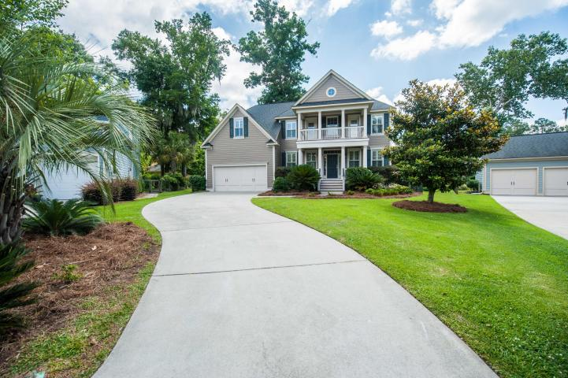
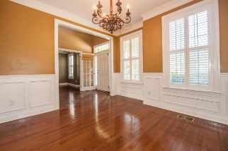
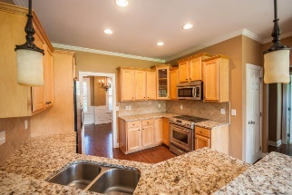
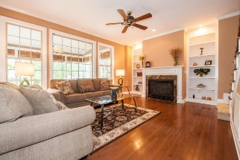
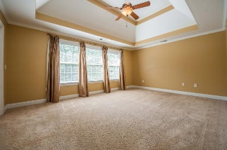
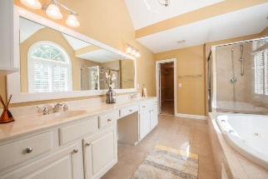
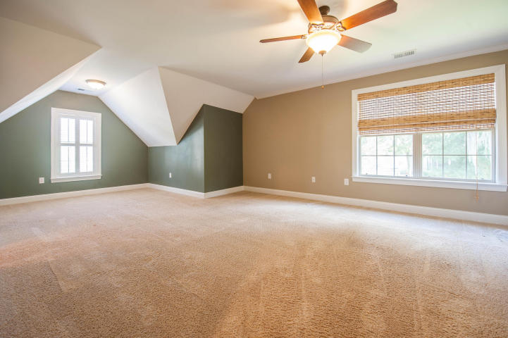
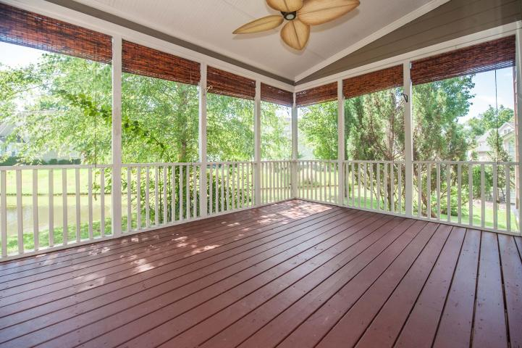
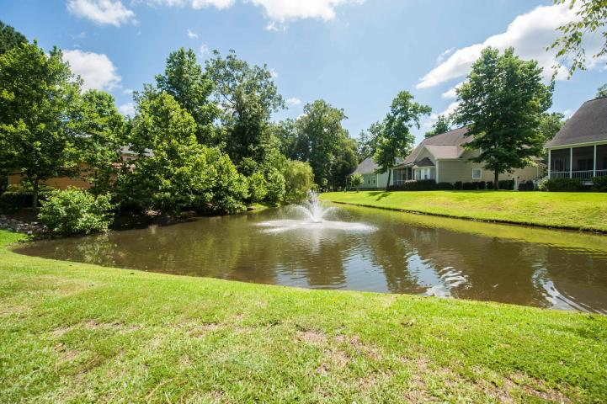

5411 Nesting Place
The Refuge at Whitehall
North Charleston, SC 29420
MLS# 16016339 | $405,900
2,869 Sq Ft - 5 Bedroom - 3 Bath
Great New Listing at the Refuge
Buying your stairway to heaven is easy in this traditional 2-story home located in the sought out Dorchester District Two school system. This home is nestled on a quiet cul-de-sac in the attentive Refuge subdivision, a family oriented community. The open floor plan encompasses three bathrooms and five spacious bedrooms with plenty of room for study, sleep and storage. Enjoy your sunny eat in kitchen, stainless steel appliances and brand new granite counter tops. The expansive family room bares gleaming hardwood floors with a gas fireplace and built in shelving with a view through the large windows to expose a spacious screened in porch that flows down onto the rear patio. Under the staircase you find your very own wine cooler! A well lit office and dinning room parallel the foyer. Upstairs the master bedroom, complete with walk-in closet and ensuite, that ensures a peaceful, private space to enjoy while over looking a scenic pond. Perfect for anyone, this home is ideally positioned to enjoy time off with amenities on the Ashley River.
Barbara Limehouse
843-870-8291
bllimehouse@gmail.com
Weichert Palmetto Coast
1035 Johnnie Dodds, Ste B2
Mt. Pleasant, SC 29464

