Slide 1

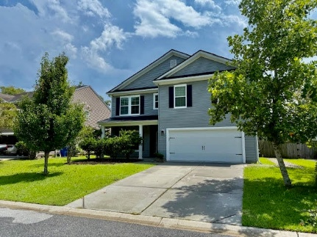
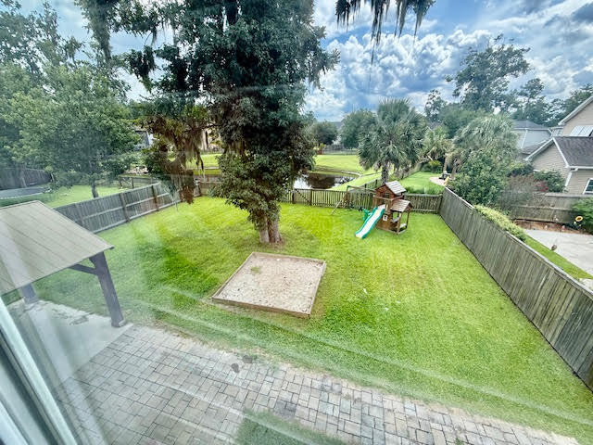
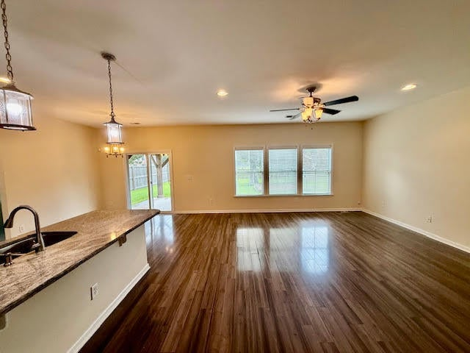
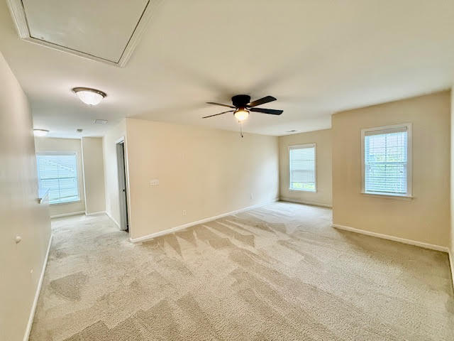
2.625% VA ASSUMABLE RATE POTENTIAL FOR QUALIFIED BUYERS!!!
$15,000
PRICE
IMPROVEMENT
5411 Overland Trail
Taylor Plantation
North Charleston, SC 29420 | MLS# 25022701 | $435,000
POND VIEWS!
AMAZING OPPORTUNITY TO STEAL THIS Beautiful home located in the sought after Taylor Plantation neighborhood! BEST PRICE IN THE NEIGHBORHOOD! This well loved home has 5 bedrooms and 3 full bathrooms, approximately 2779 square feet w/ a new ROOF (2024), with a convenient first floor bedroom next to a full bathroom. The first floor open floor plan features a nice kitchen, large family room, separate dining room, bedroom and a full bathroom. Upstairs there is a huge master suite completed with a custom tiled shower and a CUSTOM walk-in closet; 3 additional bedrooms, laundry room and a LARGE loft area perfect for family time. Additional highlights include a 2 car garage and a manicured fenced backyard that backs up to a serene POND. Conveniently located just minutes to shopping, dining, schools and the Charleston Air Force Base, this home is a must see!
Daniel Carabus
843-793-9265 | daniel@carabushomes.com
www.theblvdcompany.com
The Boulevard Company, LLC | 806 Johnnie Dodds Blvd Ste 100 | Mt Pleasant, SC 29464

