Slide 1
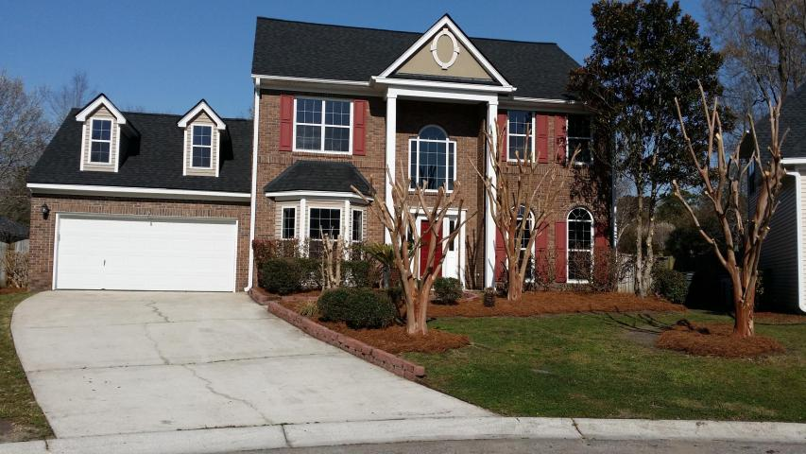
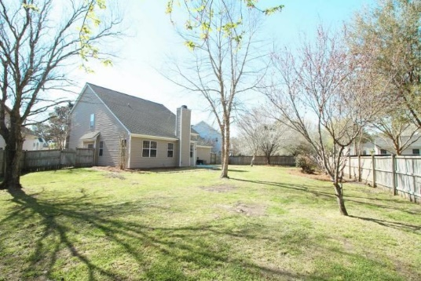
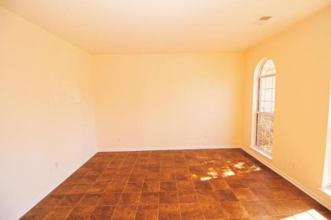
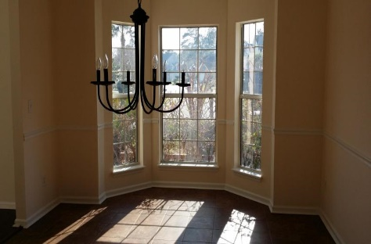
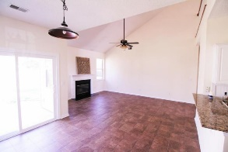
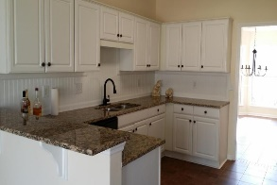
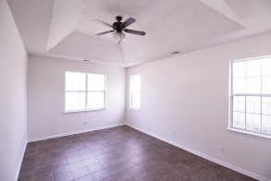
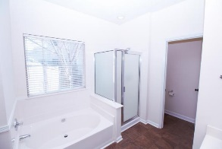
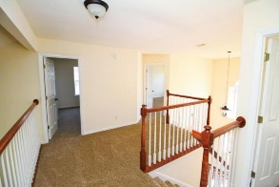
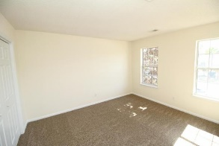


5412 Crosland Ct. West
Whitehall
North Charleston, SC 29420
MLS# 16006798 ~ $267,000
Open House
Sun. June 12th
1pm-4pm
Beautiful brick front, freshly painted, new roof, updated kitchen with granite counter top, new stainless appliances, new carpet upstairs, new hardwood foyer, tile floor, professional landscape, 4 bedrooms, 2.5 baths, family room with fireplace, formal dining, formal living or den, breakfast area, master bedroom down with trey ceilings, master bath has garden tub, separate shower, walk-in closet, 3 bedroom upstairs with loft large enough for a work desk. Large fenced in backyard and patio. Driveway extra long, 2 car garage deep enough for storing a boat. Community amenities: pool, tennis court and kids play area. Close to Charleston Airport, Boeing, down town, shopping, medical offices, and hospital. Agent does not warrant schools, sq ft, acreage. Buyer to verify. Listing agent is the owner.
Cheri Hamner
M - 843-364-4325
O - 843-261-7115
cheri.hamner@agentownedrealty.com

