Slide 1
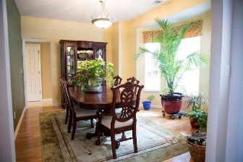
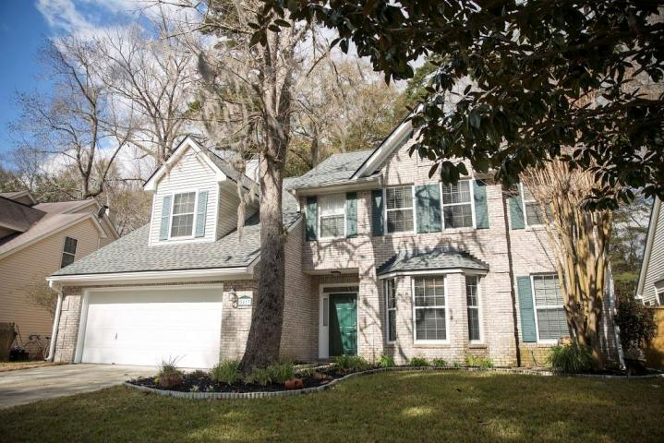
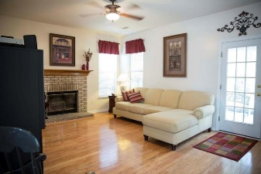
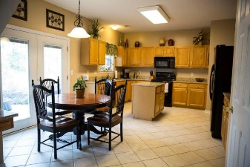
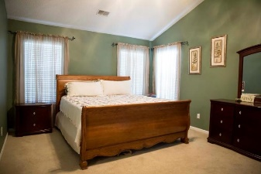
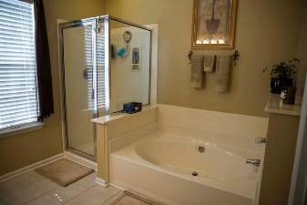
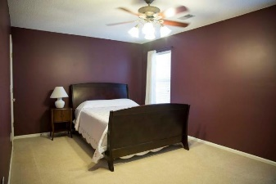
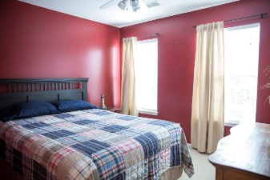
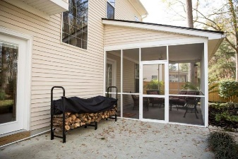
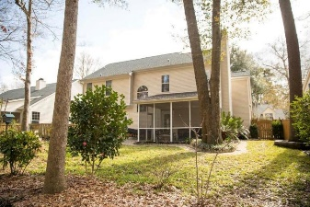


5413 Greggs Landing Drive Whitehall ~ North Charleston MLS# 16004717 ~ $249,900
Beautifully maintained home in Whitehall South!
This immaculate/updated three bedroom, two and a half bath brick veneer home features a large frog that could be used as a fourth bedroom. Home has 9' ceilings, master suite with vaulted ceiling, garden tub/separate shower. Formal dining room, eat-in kitchen and a family room with fireplace that opens out to a large screened porch, oversized patio and a nicely landscaped fenced yard. Recent updates include: new roof in 2014, granite countertops in the kitchen, updated appliance, newer wood floors in the family room, dining room and foyer. Other updates include tile floors in the kitchen, utility room and master bathroom. The upstairs carpet has been recently replaced.
Steve DeMarco
Cell - 843-442-1520 steve@beresfordappraisals.com
www.beresfordrealty.com
Beresford Realty, LLC | 672 Marina Dr, S-206B | Charleston, SC 29492

