Slide 1
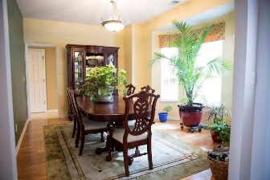
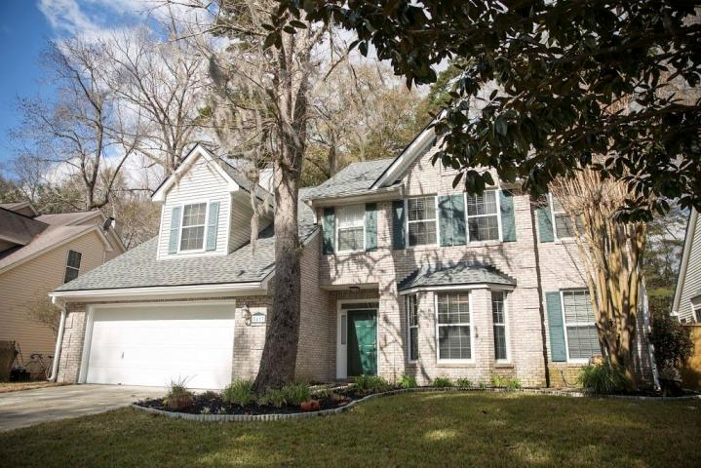
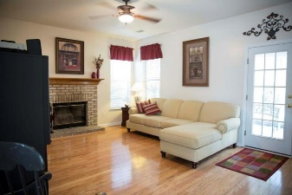
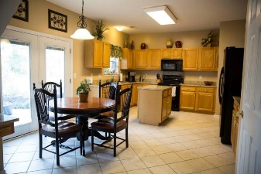
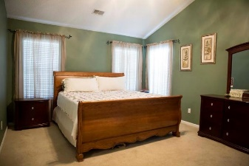
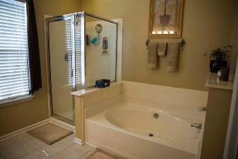
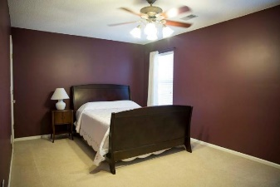
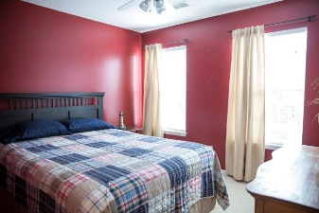
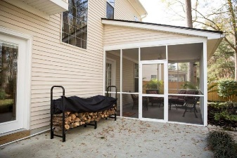
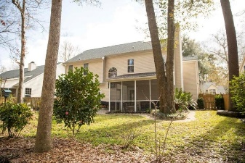


5413 Greggs Landing Drive Whitehall ~ North Charleston MLS# 16004717 ~ $245,900
MOTIVATED SELLERS!
Two new HVAC units installed 03/30/2016. Beautifully maintained and updated home In Whitehall South! The recent updates include granite countertops in the kitchen, updated appliances, new roof installed in 2014, wood floors in the downstairs have been updated, tile floors in the kitchen were installed in 2008. Great location with a short drive to shopping, Boeing, the Air Force base and dining options. Four bedroom two and a half baths with a large screened porch and oversized patio for outdoor entertainment. The wooded and fenced in back yard gives the home great privacy. Home has 9’ ceilings and vaulted ceiling in the master suite. Master bath with garden tub and separate shower and updated tile floors. A fireplace, separate dining room, updated kitchen with breakfast area .This is a must see!
Steve DeMarco
Cell - 843-442-1520 steve@beresfordappraisals.com
www.beresfordrealty.com
Beresford Realty, LLC | 672 Marina Dr, S-206B | Charleston, SC 29492

