Slide 1
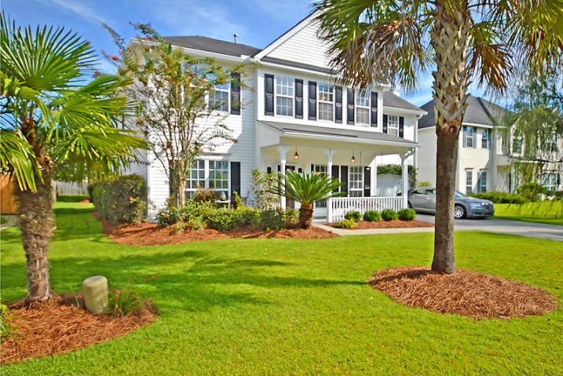
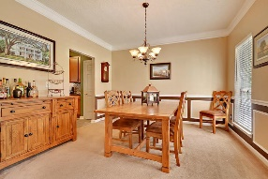
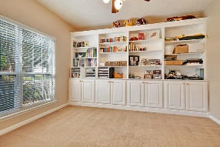
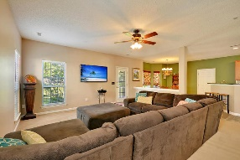
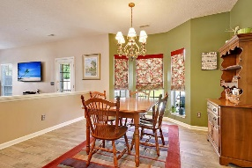
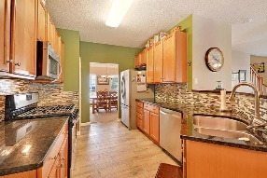
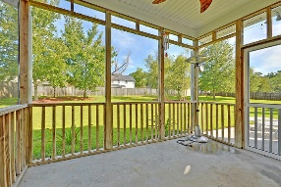
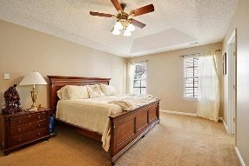
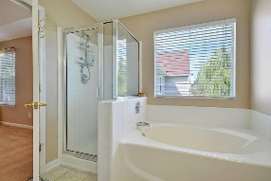
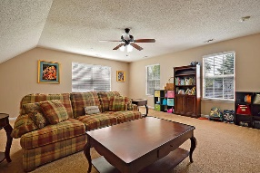
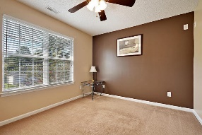
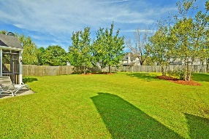
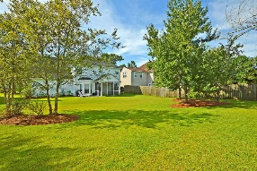


5 BR Under $300k! Close To It All In N. Charleston!
5413 Langston Park
Whitehall
North Charleston, SC 29420
MLS# 18022648
$299,900
4 Bedrooms | 3½ Baths | 2,850 sf
This 2,800 Sq. Ft., 5BR home is in excellent condition with recent upgrades to include professionally re-painted interior, new ceramic tile (wood plank style) kitchen floors and new bathroom tile floors. The spacious backyard offers plenty of room for family outdoor activities! This home also offers tons of upgrades and finishing touches that include, granite countertops, tile backsplash, custom crown molding, stainless steel appliances and much more! The floor plan is perfect for entertaining friends and family with an open concept kitchen that is open to a massive family room. The first floor offers a formal dining room, home office with built in shelving / cabinetry, excellent kitchen with eat-in area and a very spacious family room!
The master bedroom features a tray ceiling, huge walk-in closet and a large master bath with dual vanity. The other three bedrooms offer plenty of closet space and easy access to the common bath. The massive FROG is counted as the 5th bedroom and makes the perfect guest room, playroom, media room or game room. The living space continues outside with two great outdoor spaces. One is a large screened porch just off the living room and the other is a good size outdoor patio overlooking the huge back yard! Whitehall offers the highly rated Dorchester District II Schools and one of the best locations in North Charleston with easy access to Dorchester rd, I-526, I-26, Boeing, Charleston international airport, downtown Charleston and area beaches. Great neighborhood amenities include a pool, tennis courts, playground and ball fields!
Larry & Kathy Mazalatis
Larry Cell 843-693-0529
Kathy Cell 843-693-0159
Office 843-871-9133
AGENTOWNED PREMIERE GROUP | 1800 TROLLEY RD | SUMMERVILLE, SC 29485

