Slide 1
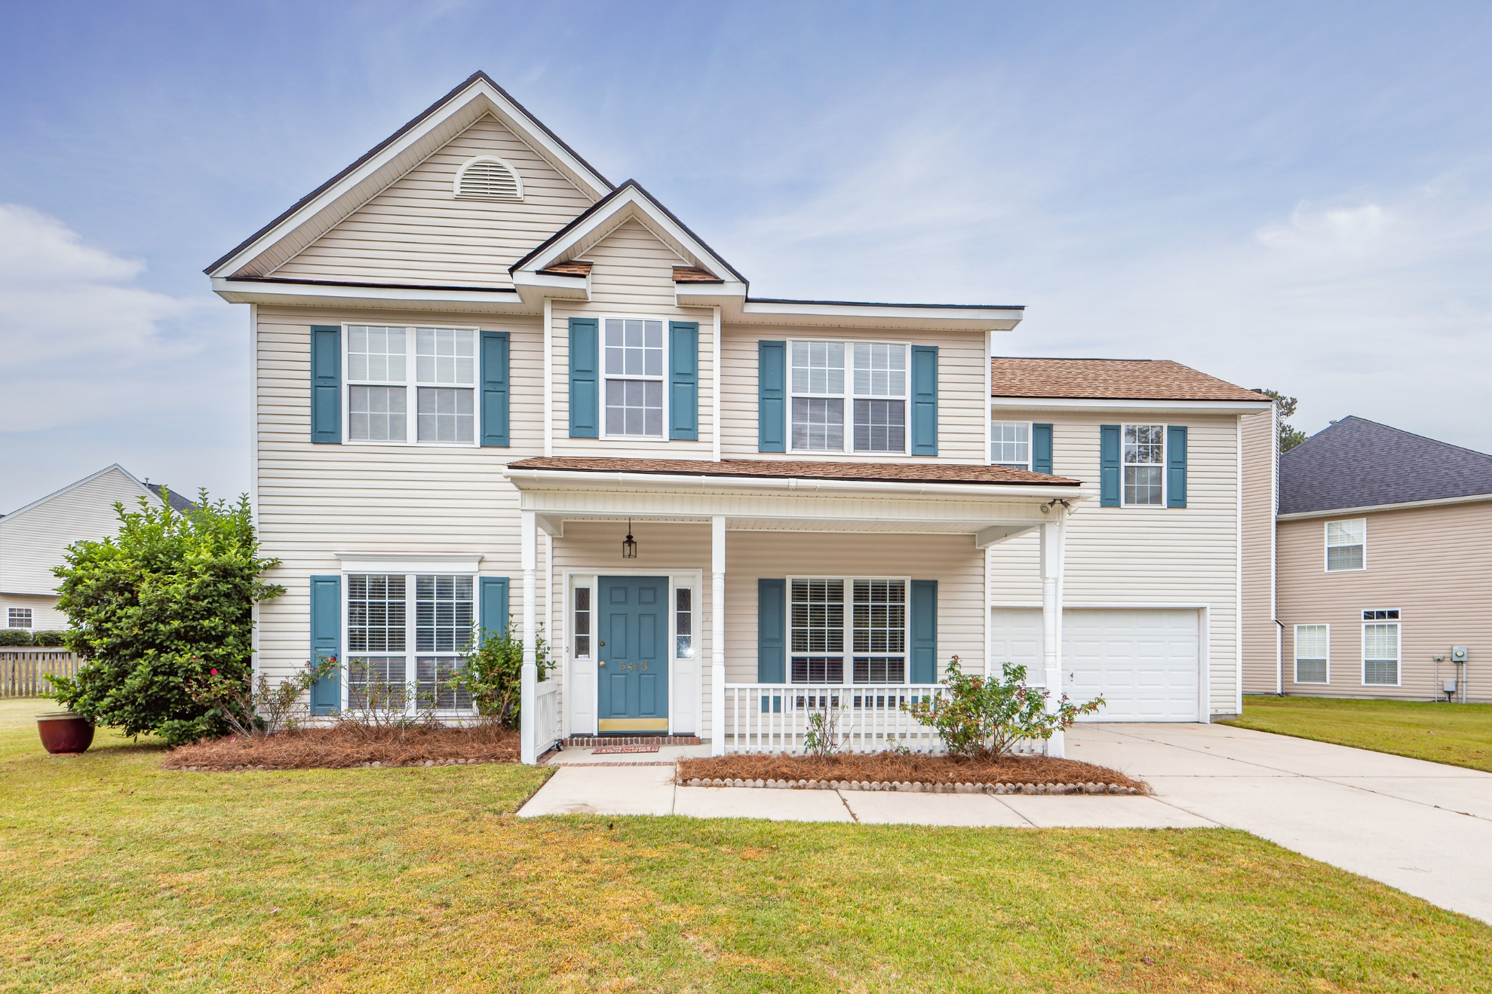
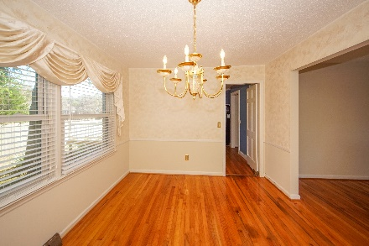
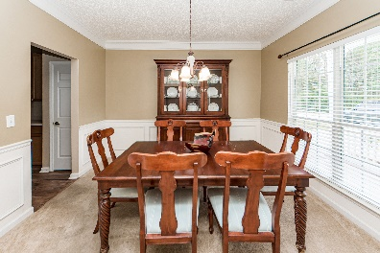
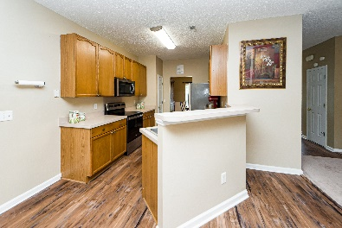
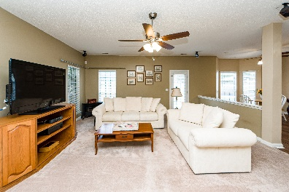
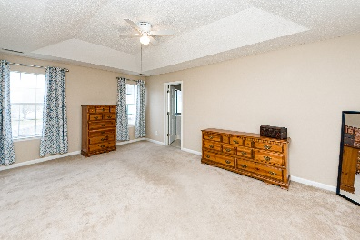
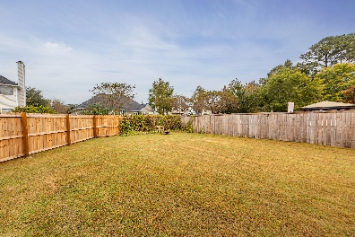


5413 Red Tip Lane
Whitehall | North Charleston, SC 29420 | MLS# 22027408 | $425,000
Otranto Beauty
$318,000
Open House
Saturday Nov 12th
11am to 3pm
Hosted by Alivia Brinson
Open House Sunday 12:30-3:30
Stunning home in Whitehall! Own a traditional 2 story home featuring 4 bedrooms plus bonus room. First floor offers formal living, formal dining, spacious living room and eat in kitchen with plenty of cabinets, counter space and stainless appliances. Master bedroom is upstairs with separate shower, soaking tub, double sink vanity and walk in closet. Secondary bedrooms are spacious and the bonus room is a perfect fifth bedroom, family room/man cave or private office. Positioned in a cul-de-sac, this home has an oversized lot with a view of a wooded treeline. New Roof installed 2020 and New down stairs AC installed 2022. Enjoy the neighborhood pool, play park and tennis courts living in a convenient location to shopping, restaurants, airport, I26 and I526. Whitehall is located in Dorchester County. Ask about the CCM Super Saver Program!
Come take a virtual tour: https://charlestonvirtualhomes.com/2220412
Connie White, Broker
843-532-3356
connie@conniewhiteteam.com
conniewhiterealestate.com
Connie White Real Estate Brokers By EXP· 102 Six Point Court· Goose Creek, SC 29445

