Slide 1
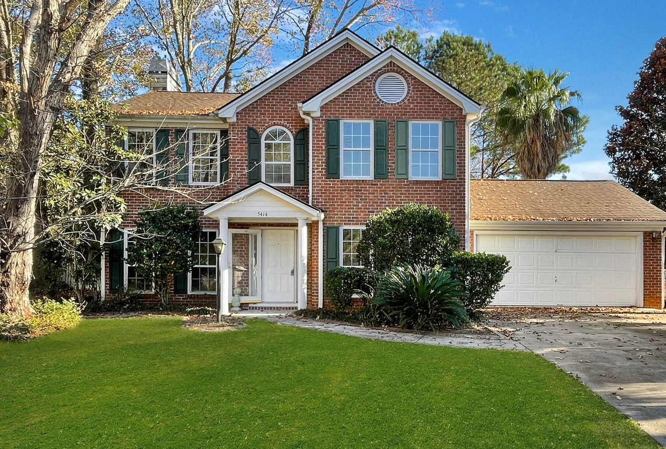
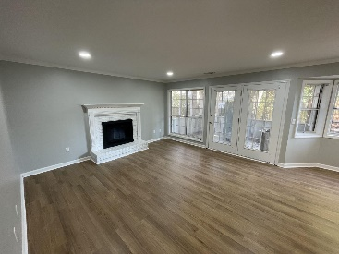
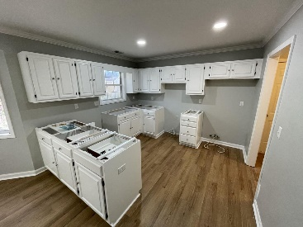
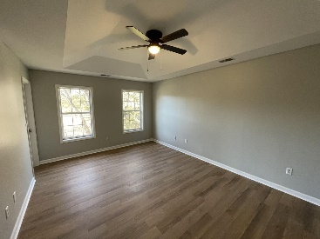
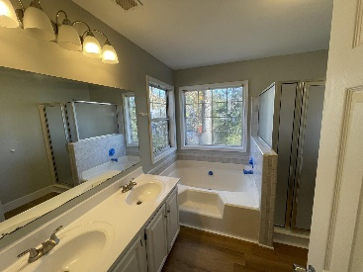
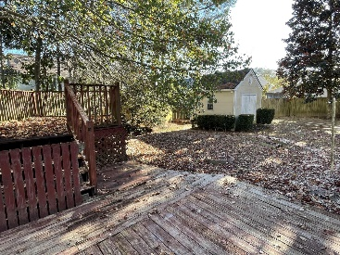



RENOVATED WITH OVER $45,000 IN WORK!
5414 Ansley Trail
Appian Landing
North Charleston
MLS# 22030514
$350,000
4 Bed | 2½ Bath | 1,961sf
DORCHESTER SCHOOL DISTRICT 2! New floors throughout the entire house, new carpet on stairs, repainted mantle/brick on fireplace, fresh painted wainscoting in dining room, new baseboards, fresh paint throughout, new fixtures, new hardware, new ceiling fans, new toilets, new subway tiled guest bathroom, fresh painted kitchen cabinets, new countertops (being installed). The list goes ON! Few cosmetic items are still being finished up and will be finished prior to closing. You truly need to come see this wonderful home. Located on a ''crescent'' (type of cul-de-sac!), this wonderful 4 bedroom, 2.5 bathroom and almost 2,000sqft home is ready for its next owner!
Air handler is 5 years old, condenser is around 10 years old, and ARCHITECTURAL ROOF IS ONLY 6 YEARS OLD! Located in a family-oriented neighborhood with VERY LOW HOA FEE, its location is just the cherry on top! Appian Landing is located within the wonderful River Oaks neighborhood, offering prime location RIGHT NEXT TO grocery stores, gas stations, gyms, restaurants, bars, retail stores, department stores, wholesale stores, liquor stores, auto part stores, doctor's offices, and SO MUCH MORE! ALL RIGHT OUTSIDE YOUR NEIGHBORHOOD! Sellers are offering a $5,000 CREDIT toward loan buy-down. Come take a look at this wonderful home today!
Nick Mazzilli
(843) 640-5575
nick@nickmcharleston.com
nickmavencharleston.com
Maven Realty
2180 McMillan Ave
#71672
Charleston, SC 29405

