Slide 1
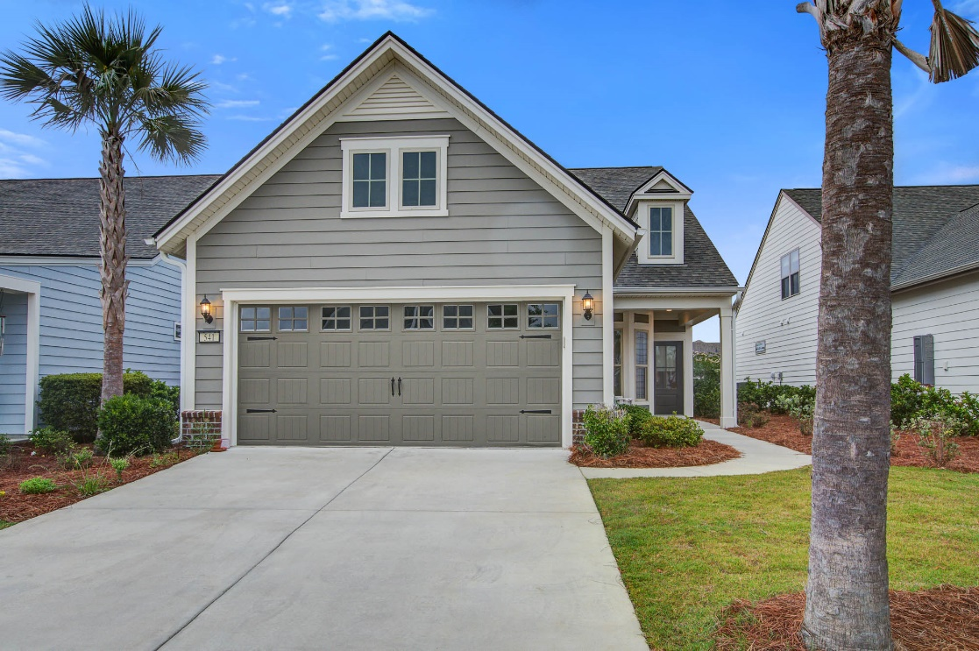
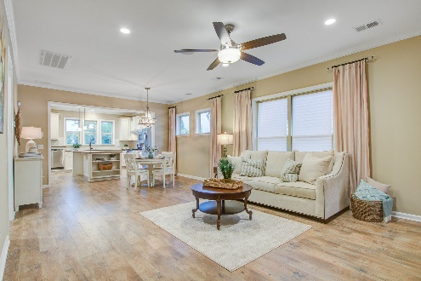
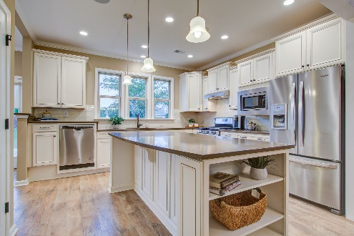
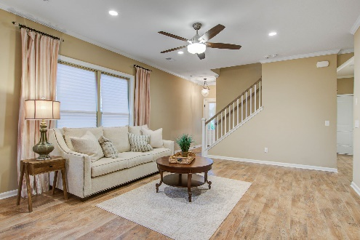
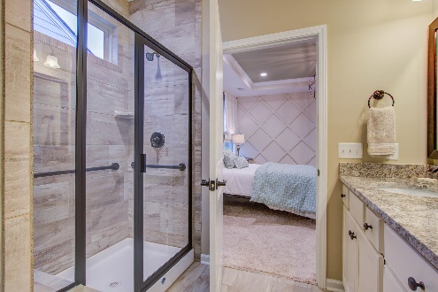


Stop By Thursday, September 21st 11-2
OPEN
HOUSE
541 Willow View Way
Nexton · Summerville, SC 29486
MLS# 23011383 · $574,900
Michael Dew
O 843-769-5100
M 843-870-7000
michaeledew@gmail.com
www.michaeldewrealestate.com
Fabulous Location! Former model home with all the upgrades across the street from the amenity center, gym and pool. Extremely well cared for 3 bed 3 bath home in Del Webb. Beautiful engineered hardwood flooring in main living areas. Oil rubbed bronze fixtures and hardware in entire home. Crown molding throughout. Beautiful kitchen with stainless steel appliances, white cabinetry with soft close drawers, tiled back splash, gas cooktop, and huge island with pendant lighting. Separate dining area and family room. Whole house surround sound system. Glass doors leading to study with accent wall. Beautiful downstairs master with tray ceiling, walk in closet and ensuite with dual sinks and tiled walk in shower. Additional bedroom and bath downstairs. Upstairs is a guest retreat with living area as well as bed and bath. Massive storage above the 2 car garage. Gorgeous paver patio with outdoor fireplace. Irrigation system for beautifully manicured yard. Must see! Minutes from everything Nexton has to offer and beautiful downtown Summerville.
AgentOwned Charleston Group
902 Savannah Hwy
Charleston, SC 29407
Real Estate ● Mortgage Insurance ● Business Brokerage

