Slide 1
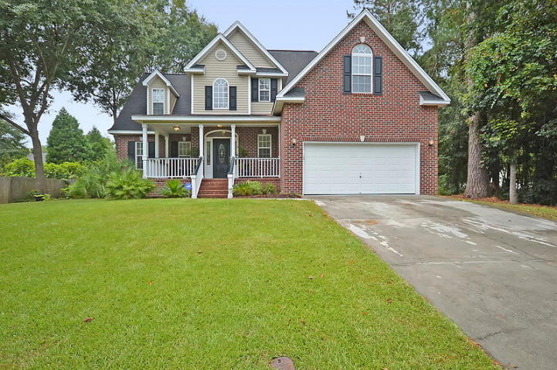
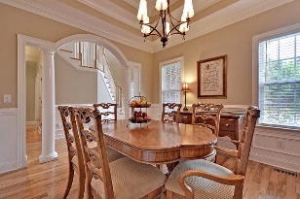
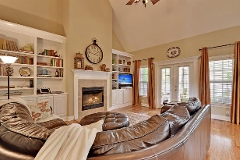
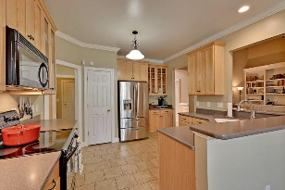
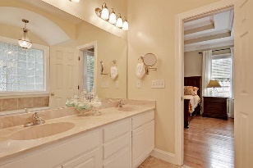
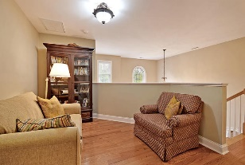
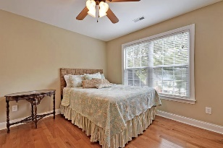
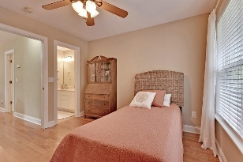
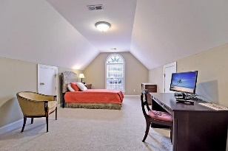
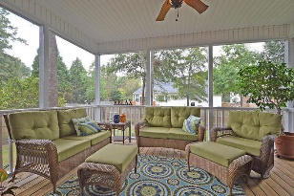
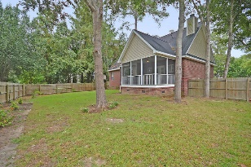
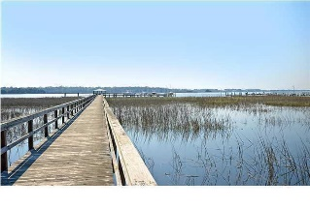

5420 Indigo Fields Boulevard North Charleston, SC 29418 MLS# 16023508 | $325,000
Loaded with Updates
Just Listed in Indigo Fields
Beautiful and inviting 4 bedroom, 2.5 bath brick home with a welcoming front porch. Dramatic two-story foyer with a large decorative chandelier greets you as you enter with handsome hardwood floors throughout. The gorgeous formal dining room has a stunning arched entryway flanked by two columns, a trey ceiling, lovely chandelier, chair rail trim, two over-sized windows, and can easily handle your largest dinner party. Walk into the family room with its soaring two-story Cathedral ceiling, the large fireplace with built in media shelves/bookcases and the wall of windows, French door leading to the huge screen porch ideal for relaxing with a good book. The family room is open to the spacious eat-in kitchen with an expansive bar top and is perfect for entertaining with its mix of open floorplan and formal well-dressed spaces. The kitchen has beautiful true maple wood Shaker style cabinets and an absolute ton of counter space-the home chef will love all this space! Walk down a private hallway into the spacious master bedroom suite with an abundance of natural light and tons of space. The master bedroom has the same flair for style as the rest of the house with the triple trey ceiling, a HUGE walk in closet and a spa-like master bathroom with its exceptionally deep-jetted soaking tub with arched ceiling and chandelier! Other features of the master bath: separate shower, dual vanities, and tile floors. Upstairs there are two formal bedrooms, a large finished room over the garage for a 4th bedroom AND a loft, plus a huge secondary bathroom with dual vanity. The fenced back yard has plenty of room for a swing set and/or grilling area. This wonderful home has so much to offer-call today to be the first to see!
Stan Huff
843-670-2835 stan.huff@agentowned.com
Jill Marcacci
843-297-5590 jill@agentowned.com
www.agentownedrealty.com
AgentOwned Realty Co. Preferred Group, Inc. | 824 Johnnie Dodds Blvd | Mt Pleasant, SC 29464

