Slide 1
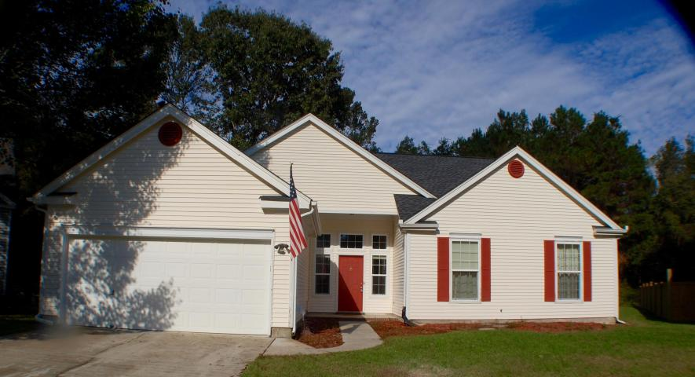
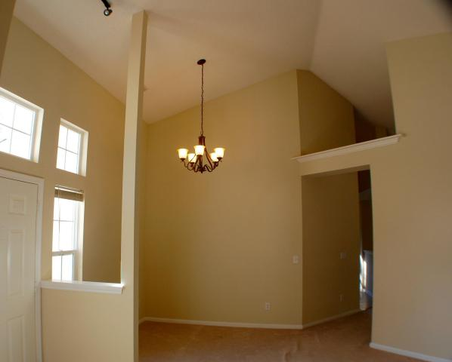
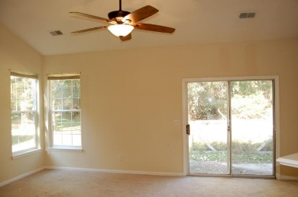
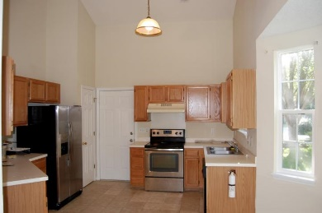
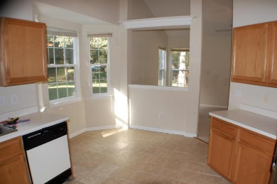
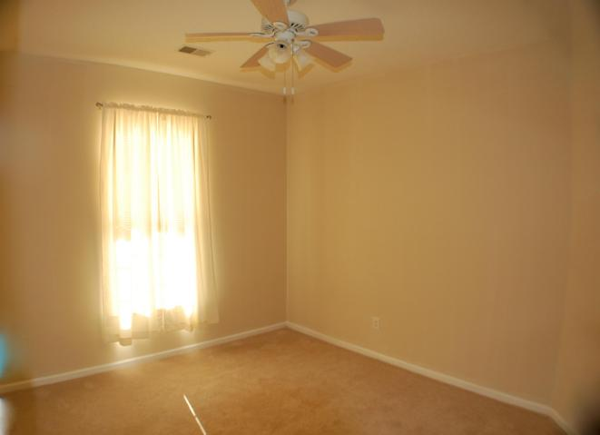
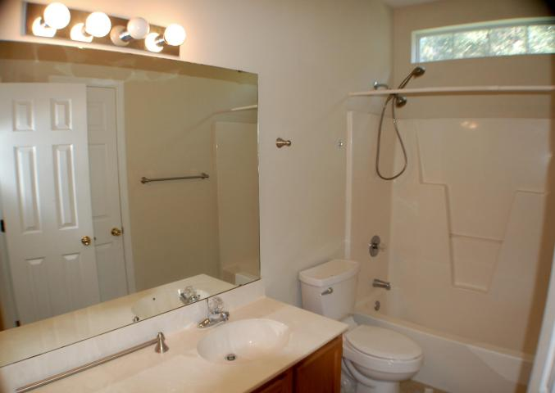
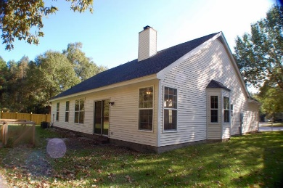
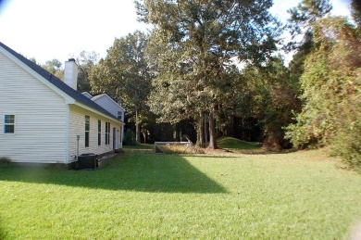


5420 Percival Lane
Whitehall
North Charleston
MLS# 15028227
$185,000
3 Beds | 2 Baths
1,702 Square Feet
Have it all!
One story living. New roof! New Fabulous Updated Master Bath with HUGE JACUZZI TUB, New windows. Huge yard. Wooded view. Newer kitchen appliances.
Flexible floor plan (Family rm w fireplace, dining area and living room too!) and great closet space. Real laundry rm not a closet! Cul de sac location and Dorchester II schools. 10 minutes to Boeing/Airport. 20 minutes to downtown Charleston. Please schedule your showing quickly!!
This one will be gone!
Di Johnson
843-270-6448
dijohnsonsc@gmail.com
www.agentownedrealty.com
AgentOwned Premiere Group
100 Crowfield Blvd
Goose Creek, SC 29445

