Slide 1
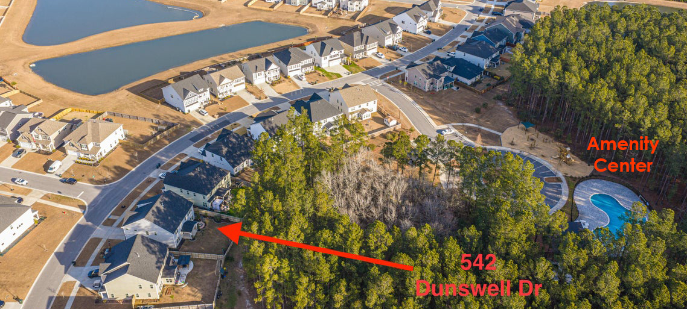
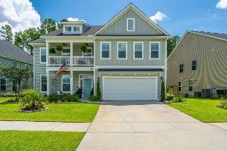
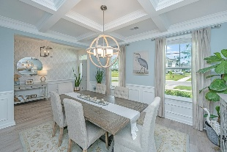
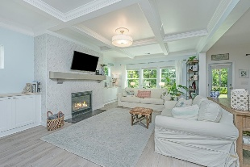
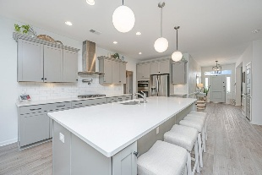
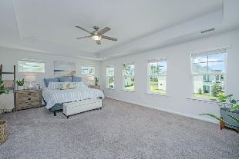
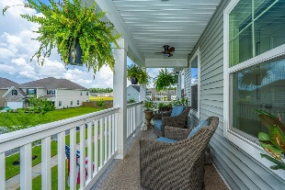

542 Dunswell Drive
Cane Bay Plantation · Summerville, SC 29486 · MLS# 25021141 · $624,500
Open House Saturday, February 28th from 2-4pm
Welcome to 542 Dunswell Drive, situated in the distinguished Mungo-built Lochton Community within Cane Bay Plantation. Lochton offers an intimate setting with only 210 residences, fostering a close-knit community environment. Upon arrival, double front porches evoke classic Low Country charm. The entryway features a proper foyer enhanced by wainscoting, 9-foot ceilings, and upgraded luxury vinyl plank flooring extending throughout the main living areas. To the left of the foyer, a spacious dining room is accentuated by a coffered ceiling and a hand-stenciled accent wall. The open-concept design seamlessly integrates the gourmet kitchen, family room, and eat-in area. The family room includes a coffered ceiling, gas log fireplace with marble tile surround, and custom cabinetry with butcher block tops. The kitchen boasts quartz countertops, 10' kitchen island, tiled backsplash, under cabinet lighting, wall-mounted pot filler, stainless steel appliances, and substantial storage options including an oversized pantry adjacent to a custom drop zone and built-in desk. The first floor also offers a guest bedroom with en-suite bath, ideal for visitors, multi-generational living, or as a private office space. Upstairs, the expansive owner's suite features a private balcony, tray ceiling, dual walk-in closets, extended dual vanity, separate water closet, large garden tub, and a ceramic-tiled walk-in shower. Three additional bedrooms are located on this level: one with a private bath, and two sharing a Jack and Jill bathroom. A generous bonus room provides flexible space suitable for a game room, media room, exercise studio, homeschooling area, or additional family room. The sizable laundry room is conveniently located upstairs. The backyard presents a covered porch overlooking a beautifully landscaped garden with an Alexa-controlled fountain. Mature plantings, irrigation system and a fully fenced yard with a gated, trellised entrance and a flagstone pathway offer privacy and tranquility. Several extras to mention: A Generator Panel Interlock installed in the garage, whole house 6 inch gutters, transferable Builders Warranty and the Arlo Doorbell and Camera's will convey. Lochton amenities are just a short walk and feature a tree-lined neighborhood pool and playground. The Cane Bay amenities include 12+ miles of trails, a state-of-the-art YMCA, fire station, schools, grocery stores, shops, and restaurants - all golf cart accessible. This meticulously maintained property combines comfort, style, and functionality!
Nickole Samios
(843) 330-4136
nickole@carolinaone.com
Carolina One Real Estate
900 N Main St
Summerville, SC 29483
www.summervillesouthcarolinahomes.com

