Slide 1
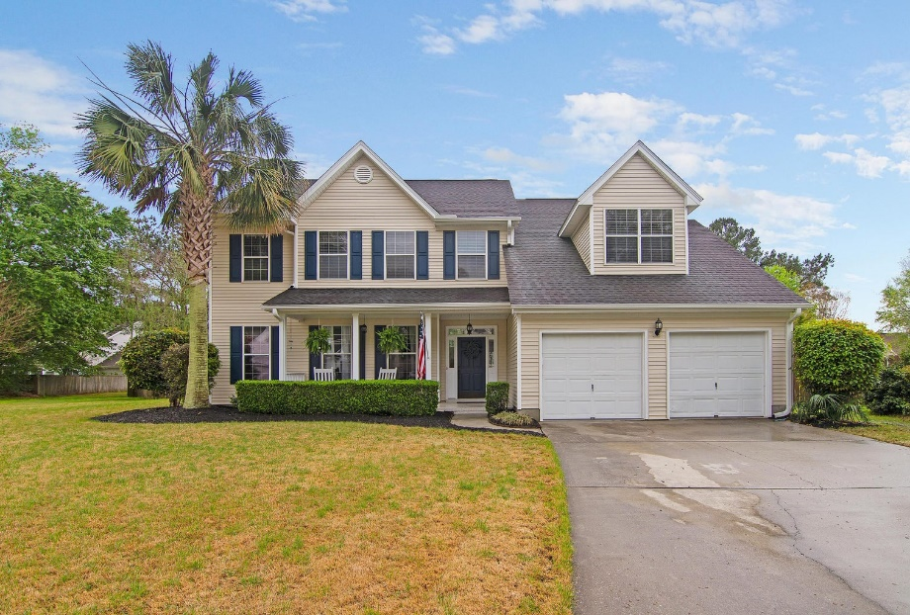
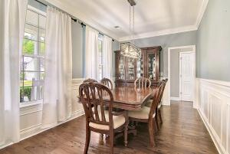
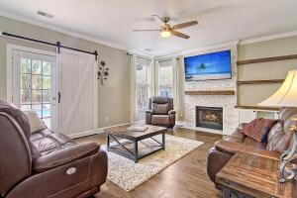
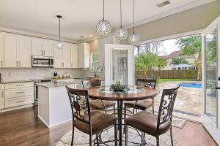
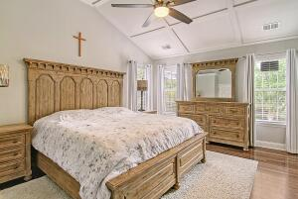
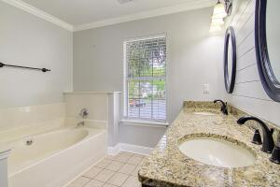
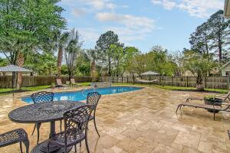
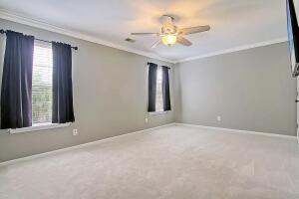
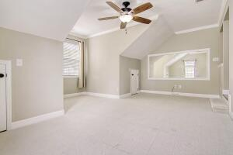
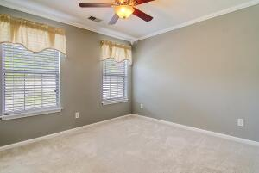
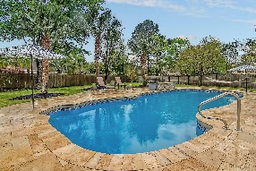
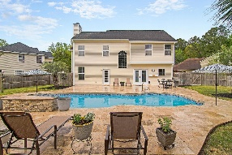
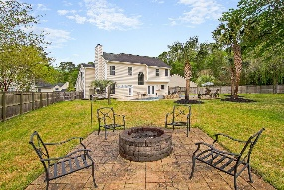


Cul-de-sac Home With An In-ground Pool!!
5431 Altamaha Drive
Whitehall
North Charleston, SC 29420
MLS# 23006899
$449,900
3 Bedrooms | 2½ Baths | 2,258 sf
Get ready to spend the summer poolside! Welcome to 5431 Altamaha Drive where the backyard is your own piece of paradise with a beautiful in ground salt water pool including a waterfall and travertine tile surround. Palmetto trees surround the pool to give you the feeling of being on vacation! The backyard also offers a fire pit, hammock area plus plenty of green space. Located in a cul de sac, this home offers lovely landscaping, a large fenced in backyard and a full front porch for relaxing. Upon entering, you'll immediately notice the wood flooring, beautiful light fixtures, wrought iron stair rails plus beautiful trim work and shiplap. The dining room, with an arched entry way, is to your left and is the perfect size for entertaining. Continue on to the family room which is a great size and offers a beautiful stacked stone fireplace and shelving which is the focal point of the room.A barn door which has access to the backyard behind it gives the room an extra homey feel. The kitchen has updated cabinetry, granite countertops, tiled backsplash, stainless steel appliances, an island, pantry and eat in kitchen area. Off of the kitchen is the laundry room with custom cabinetry as well a half bath. Head upstairs to the primary bedroom which is a great size and has a shiplap accent wall as well as trim work on the vaulted ceiling. So many special touches that make this room stand out! The primary bath has dual vanities as well as a separate shower and jetted tub. Down the hall you'll find two more bedrooms as well as a full bath in the hall and the large bonus room. This room can easily be a 4th bedroom if needed. This home is just what you've been waiting for! A short drive to the airport, Boeing and Palmetto Commerce Park. All the shopping you need is within a mile of this home and this neighborhood attends Dorchester District 2 schools!
Come see this beautiful home today!
Larry & Kathy Mazalatis
Larry Cell 843-693-0529
Kathy Cell 843-693-0159
Office 843-871-9133
AGENTOWNED PREMIERE GROUP | 1800 TROLLEY RD | SUMMERVILLE, SC 29485

