Slide 1
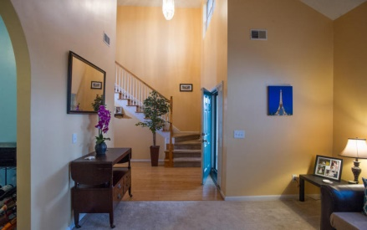
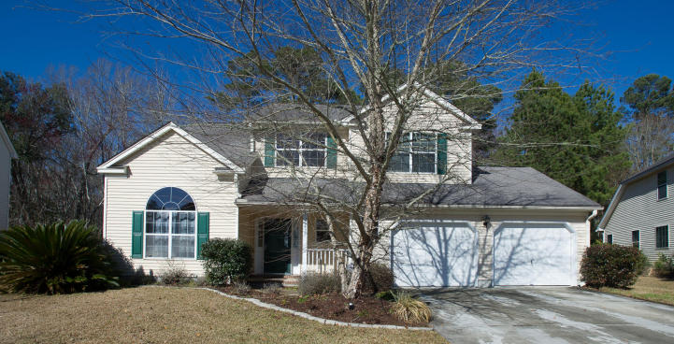
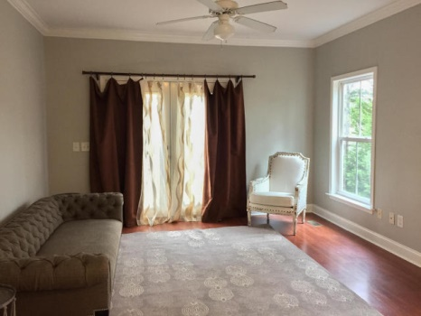
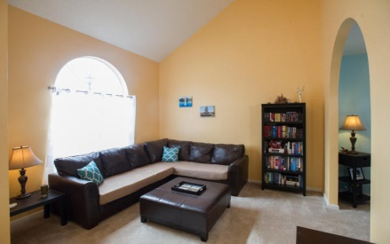
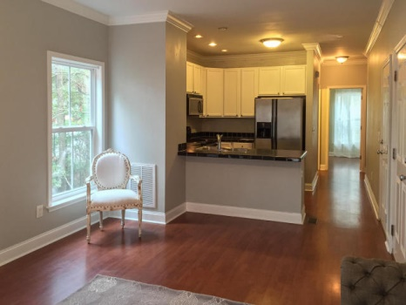
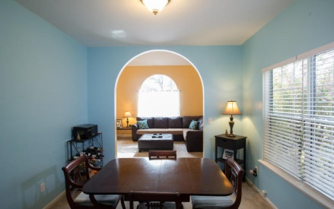
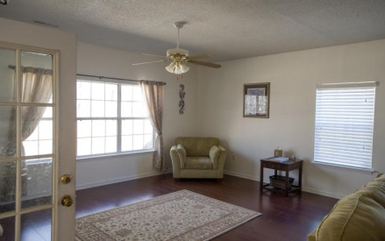
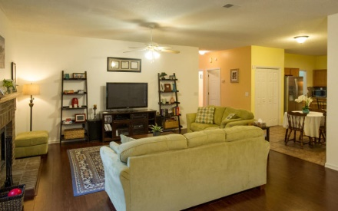
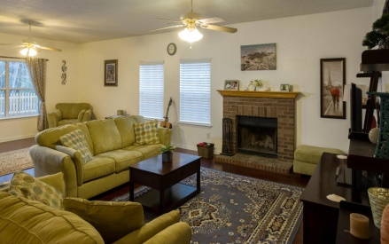
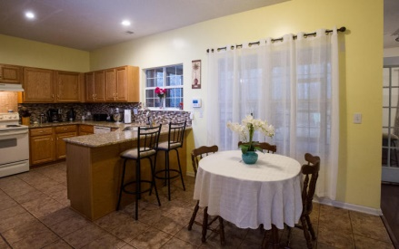
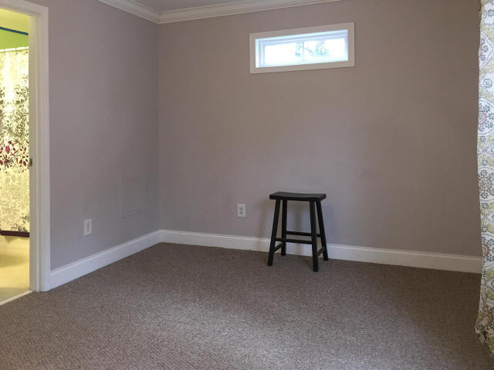
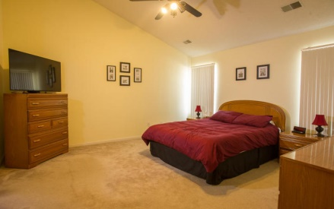
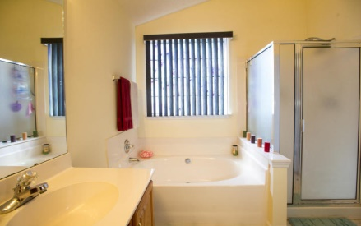
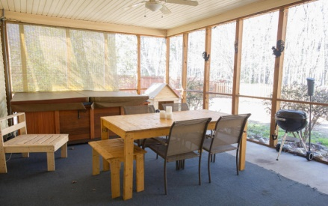


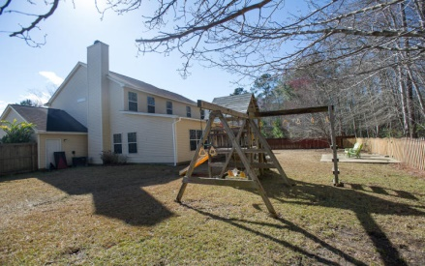
5436 Altamaha Drive Whitehall Plantation ~ North Charleston MLS# 15002765 ~ $255,000
Open House Thursday 12-2 $50 Gas Card
Folks look no further! You've found your dream home! This home has many wonderful features including a beautiful back yard that backs up to wetlands for privacy and an oversized screened in porch with a hot tub....yes that’s right....a hot tub! Inside you will find ample amounts of living space including a extra large family/great room with a fireplace and a lovely eat in kitchen that opens to the family room. The kitchen has a gorgeous backsplash with granite counter tops and tons of cabinet space. There is a formal dining room just off of the kitchen that leads into a lovely formal living room which has a nice sense of space with its vaulted ceiling! There is a half bath in the hallway next to the very large laundry room. Upstairs there are 4 bedrooms including the master bedroom. The master bedroom is quite large and boasts a walk in closet and a lovely en-suite bathroom. The other 3 bedrooms are also of generous size which makes this home perfect for a large family or buyers needing extra room for office space. Don't miss out on this opportunity to live in one of the Charleston Area's most coveted neighborhoods. Whitehall Plantation is a lovely community that includes a neighborhood pool, walking trails and a play park for the kids or grandkids! Schedule a showing today!
Carey Nikonchuk
(843) 276-1701 M
cnikonchuk@gmail.com
www.palmettoproperty.net

