Slide 1
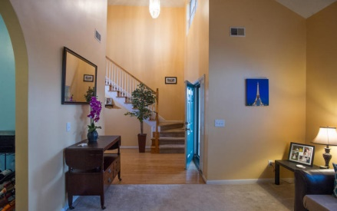
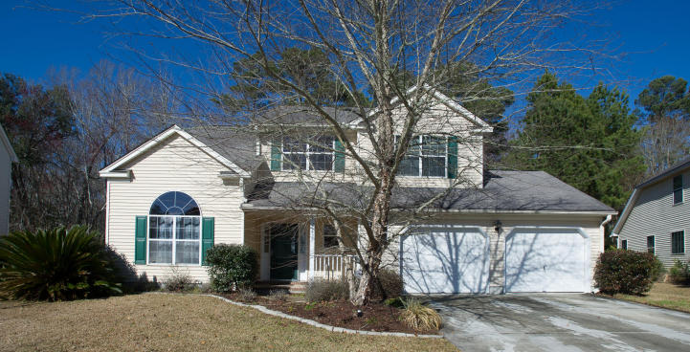
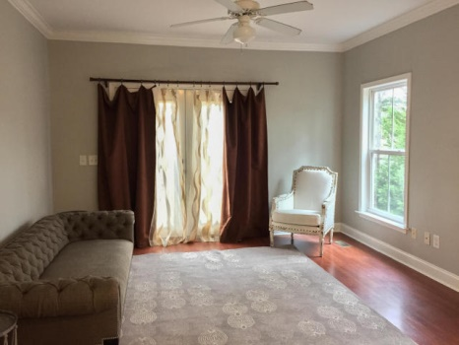
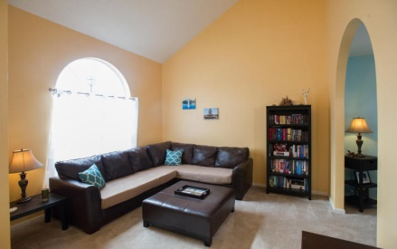
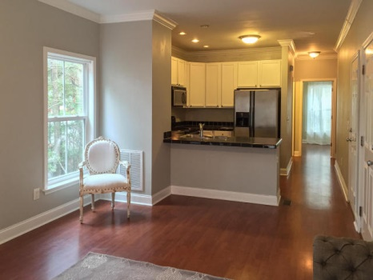
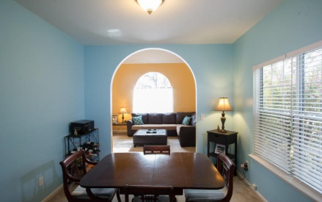
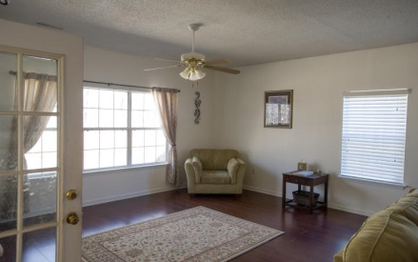
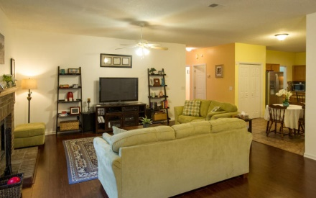
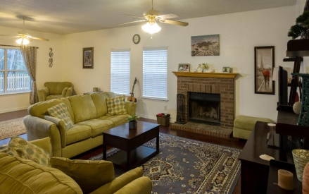
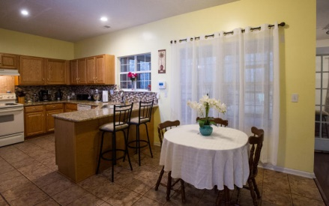
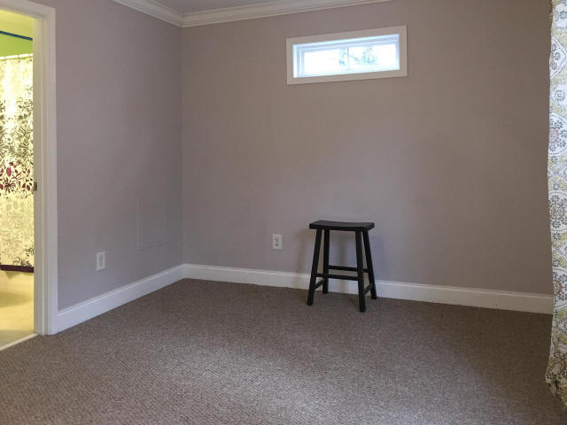
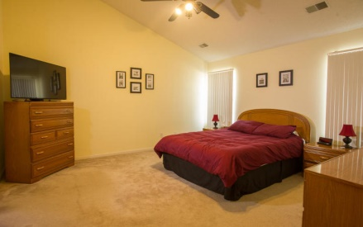
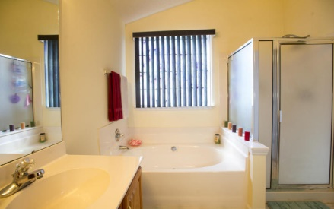
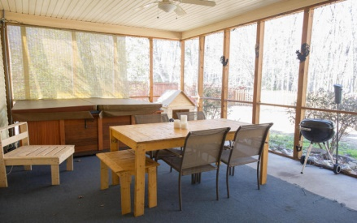


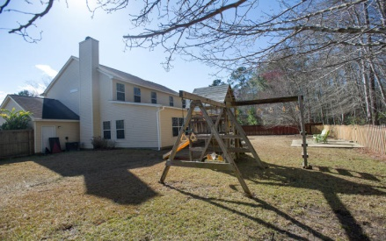
5436 Altamaha Drive
Whitehall Plantation ~ North Charleston
MLS# 15002765 ~ Just Reduced to $248,500
Open House Sunday 1-3
Beautiful and spacious 4 bedroom / 2.5 bath home for sale in Whitehall. Conveniently located minutes from Boeing, Air Force Base, Charleston Int’l Airport, I-26/I-526, new Westcott shopping center, and Fort Dorchester High School. The property is situated on a cul-de-sac and backs up to protected wetlands providing excellent privacy. Downstairs offers an open floor plan including a formal living room, formal dining room, kitchen, breakfast area, great room, half bath, and laundry room. The great room has new laminate flooring, a wood fireplace, large windows providing natural light, and a huge area for entertaining and spending time with family and friends. The kitchen has granite counter tops offering much counter space, along with abundant cabinet room and a pantry. A spacious, screened in porch off the great room and kitchen offers a relaxing area to enjoy the outside and will convey with a Hot Tub! The porch overlooks a very large and private back yard that is newly fenced in. Also, a well built and fun play set will convey with the property or can be removed upon request. Upstairs are 4 bedrooms with the master bedroom having vaulted ceilings, walk-in closet, and a large bathroom with stand up shower and garden tub. The other three bedrooms are freshly painted and include two large bedrooms with desired closet space and one bedroom that can be used as a bedroom or large office. An attached two car garage gives ample space for vehicles as well as enough room for a workshop and storage. Up to a $3,000 carpet/flooring allowance with the right offer. Additionally, remaining laminate floors (413 sq ft - same as the great room) can also be negotiated with flooring allowance. Whitehall offers a community pool, tennis courts, playground, and open field for other sports only blocks away from this home. Schedule an appointment soon!
Carey Nikonchuk
(843) 276-1701 M
cnikonchuk@gmail.com
www.palmettoproperty.net

