Slide 1
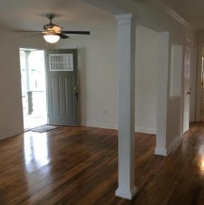
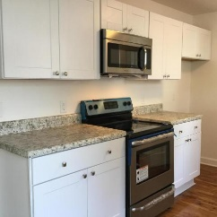
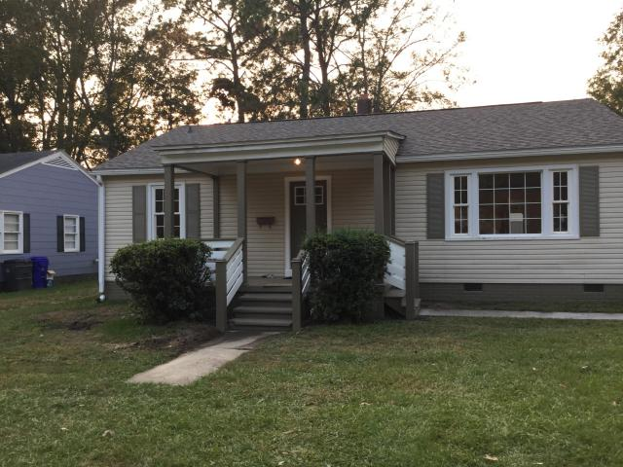
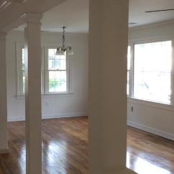
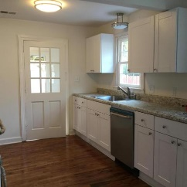
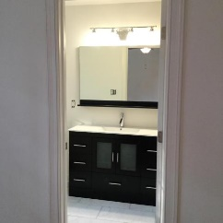
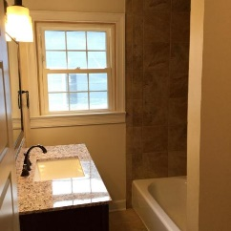
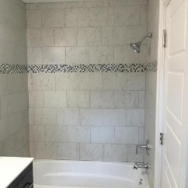
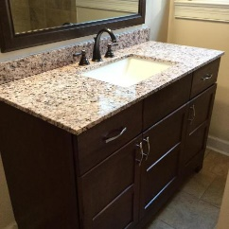

House and Cottage near Park Circle
5439 Marie Street
Charleston Farms ~ North Charleston
MLS# 16029418 ~ $197,500
RARE FIND! Completely remodeled 3 bed/ 2 ba house with a 700 sq ft detached cottage in back . This is a great location close to Park Circle. House has been completely rewired, new Architectural Shingled roof, open kitchen with new counters, cabinets and stainless steel appliances, master bath with high end vanity with gorgeous tile job. NEW (plumbing, light fixtures, ceiling fans, interior and exterior cottage style doors, painted throughout with Sherwin Williams paint, front and back porches, hall bath with new toilet, vanity with granite top, new floor and tiled tub surround, laundry room.). Cottage is also being remodeled and has kitchen with small fridge, microwave, 1 bedroom, bath, and living room. Cottage has wall mounted heat pump that heats & cools. DON'T MISS THIS GREAT DEAL!
Coastalina Realty of Charleston
916 Palm Blvd
Ste 101
Isle Of Palms, SC 29451
Dar Venable, Realtor
Mobile - (843) 330-2424
dvislander@bellsouth.net
coastalinarealtyofcharleston.com

