Slide 1
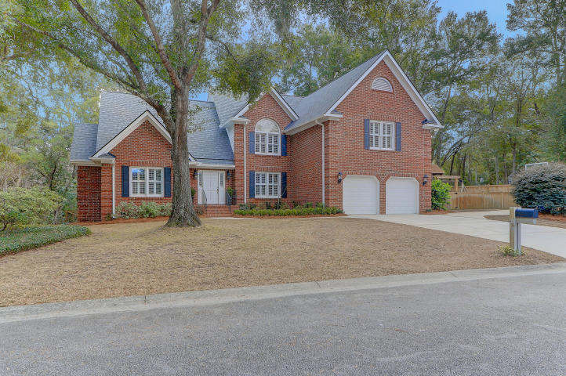
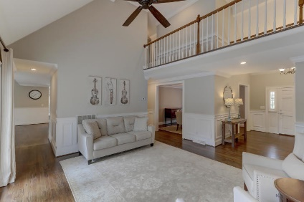
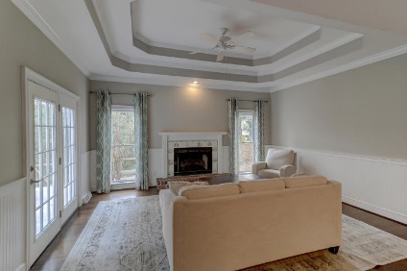
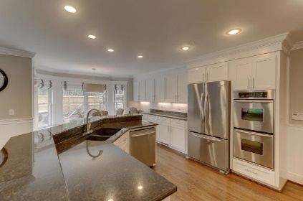
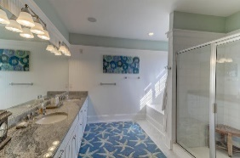
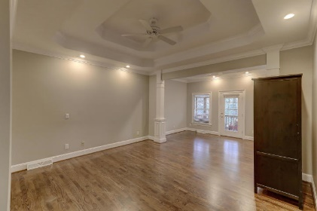
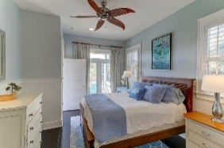
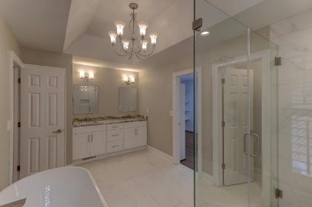
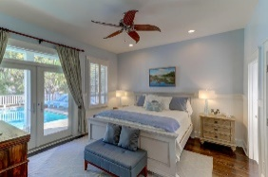
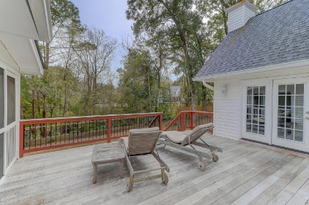
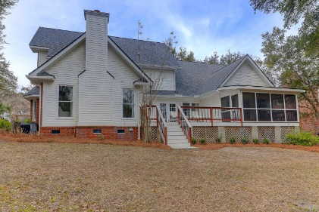
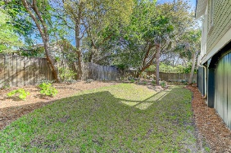


543 Flambeau Retreat
Molasses Creek | Mount Pleasant
MLS# 19004340 | $879,000
Just Listed
Beautifully Renovated
Master Down
Open House This Weekend
1:00 - 3:00 Both Days
Welcome to 543 Flambeau Retreat! This stately, brick home offers a nice sized, private lot with large fenced back yard, a deck off the back and a porch off the master. An exceptional large dining room that can accommodate a large dining table and buffet. The kitchen offers stainless steel appliances, wine cooler, double ovens, an abundance of cabinetry and a generous walk in pantry. The eat in kitchen is filled with natural light, cafe seating as well as a desk area. Open to the kitchen is the family room with a gas log fireplace and beautiful wainscoting. The formal living room feels like a retreat with elevated views of the trees in the backyard. The 1st floor master is complete with a totally updated master bath with a custom shower, large oval soaker bathtub, double sinks with quartzite terra bianca counters, and carrara tile on the floors and shower. All the baths in this home have been tastefully renovated. A separate gas line for the grill on the deck, tons of attic storage, ipe decking on the deck and 2 car garage. Molasses Creek is a high desirable neighborhood and close to shopping and downtown. This home is easy to show.
Darlene Smith
Office - (843) 886-8110
Mobile - (843) 696-7824
darlenesmith@carolinaone.com
DarleneSmithTeam.com
Carolina One Real Estate
1503 Palm Blvd Ste
Isle of Palms, SC 29451

