Slide 1
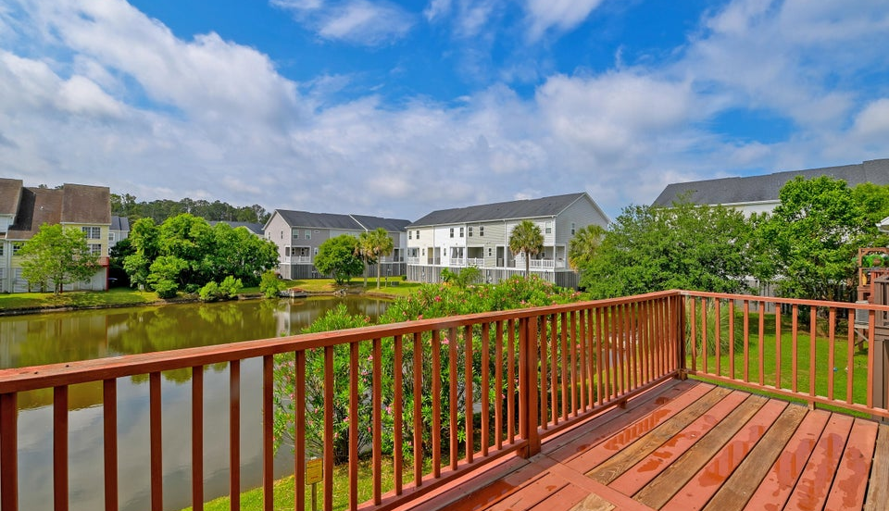

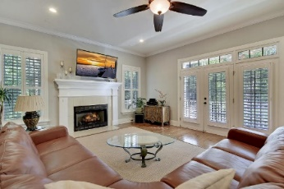
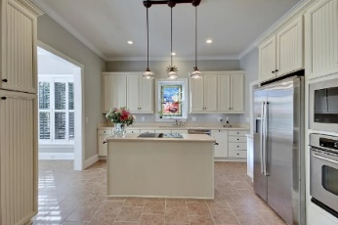

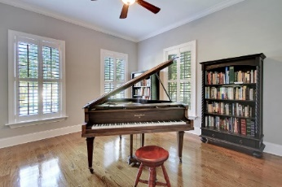
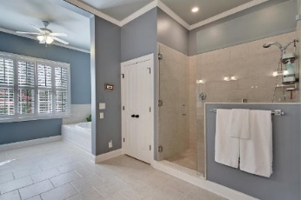
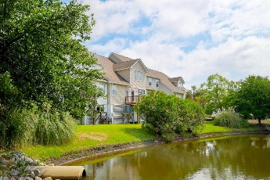
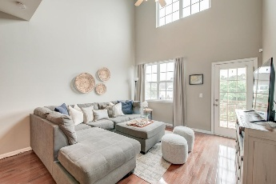
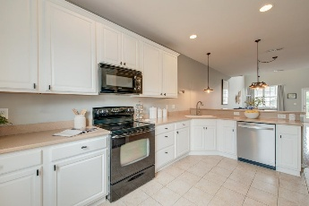
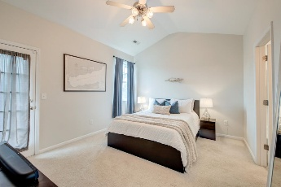
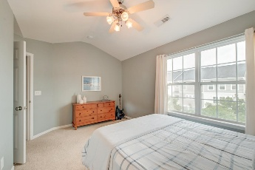
Price Reduced!
Price Improvement
Happy Hour Broker Open House Friday, Nov 22 from 3-5
$100 Gift Card Giveaway
543 Mclernon Trace Marshview Commons | Johns Island, SC 29455 | MLS# 25013893 | $356,250
***Ask about the possibility of receiving 1% reduction in interest rate and free refi.*** Situated in the Marshview Commons community on Johns Island, this townhouse offers a comfortable lifestyle with a spacious design and tranquil pond views. Upon entering the home, you're welcomed by a bright and open floor plan that creates a warm and inviting atmosphere. The kitchen is thoughtfully designed with white cabinetry, sleek appliances, generous countertop space, and a convenient pantry. Flowing seamlessly into the dining area and living room, the layout is ideal for both daily living and entertaining. The living room features a soaring volume ceiling and access to the back porch, where serene views of the pond provide a peaceful backdrop. The main level also includes a spacious
primary suite, a perfect retreat with a vaulted ceiling, access to the porch, and an ensuite bath complete with a dual-sink vanity, step-in shower, soaking tub, and walk-in closet. A conveniently located powder room rounds out the main floor.
Upstairs, a versatile loft area offers flexible space that can serve as a second living room, media room, home office, or play area. Three additional bedrooms and a full bathroom provide plenty of room for family or guests.
The home also features a tandem two-car garage located on the ground level, offering both parking and additional storage. This property is conveniently located just 3.1 miles from the West Ashley Circle, 4.7 miles from I-526, 9.3 miles from downtown Charleston, and 12.5 miles from Charleston International Airport. With its ideal location and thoughtful layout, this is a place you'll love to call home.
True Edwards true@mattoneillteam.com 843-442-6253

