Slide 1
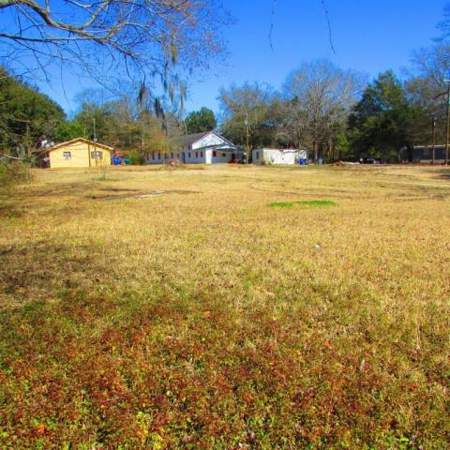
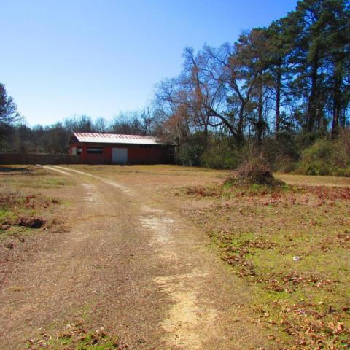
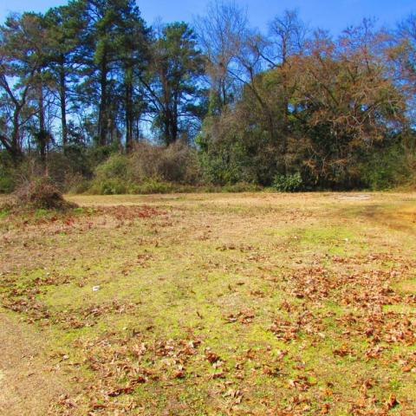
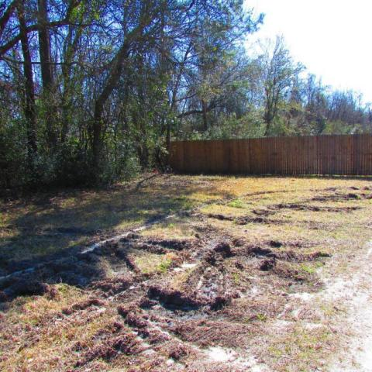
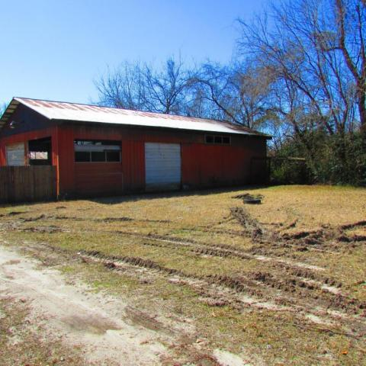
Calling All Builders & Developers!
5445 Assembly Street
Charleston Farms
North Charleston, SC 29406
MLS# 15029779
$77,597
To all builders and developers if you want to build close to Park Circle at a lower price, this is your property. One of the hottest areas around, Park Circle is the next big thing. This is a dynamic one acre of build-able ground and a half acre of no buildable ground to turn into a park or tennis court for your new development. Just a short distance from Park Circle the hottest up and coming area in Charleston County. Get in now while prices are low and it still makes sense to build. The owner is ready to sell. Drive by and take a look at what this property. Take a glimpse into the future and think about what your next development can turn into.
Henry Wolfe, Realtor
wolfeorg1@yahoo.com | Mobile (843) 609-5039
Brand Name Real Estate | 4 Carriage Lane Suite 106 | Charleston, SC 29407

