Slide 1
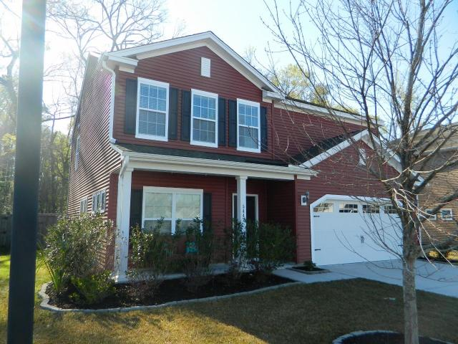
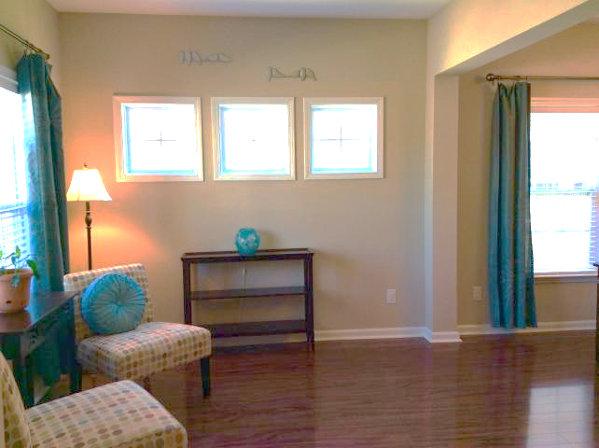
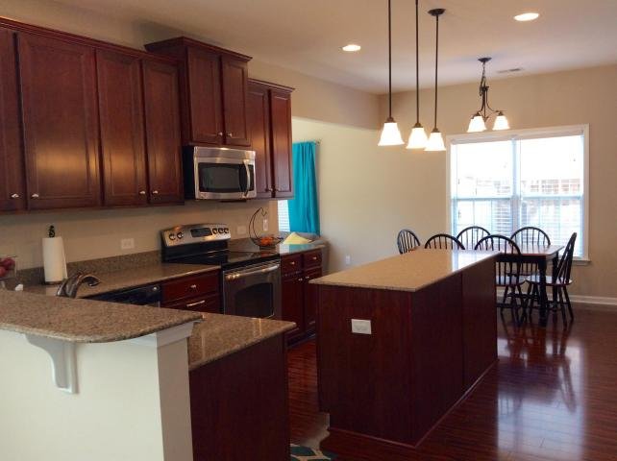
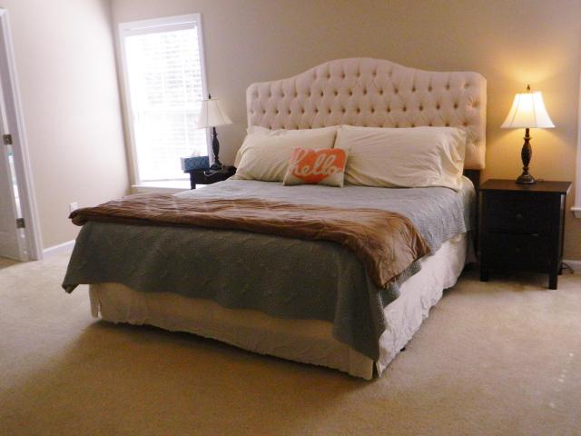
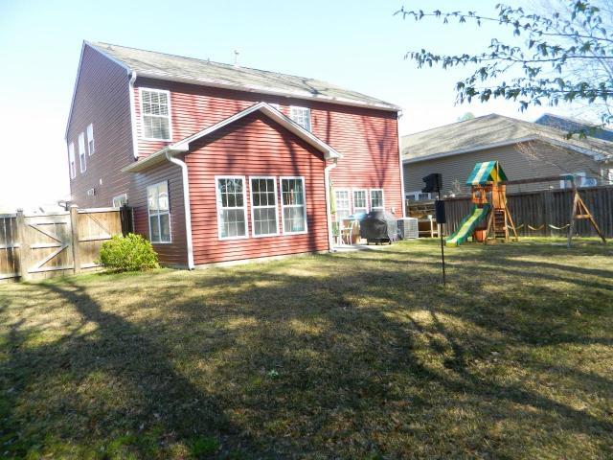
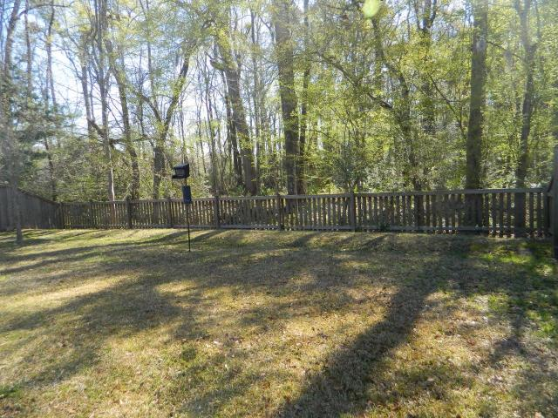
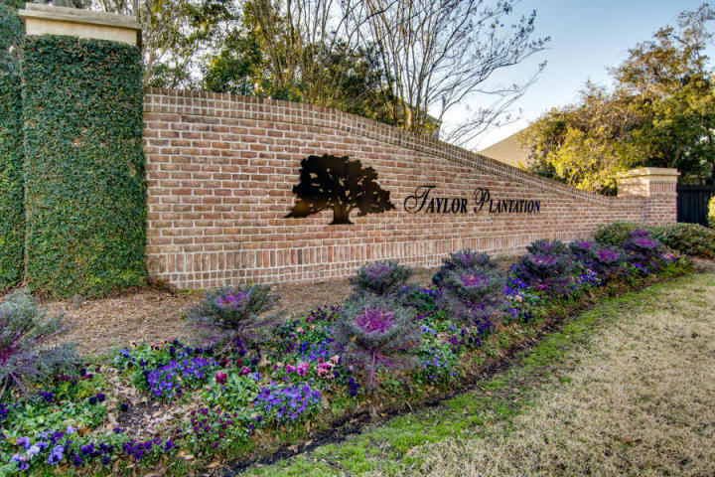

5447 Kings River Drive
Taylor Plantation ~ North Charleston
MLS# 17007604 ~ $272,500
Welcome home!
Beautiful two-story home located in Taylor Plantation on the banks of the Ashley River! Large family room is perfect for entertaining and open to the kitchen with upgraded 42 inch maple high-end cabinets, stainless steel GE Profile appliances, easily maintained Silestone countertops, a bar overlooking the family room, eat-in area and a six foot granite island. Separate dining room and study. Four bedrooms upstairs, full bath with dual vanities, laundry room, and huge master bedroom with tray ceiling, separate garden tub and shower and walk-in closet. This home has many upgrades including beautiful laminate floors throughout downstairs, bronze fixtures and raised height bathroom vanities. The sun room off the back of the home has a great view of the large private fenced yard.
Elizabeth Chase
Dargan Realty & Associates
(843) 813-5050
Elizchase@hbrtwn.com
www.elizabeth.hbrtwn.com

