Slide 1
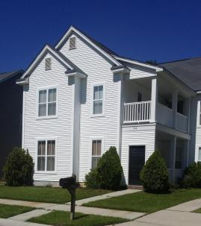
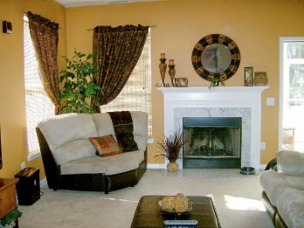
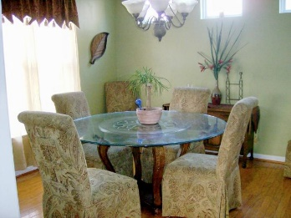
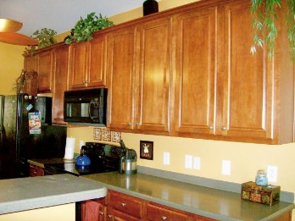
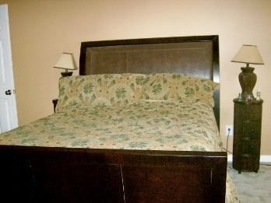
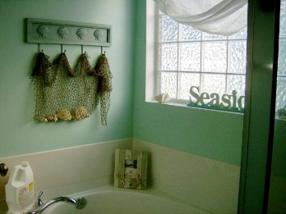
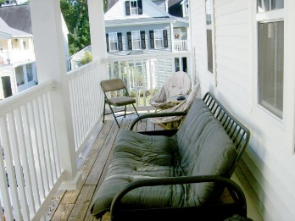
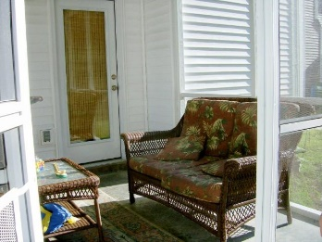
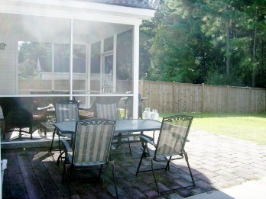
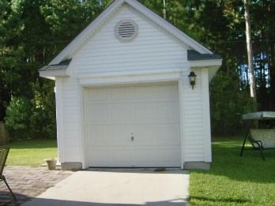
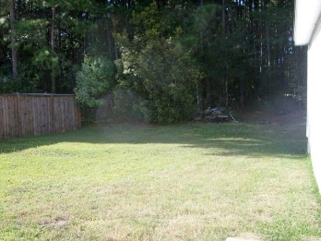


544 Delafield Dr
Weatherstone
Summerville
MLS# 15024189
$1,700
5 Bedrooms
3½ Baths
2,400 Sq Ft
Charming & Comfortable Living
Available
Nov 1st!
Need five bedrooms plus a game room, and want to be near the interstate, then you must come and see 544 Delafield Dr in the conveniently located subdivision of Weatherstone. This Charleston Single has it all - room and convenience for it is close to shopping, schools, dining, and entertainment. The subdivision boasts of a play park, swimming pool and side walks- very family friendly. The house has a fireplaced family room, A master down with a separate shower and tub and walk-in-closet. The kitchen is beautiful with corian counter tops. A separate dining rooms rounds out the first floor. Upstairs are 4 more bedrooms and a game room which opens onto a covered porch. Nice screened-in porch and patio outside makes this a very comfortable home.
Liz & Bob Simonds
843-437-9696
lizandbob@agentowned.com
AGENTOWNED REALTY CO. PREMIER GROUP, INC.
141-A N. MAIN STREET
SUMMERVILLE, SC 29483

