Slide 1
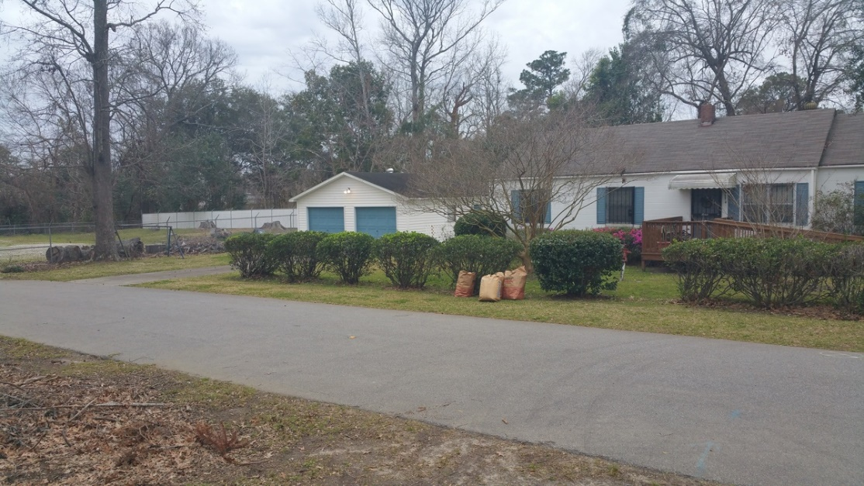
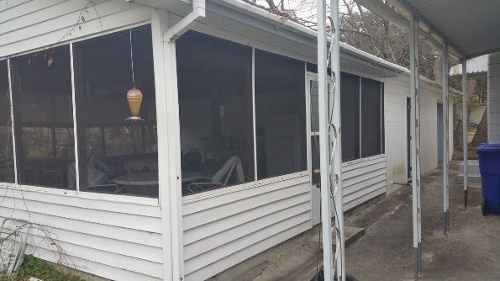
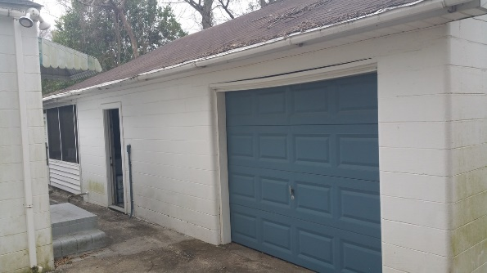
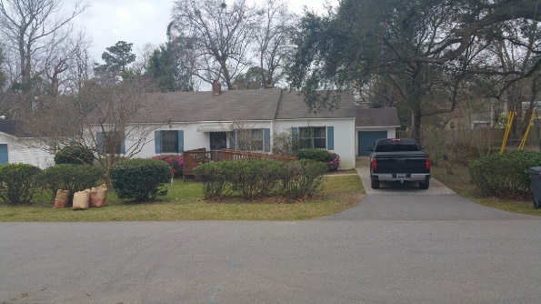

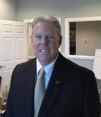
5453 Paulson St North Charleston, SC 29406 ~ Catylist ID: #30042555 ~ $240,000
Live Here… Work here
Present use is residence. Adjacent to Janitrol. Behind dentist office and to be built Waffle House & Across N Rhett is the new Bojangles. At the N Rhett I 526 intersection . With detached 2 car garage and detached 1 car with 1 car area shop space. Also shop/garage has attached outside screened deck. Because of location and buildings on site this property is easily converted to office/shop business. .3 acres according to N Charleston maps. THIS PROPERTY HAS BEEN LIVED IN BY THE SAME FAMILY SINCE 1954 AND WE WILL NEED TO SHOW THIS BY APPOINTMENT ONLY. DRIVEBYS ARE WELCOME DO NOT BOTHER THIS OWNER PLEASE.
Bob Glover, CCIM
(843) 572-0000
bobgloverccim@gmail.com
Bob Glover Real Estate LLC | 105 A Old Hwy 52 | Moncks Corner, SC 29461

