Slide 1
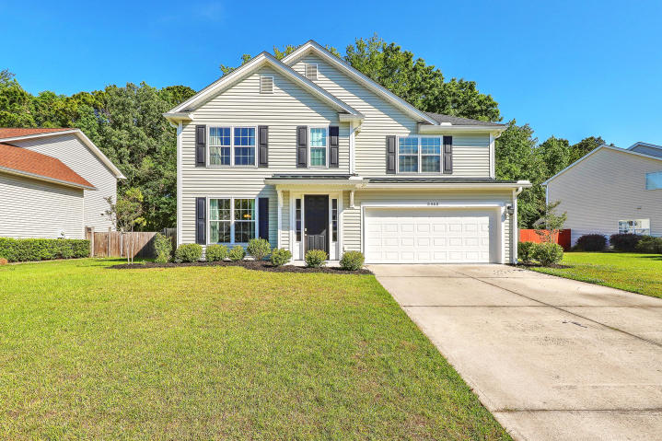
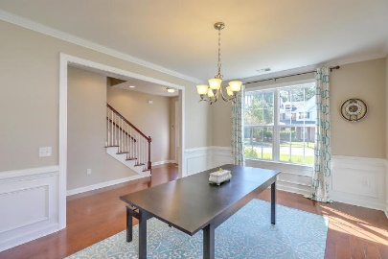
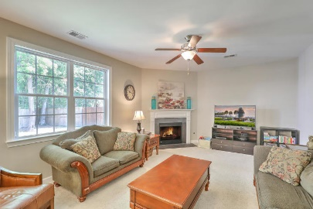
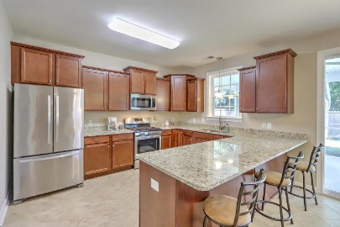
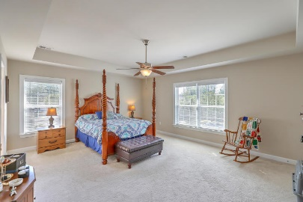
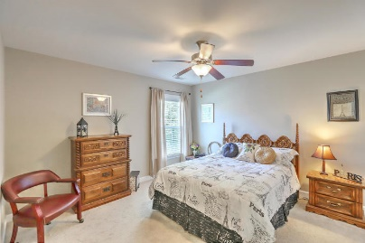
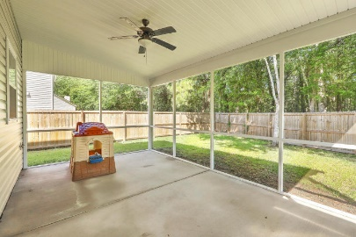
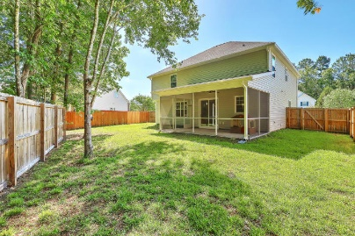


5460 Altamaha Drive
Whitehall | North Charleston, SC 29420 | MLS# 19012112 | $305,000
New Price!!
Open House Sunday 1-4
You will LOVE this TURN-KEY, ENERGY EFFICIENT CUSTOM BUILT HOME set on a WOODED LOT for extra privacy! Step inside where you will find wood floors flowing from the foyer through the formal dining room, hallway and stairway to the second floor. The separate dining room is appointed with crown and chair rail molding, giving the space a more high-end feel. The spacious eat-in kitchen is equipped with a pantry, stainless appliances, plentiful upgraded designer cabinets, an under-mount sink and granite countertops with a counter height peninsula, perfect for barstools and entertaining. Relax in the family room just off of the open dining area and enjoy your gas FP for those chillier days. Gas heat, tankless hot water heater and energy star features will save you money! There is also a guest bathroom downstairs along with a drop zone leading from the hallway out to the 2-car garage. Here you will find an extra storage closet and bead board trim. Head upstairs where you will find the master suite with a beautiful tray ceiling, 2 walk-in closets as well as room for king-sized bedroom furniture. The master bathroom has dual vanities, a garden tub and separate shower. 3 additional bedrooms, 2 with walk-in closets, a full bathroom plus a laundry room complete the second floor. Head out back and enjoy your huge screen porch overlooking a fully fenced backyard with access gates on both sides.
Beth Mandell
M 803-463-7734 | O 843-871-2121
bmandell@century21properties.com
www.bestcarolinahomedeals.com
Century 21 Properties Plus of Summerville | 118 W Richardson Ave | Summerville, SC 29483

