Slide 1
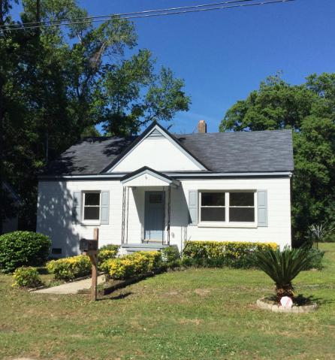
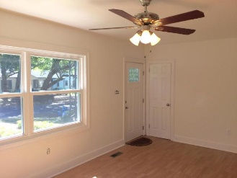
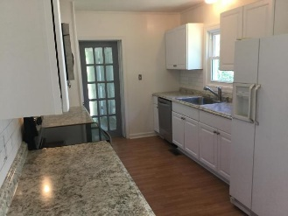
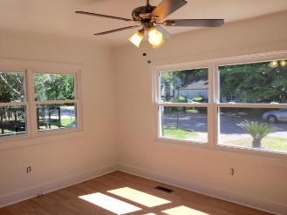
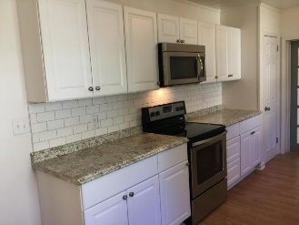
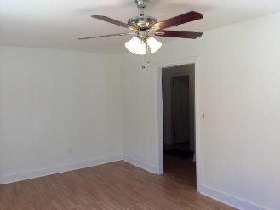
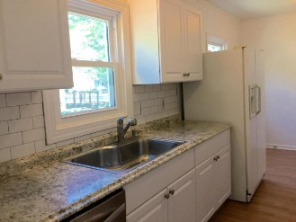
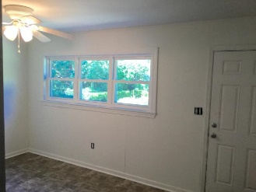
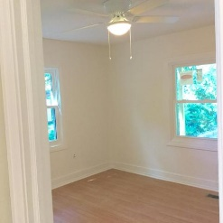
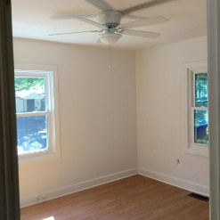
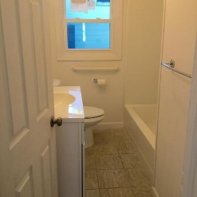
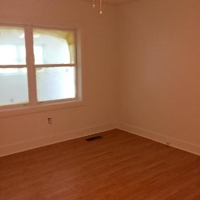
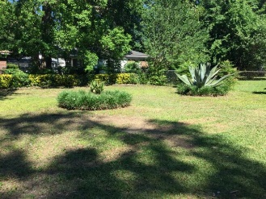

Newly Renovated & Close to Park Circle
5463 Marie Street
Charleston Farms ~ North Charleston
MLS# 16012113 ~ $134,000
Renovated 3 bed/1 bath with sunroom
1260 Square feet
Completely painted inside and out with new windows
All new electrical and plumbing
Updated kitchen and bath
New stove, dishwasher, and microwave
Fenced yard
Coastalina Realty of Charleston 916 Palm Blvd
Ste 101 Isle Of Palms, SC 29451
Dar Venable, Realtor Mobile - (843) 330-2424 dvislander@bellsouth.net coastalinarealtyofcharleston.com

