Slide 1
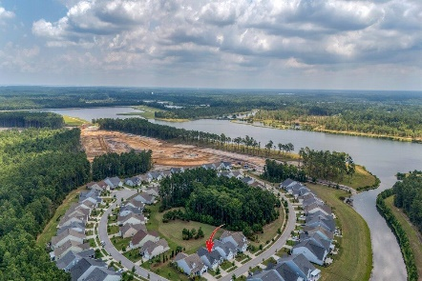
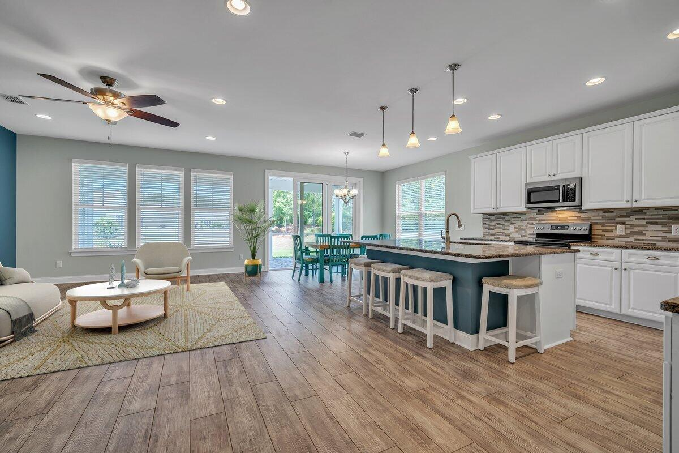
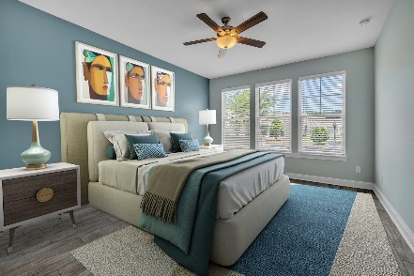
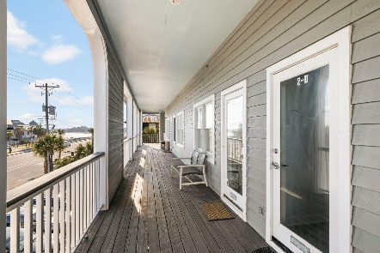
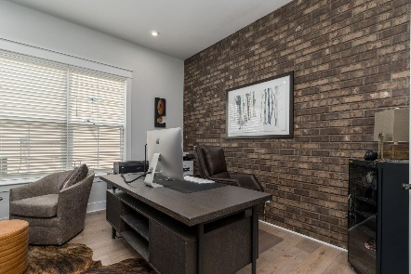
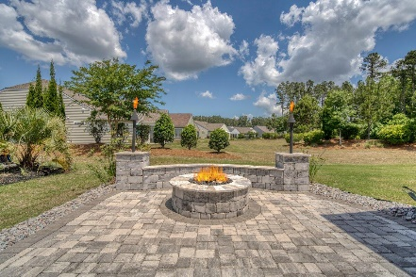
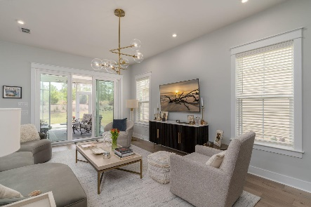
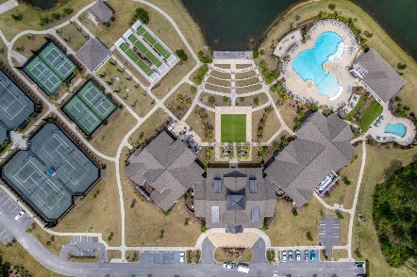

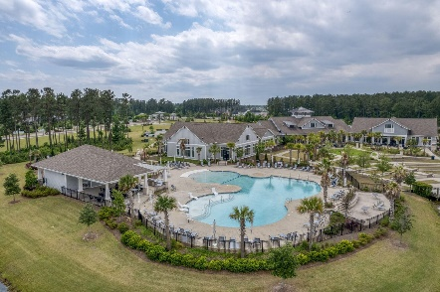
546 Four Seasons Boulevard
Cane Bay Plantation | Summerville, SC 29486 | MLS# 24016410 | $535,000
Darrell Creek Elevated Home With Elevator & Salt Pool
Back on the Market (at no fault of Seller)
Price Reduced to $535,000
Offering a 2.5% Buyer Agency Compensation
Co-hosting with
Lisa Wood from
Crown Home Mortgage
Offering $2500
Lender Credit
Welcome to 546 Four Seasons Blvd, nestled in the heart of Summerville's premier active adult community, Four Seasons. Step into luxury living with this popular 1-level Dorchester floor plan boasting 3 Bedrooms, 2.5 Baths, an unfinished FROG, and an outdoor space that feels like paradise! As you enter, notice there is no carpet, only durable and stylish LVP and tile flooring throughout. The entire interior has been re-painted, radiating a sense of modern elegance. The upgrades in this home are nothing short of exceptional, including a Custom Master Closet for organized living, state-of-the-art appliances that all convey, and thoughtful additions like high-end ceiling fans and window treatments. The FROG presents a canvas of possibilities, already painted and equipped with added shelving which could be used as a Storage Room, Craft or Sewing Space, or even ad Additional Bedroom. Even the garage has received extra attention, with custom paint, epoxy flooring for a polished finish and added storage under the steps.
The Grand Finale is the Outdoor Space, where $25,000 worth of upgrades transform the backyard into an oasis of relaxation and entertainment. An extended driveway welcomes guests with ample parking, while pavers adorn the screened porch and patio, providing a picturesque setting for al fresco dining or leisurely gatherings. Experience cozy evenings by the outdoor fireplace, conveniently fueled by a gas line, or bask in the warm glow of the tiki torches, enhancing the ambiance. Aluminum edging and upgraded landscaping add the finishing touches, elevating the curb appeal and creating a serene retreat to call home.
In Four Seasons you will never be bored, as this is the only Active Adult Community in the area that is built around a 300-acre lake with its own private boat dock! Other amazing amenities include an indoor and outdoor pool, fitness center, dog park, bocce, pickleball, tennis courts, a kayak launch and so much more! There is also a packed monthly events calendar and Full-time Lifestyle Director. Once you move to the Four Seasons, you will never want to leave! And this home is the perfect way to retire in LUXURY!
$2500 Lender Credit is available with use of Preferred Lender!
House Tour | Amenity Tour
Elissa Campbell
843-853-1433 | elissa.campbell@agentownedrealty.com
AgentOwned Realty Preferred Group | 824 Johnnie Dodds Blvd | Mt Pleasant, SC 29464

