Slide 1
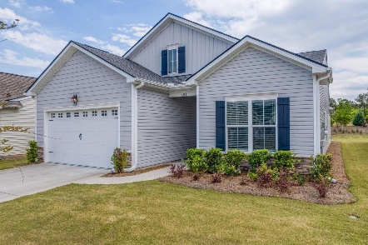

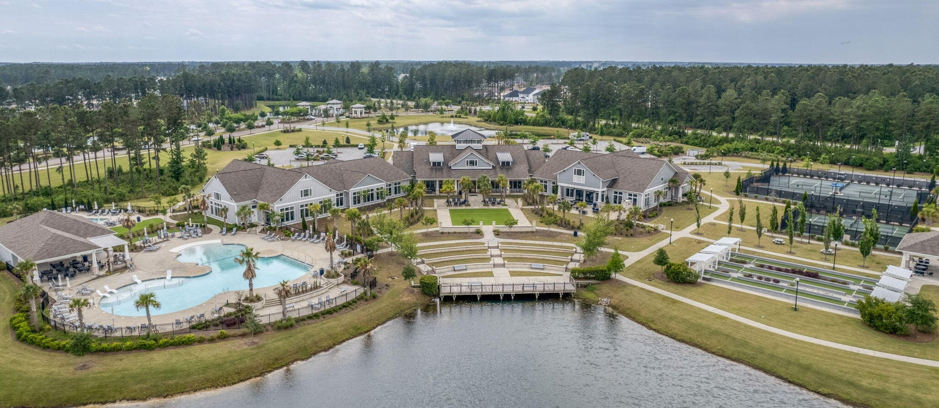
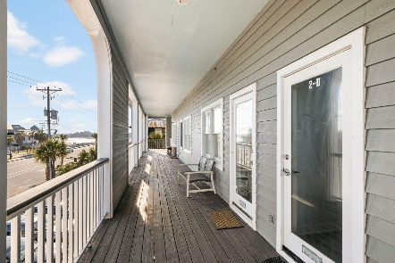
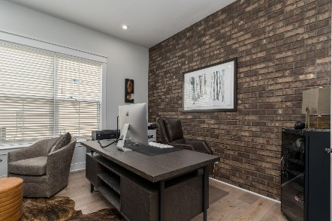
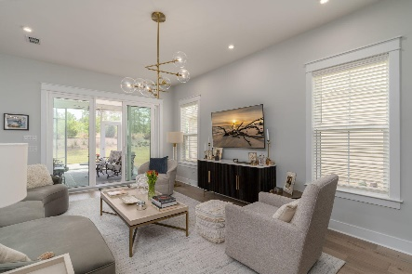
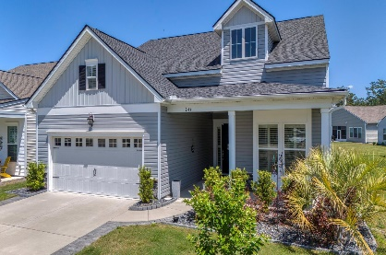
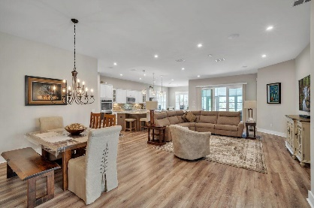
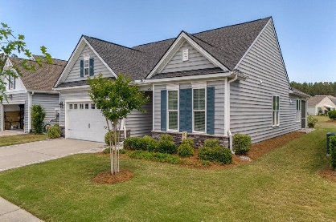
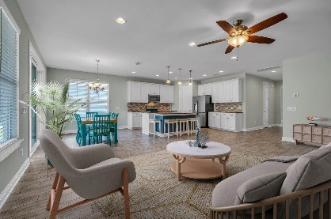
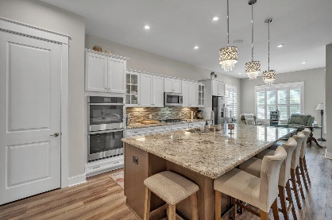
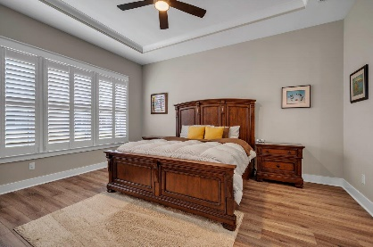
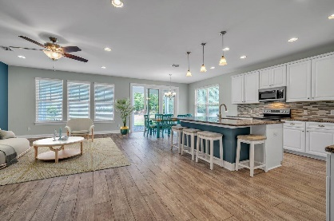
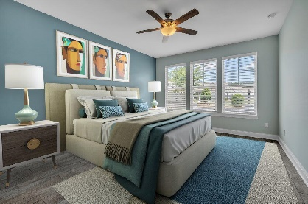
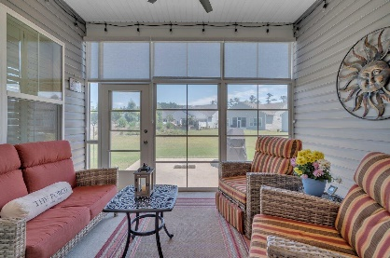
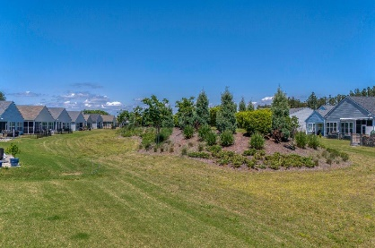
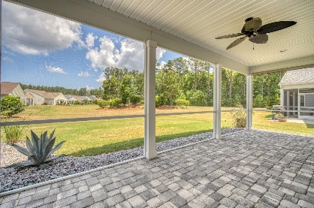
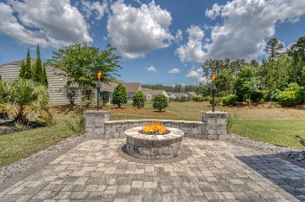
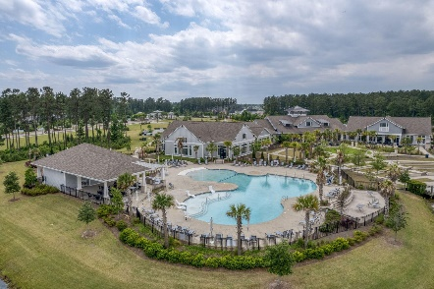
244 Tupelo Lake Drive MLS# 24010270 | $636,900 Video Walkthrough
Darrell Creek Elevated Home With Elevator & Salt Pool
2 New Listings & Open House in the Four Seasons
Exciting Giveaways at Both Houses!
Saturday, May 11th from 1-3 PM
Co-sponsored by
Offering $3000
Lender Credit
546 Four Seasons Boulevard
MLS# 24011600 | $559,000
Video Walkthrough
Take a Video Tour
Elissa Campbell
843-853-1433 | elissa.campbell@agentownedrealty.com
Lauren Parker
843-607-0971 | lauren.parker@agentownedrealty.com
AgentOwned Realty Preferred Group | 824 Johnnie Dodds Blvd | Mt Pleasant, SC 29464

