Slide 1
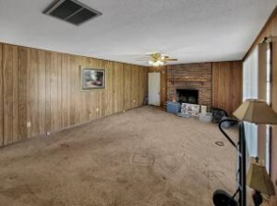
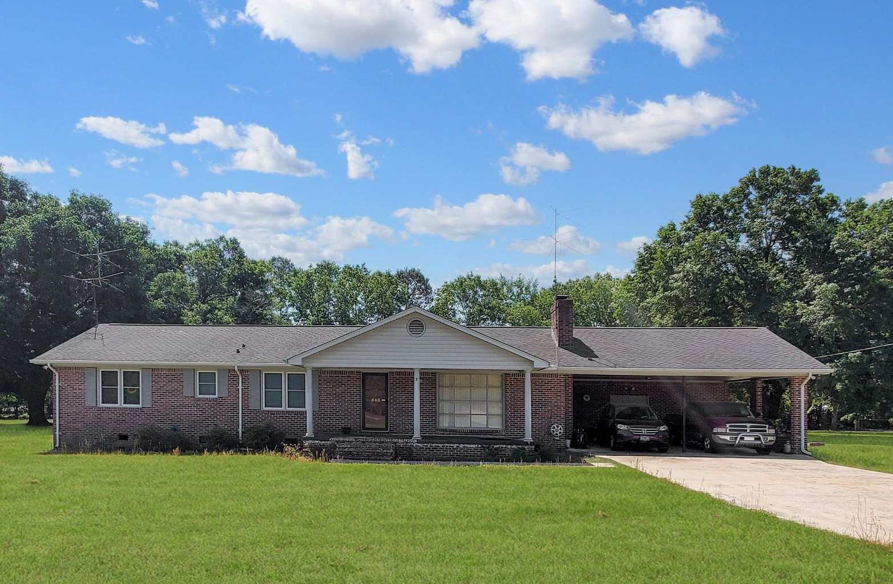
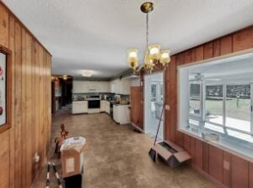
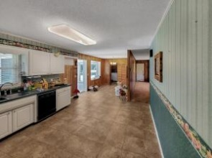
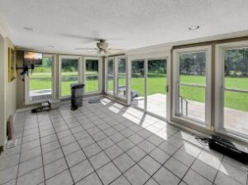
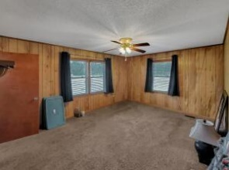
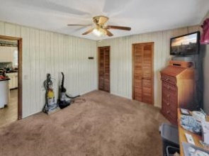
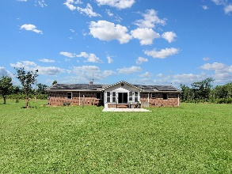
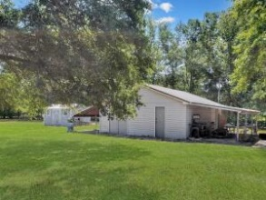


546 Hidden Acres Road Cordova, SC 29039 MLS# 22011913 | $250,000
Brick Ranch on 3 Acres in Orangeburg County
SCHEDULE YOUR SHOWING TODAY!
Adorable ranch home located only 10 minutes from Orangeburg!
This home offers 3 bedrooms, 2 full baths, over 2100 sq ft of living space, and 3 acres! Property offers a detached workshop and separate storage area. The home provides a large living room area, plenty of cabinet space in the kitchen, and a gorgeous sunroom area!
If you have been looking for a home offering the peace and tranquility of the country but still close to town, this is the one to see!
Brandon Ray
(843) 499-1928
brandon.ray@carolinaone.com
www.therightrayhome.com
Carolina One Real Estate
900 N Main St
Summerville, SC 29483

