Slide 1
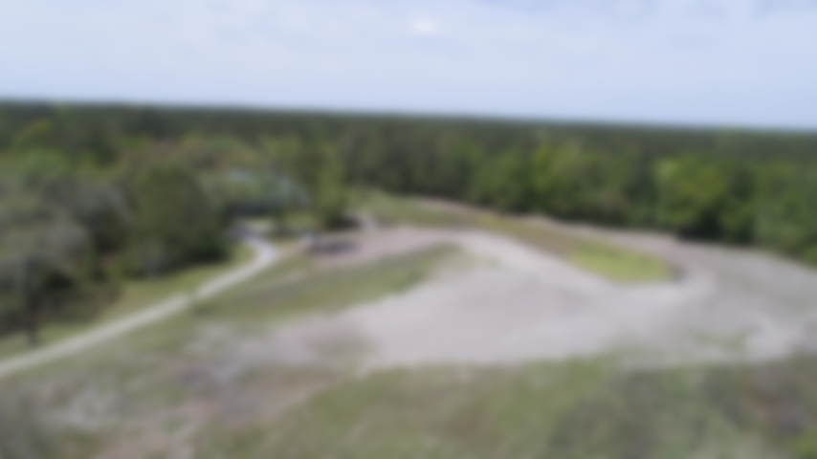
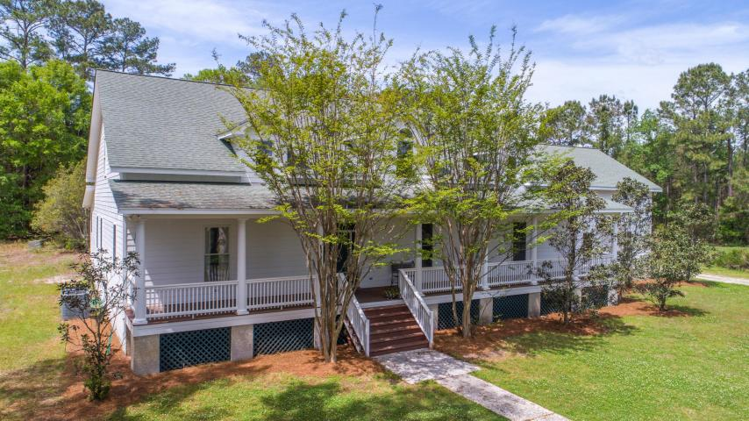
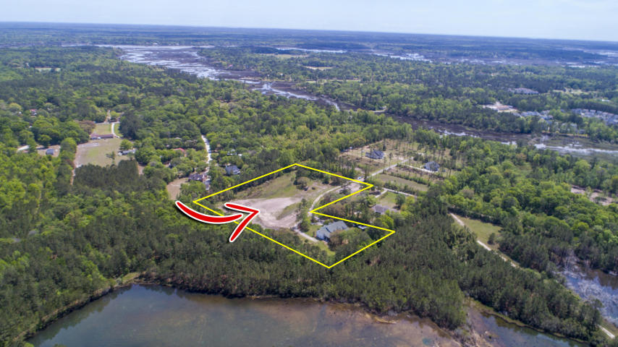
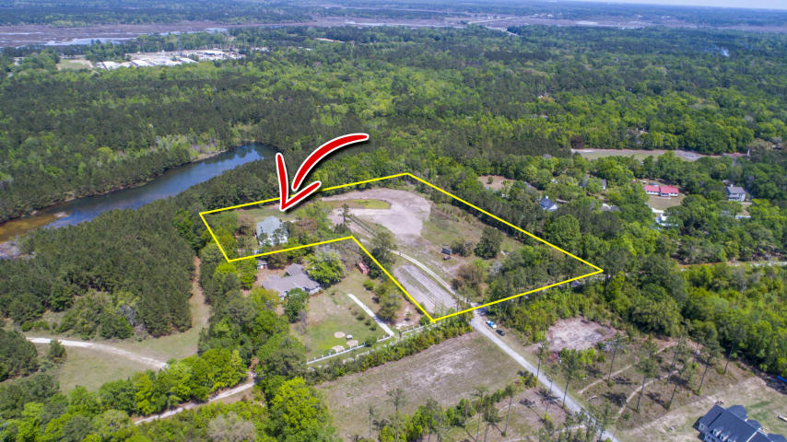

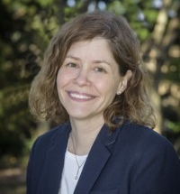
Broker Open House Wednesday, 5/11 from 10-12 $50 Gift Card Giveaway!
5470 Nashfield Road
Hollywood, SC 29449 · MLS# 17010847 · $875,000
5749 Sq Ft Home on 7.75 Acres
10 Minutes from West Ashley
2 Min from Stono Ferry Golf Course
Potential Horse Farm
5 Bedroom, 4 Bathroom
Master Suite on First Floor
Custom Kitchen
No HOA
Close to Kiawah & Edisto
Leslie Tester Krauk
(843) 901-1971
leslietester.realestate@gmail.com
The Boulevard Company, LLC | 35 Broad Street | Charleston, SC 29401

