Slide 1
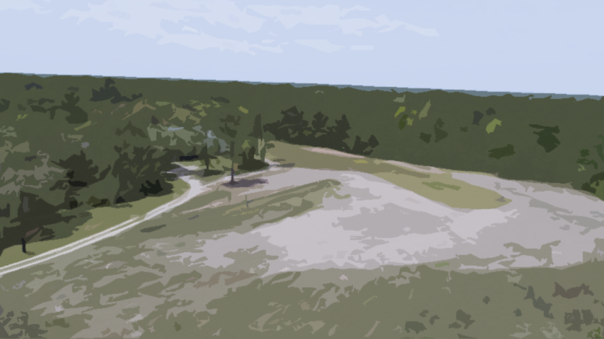
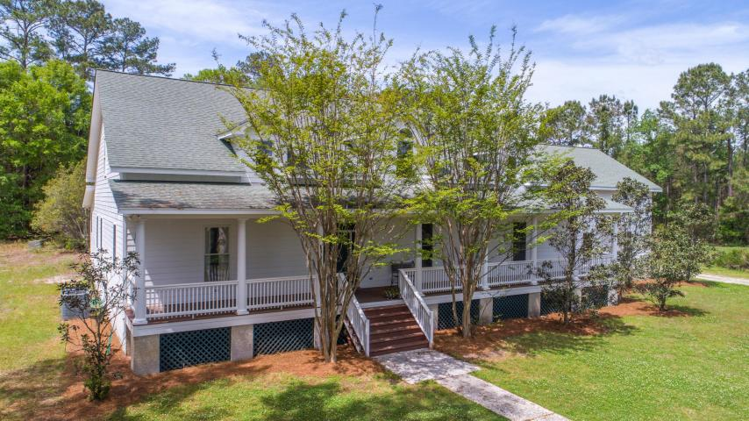
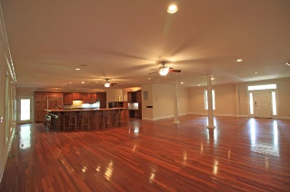
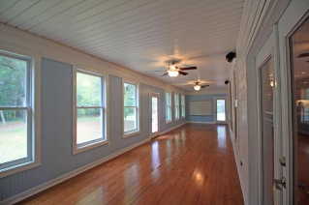
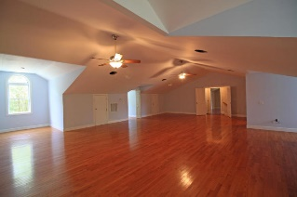
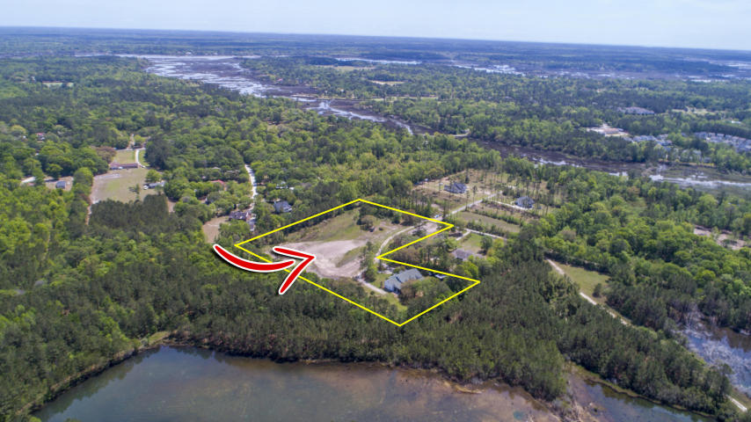
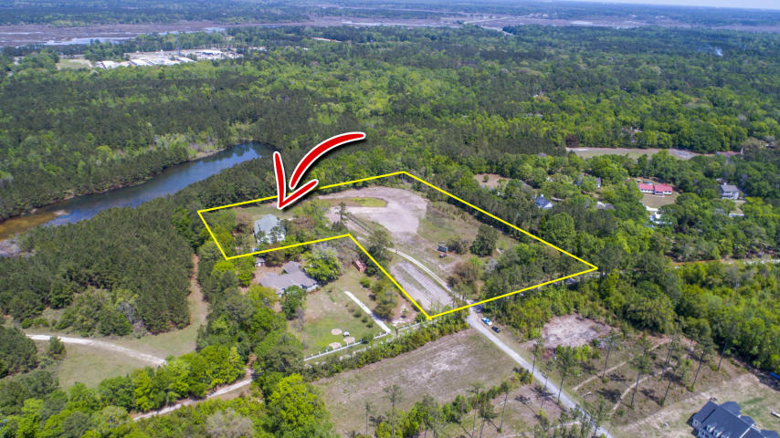

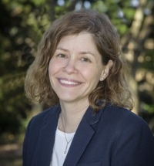
Investment Opportunity - Bed & Breakfast - 795K!
5470 Nashfield Road
Hollywood, SC 29449 · MLS# 17010847 · $795,000
3 min from Wedding Venue, Olde Wide Awake Plantation (Actress Reese Witherspoon married here)
Only B&B opportunity in the area!
5479 Sq Ft on 7.75 acres
5 bed/4 bath (6th bedroom possible)
Golf at Stono Plantation, 2 min away
10 min to 526; 25 min to Historic Charleston
Close to Kiawah & Edisto Beaches
Schedule Your Showing Today!
Leslie Tester
(843) 901-1971
leslietester.realestate@gmail.com
The Boulevard Company, LLC | 35 Broad Street | Charleston, SC 29401

