Slide 1
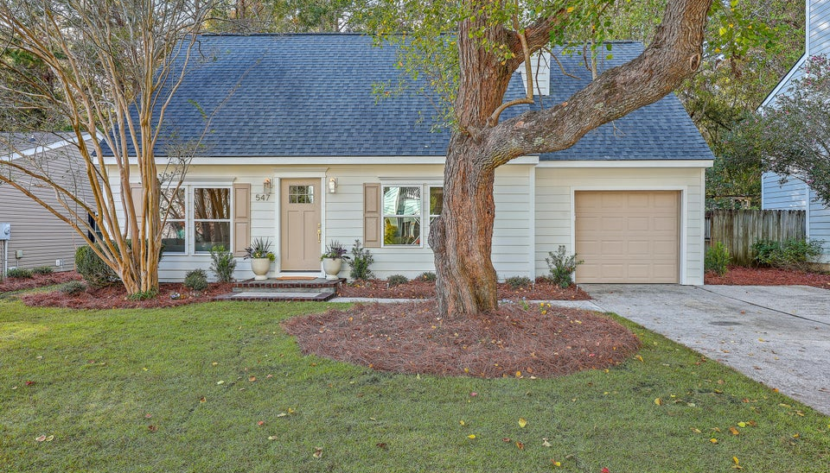
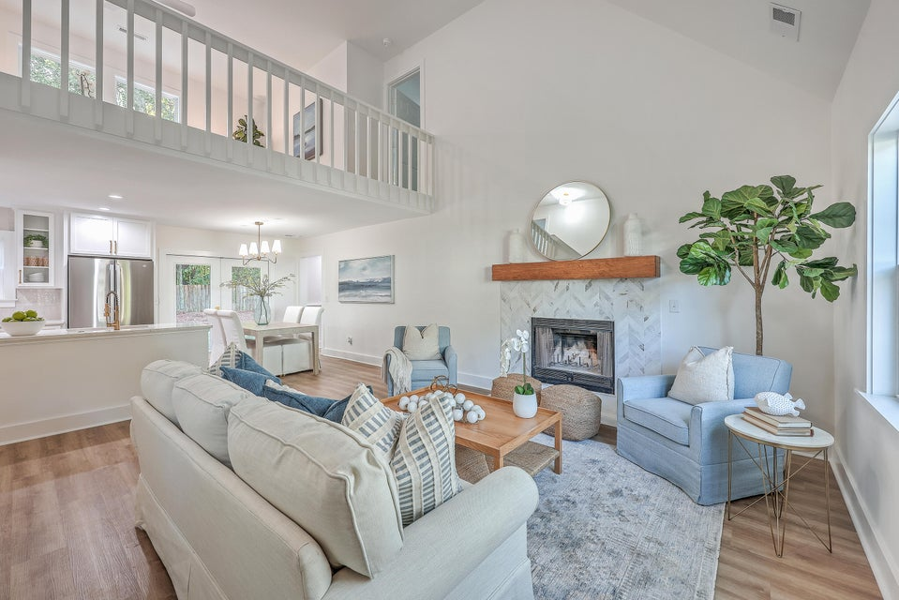
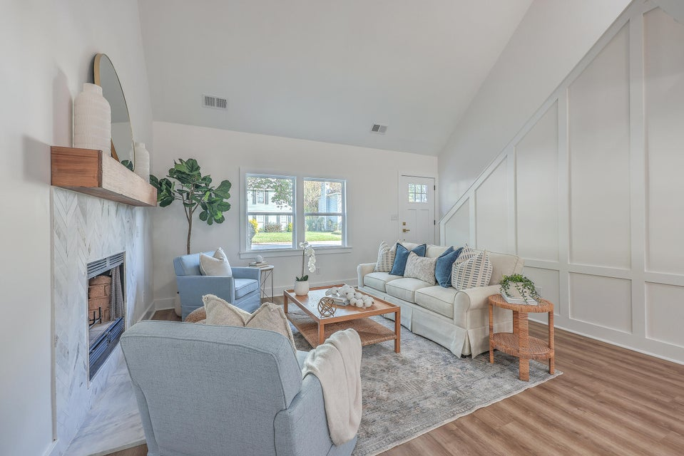
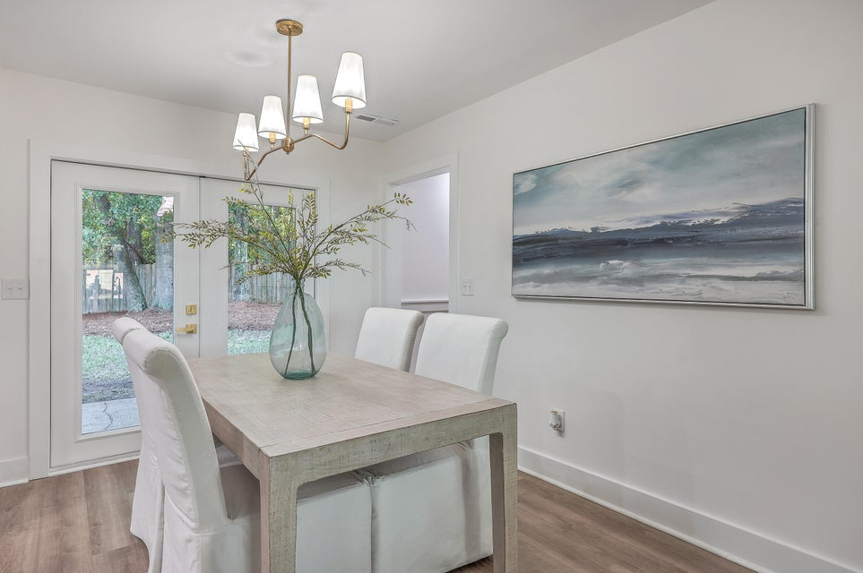
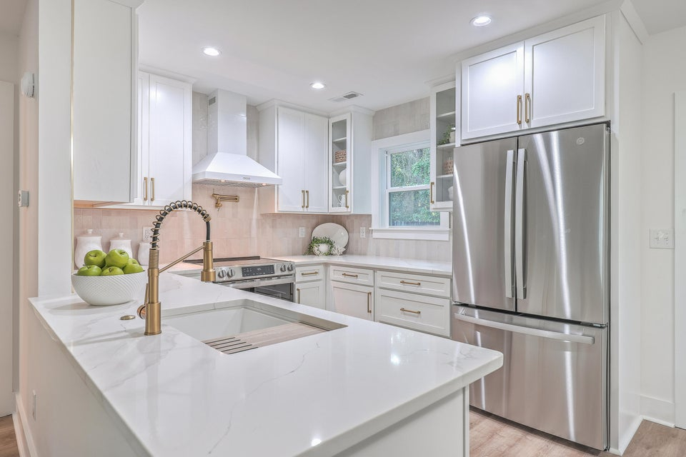
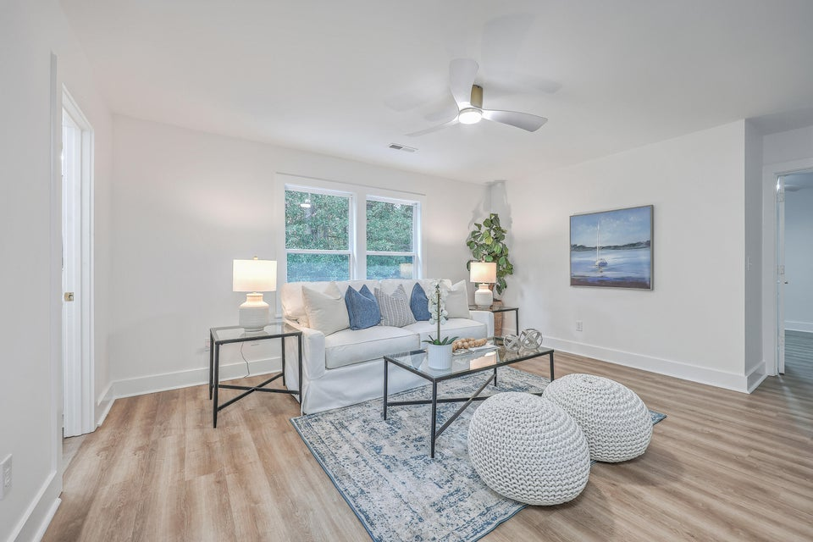
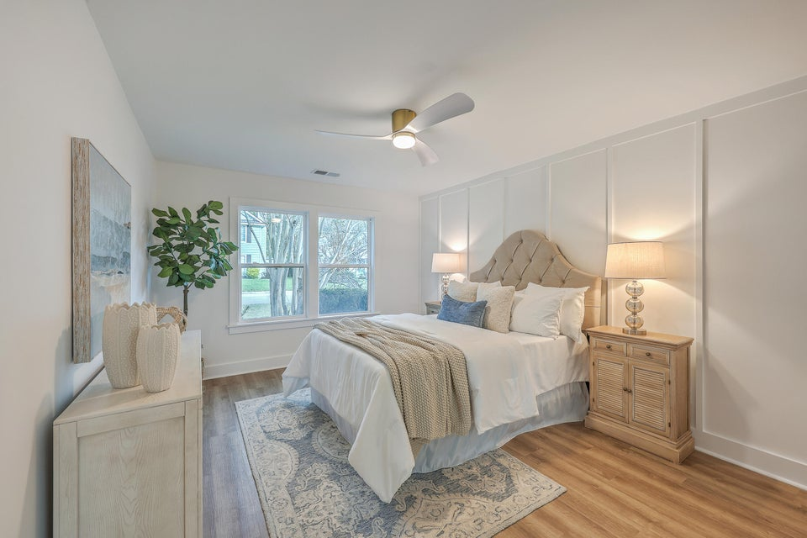
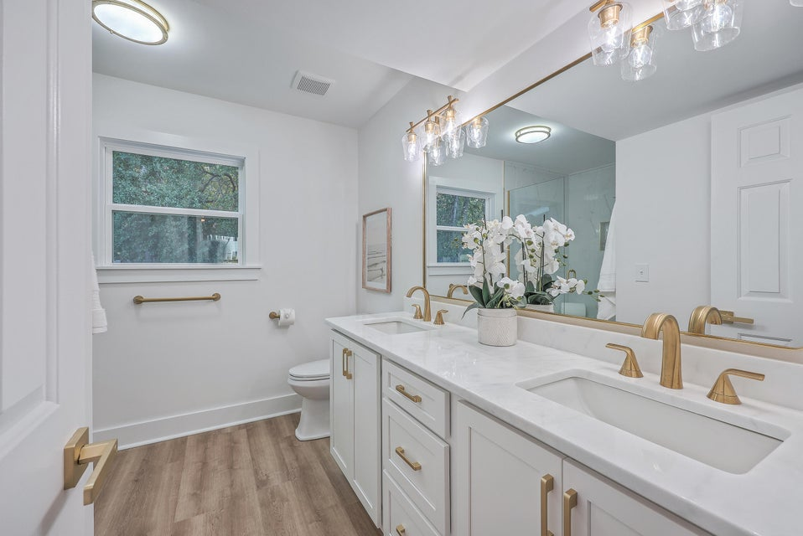
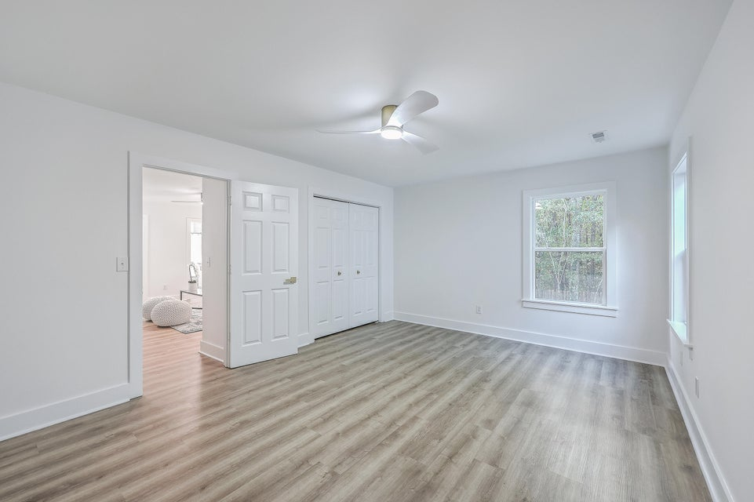
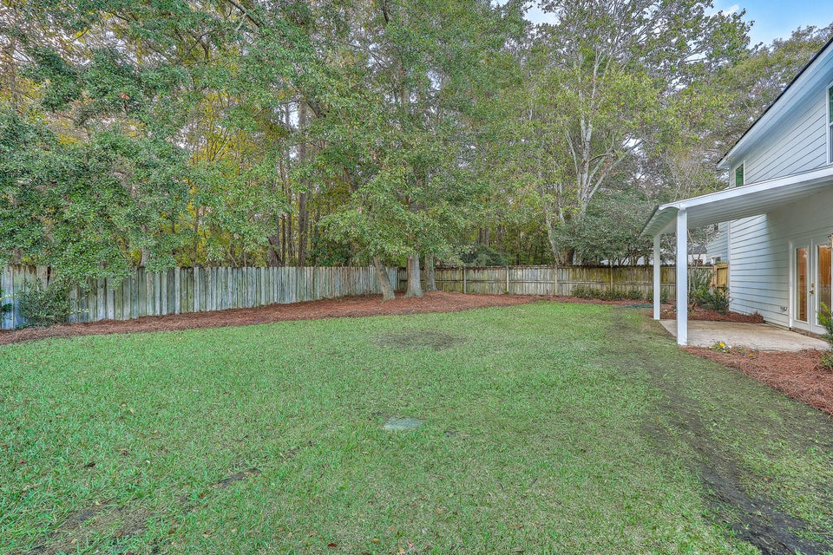
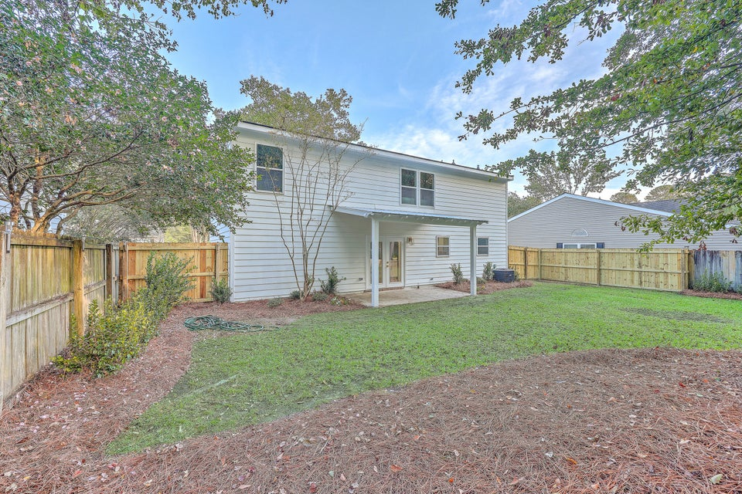
Price Reduced - Show & Sell!
547 Castle Hall Road
Longpoint | Mount Pleasant, SC 29464
MLS# 24028420 | $799,900
Beautiful renovated 3 bedroom 2 ½ bath home located in Longpoint! This home features a two story open floor plan with cathedral ceilings in living room, fireplace and new LVP flooring and paint throughout. Kitchen has new cabinets, calacata gold storm quartz countertops, smooth top stove has pot filler, new dishwasher and refrigerator. Master bedroom has custom walk in closet, master bath is incredible with large shower and frameless glass, multiple shower heads, built in bench, and dual sinks and new cabinets. Upstairs features 2 bedrooms with a bathroom that has dual sinks, gorgeous countertops, tile, and new cabinets with a large open loft/2nd living area. All bedrooms have custom closets and new ceiling fans. Laundry closet features shelving and beautiful rattan doors. Backyard is fenced and patio has large covered area for entertaining. Attached single car garage with new garage door, door opener and outside key pad. New hardieplank siding with fresh paint on the exterior. Freshly landscaped front and backyard with new sod in the front! Don't miss this opportunity to own a renovated home in Longpoint! Longpoint is just 15 minutes to Isle of Palms, 20 minutes to downtown Charleston, minutes to the areas best schools, and a short walk or bike ride to the community pool, walking trails, tennis courts and Palmetto Island County Park.
Carl Wolff
843-743-6638 | carlwlff@aol.com
Salmonsen Realty | 864 Lowcountry Blvd Ste B | Mt Pleasant, SC 29464

