Slide 1
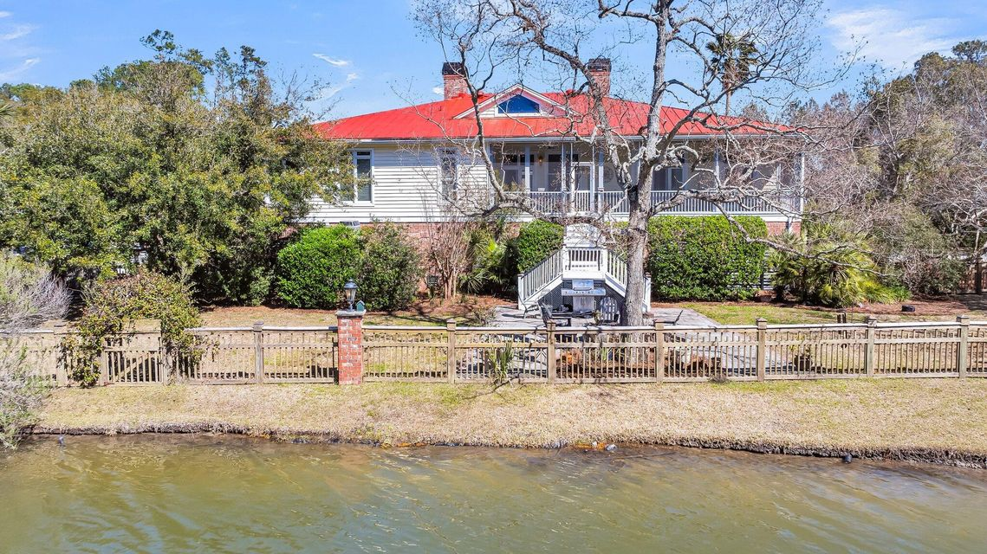
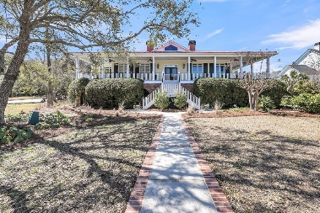
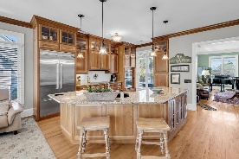
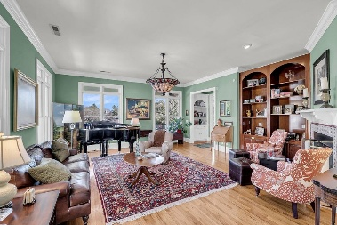
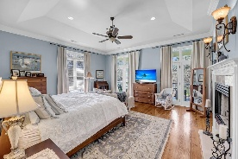
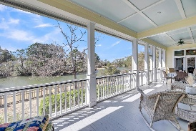
$1000 Agent Bonus Through the End of April!
547 Island Walk
Belle Hall | Mount Pleasant, SC 29464 | MLS# 25005198 | Now Offering at $1,795,000
Sean Harrington
(843) 226-9652 | sean@milerproperties.com

