Slide 1
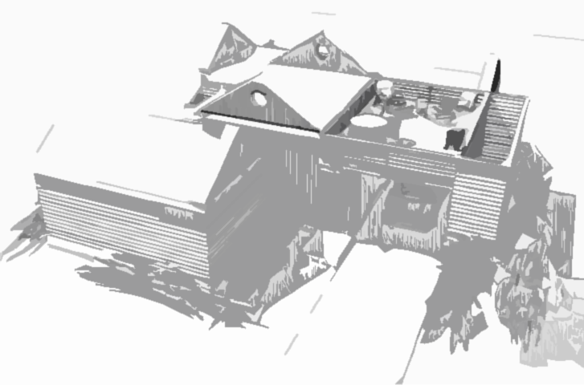
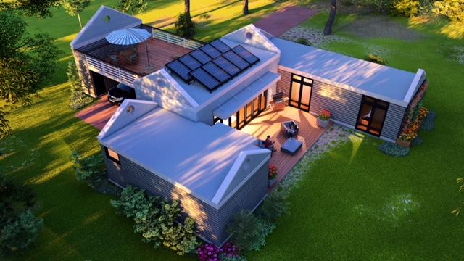
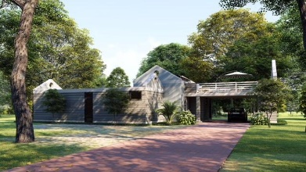
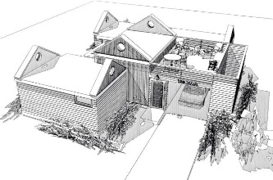
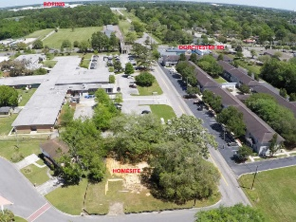
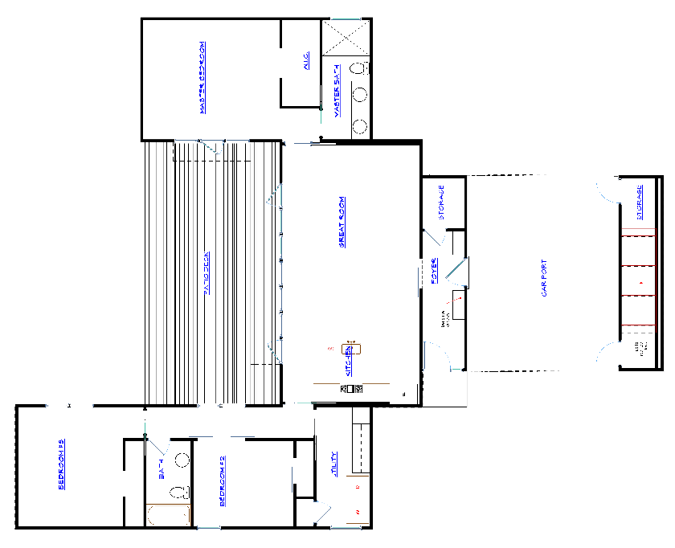
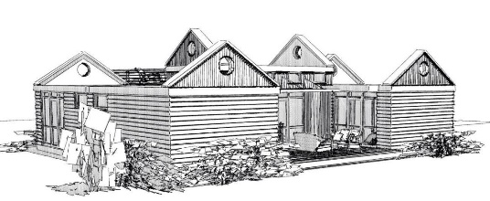
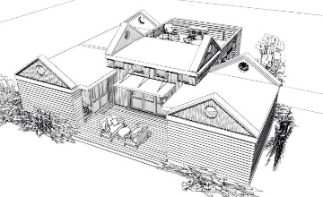



5481 Fowler Drive
North Charleston
MLS# 18014271
$299,999
3 Beds | 2 Baths
1,450 Square Feet
Di Johnson
843-270-6448
dijohnsonsc@gmail.com
CharlestonRealEstateFind.com
Contemporary Design New Construction
10 minutes to Boeing
A small, eco friendly home that lives large. Open Floor Plan, SOLAR POWERED, tankless water heater. Environmentally friendly & wind resistant STEEL FRAMING. LOW ENERGY BILLS w solar panels & spray foam insulation. This unique home features a ROOF TOP PATIO for entertaining under the dramatic canopy of Live Oak Trees. A 1,000 sq ft deck off the living room. Additional features include the LATEST IN WIFI TECHNOLOGY, thermostat, door bell, garage door. Two car garage. GroWall to grow a vertical garden. Flat roof membrane. NO HOA FEES Meet with builder to discuss design options & alternative locations. Visit Bluezerohomes.com to experience the Gro Home difference in design, construction, future expansion & low environmental impact.
AgentOwned Premiere Group | 824 Johnnie Dodds Blvd | Mt Pleasant 29464

