Slide 1
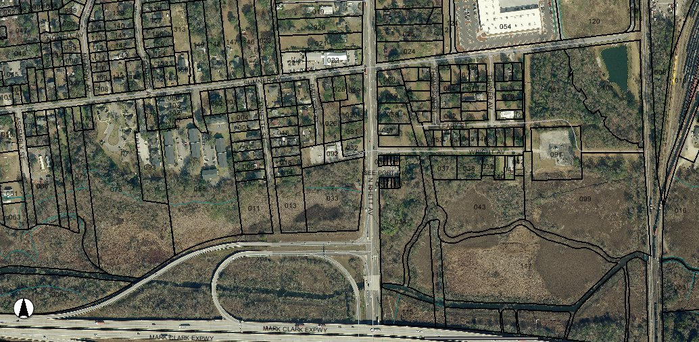
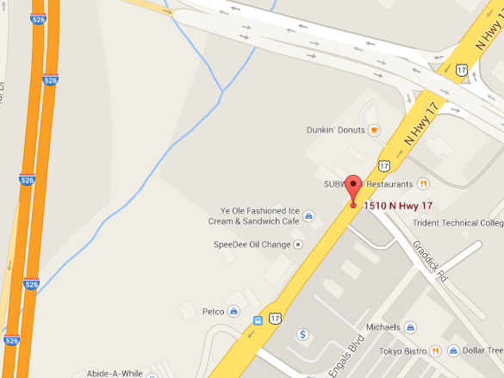
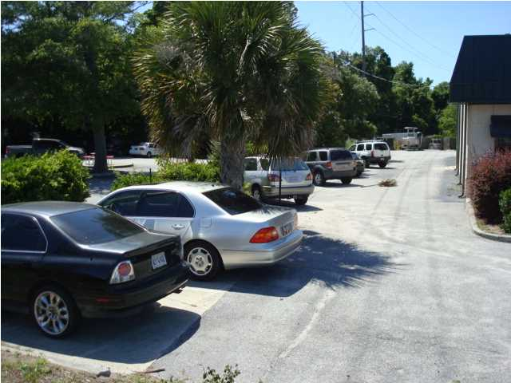
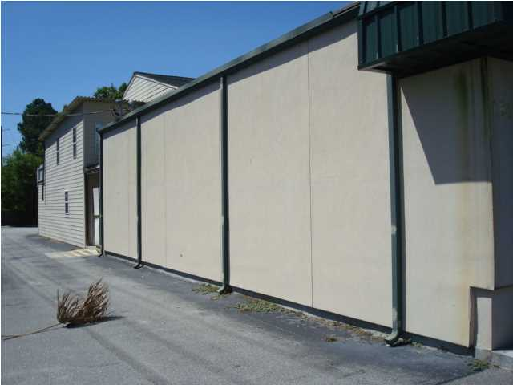
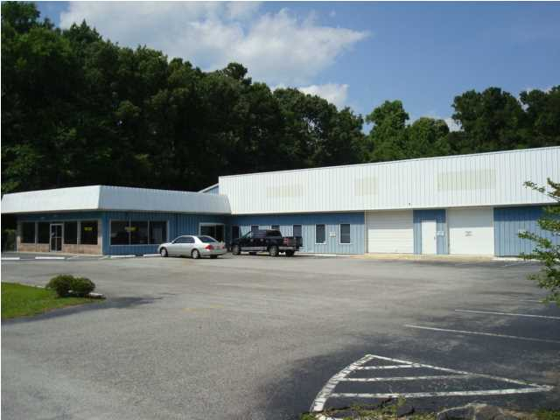
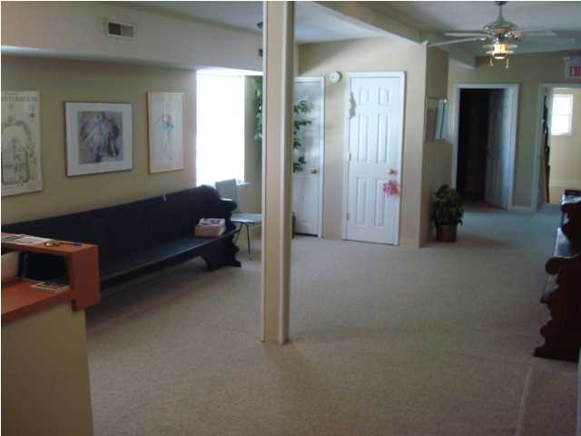
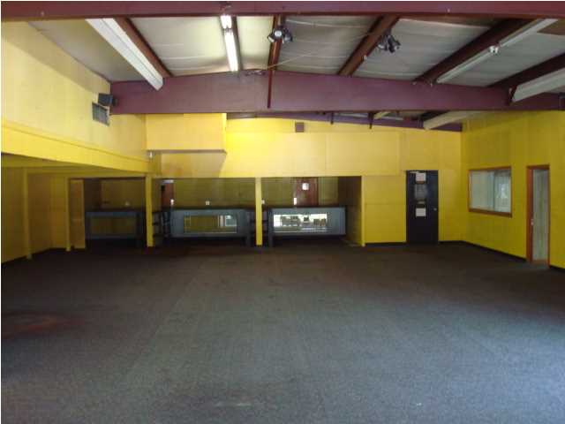

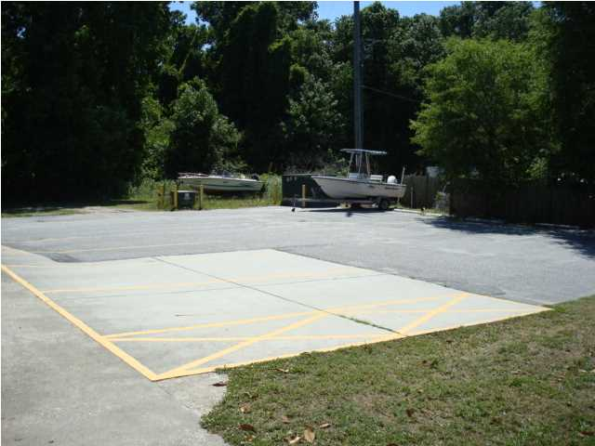
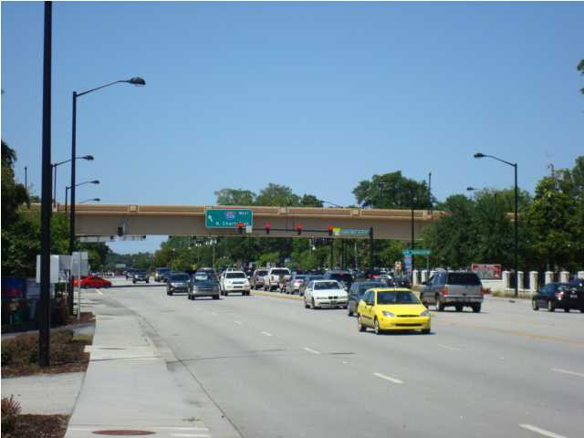
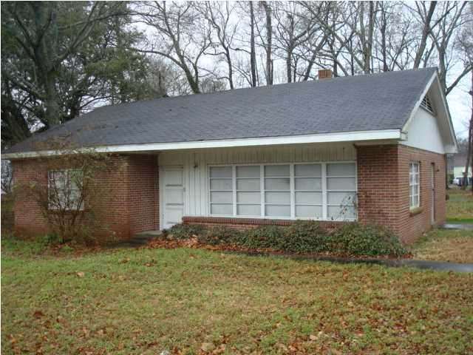
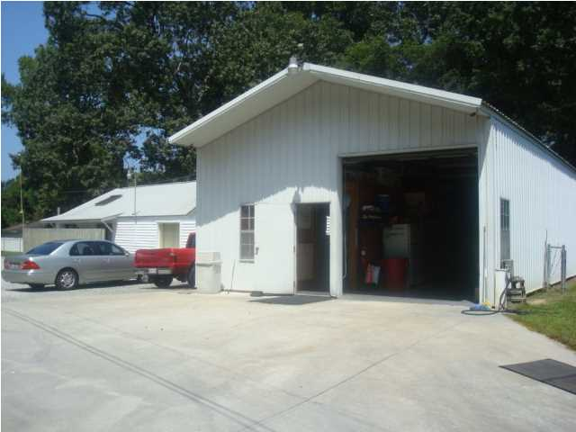
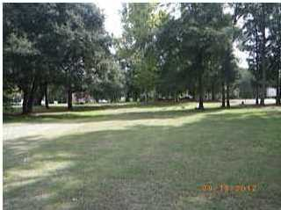
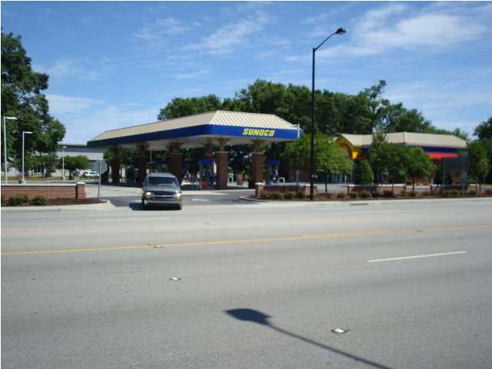
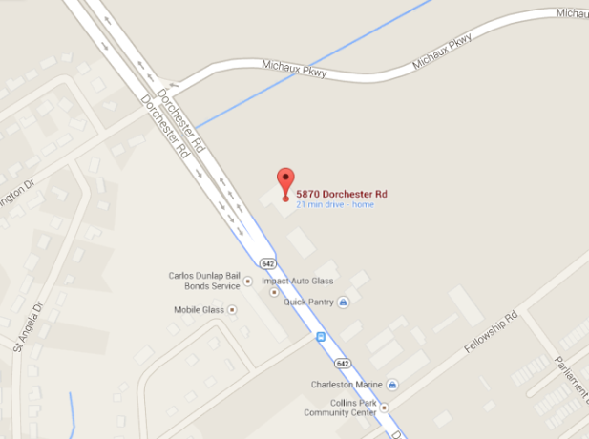
5841 N Rhett Ave, N Charleston, SC 29406
A DEVELOPER'S DREAM – 8 ADJOINING LOTS
3 Total Acres – Will Subdivide
SUMNER AVE
$1,250,000
All 8 Lots / 3 Acres
Warehouse & 2 Houses
MLS# 1406295
N RHETT AVE
Property lines as highlighted are approximate
MLS# 1414148
13,300 sq. ft.
$200,000 0.34 Acres/Commercial 1,348 sf House MLS# 1419141 | $450,000 Commercial .94acres + Warehouse & House MLS# 1406311 | $250,000 Commercial 1 Acre @ Paulson & Sumner MLS# 1406301
Sale - $895,000 | Lease - $6,000/Mo
Location...Location...Location...It doesn't get any better than this for price...Location and Size. This is a developer's dream!...Develop...Build to suit or simply hold and let the value increase. This property has a total of over 1,000 feet of road frontage on North Rhett, Sumner, and Paulson directly across from Seacoast Christian Church at the intersection of I-526 and N. Rhett. Where else can you find 3 acres at an interchange of I-526 for this price? This property can be subdivided and consists of both B-1 and B-2 zoned property price from only $250,000 per acre. (Includes 8 separate TMS#'s which totals 3 acres)... Property includes 2 separate houses and a 1900 sq. ft. warehouse…MOTIVATED SELLER!
Rick Willis
843-327-3017
rwillisteam@gmail.com
The Group, LLC

